Slide 1
CHAPTER 10
DEFUZZIFICATION

Slide 2
DEFUZZIFICATION
Defuzzification is a mapping process from a space of fuzzy control actions defined over an output universe of discourse into a space of crisp (nonfuzzy) control actions.
Defuzzification is a process of converting output fuzzy variable into a unique number.
Defuzzification process has the capability to reduce a fuzzy set into a crisp single-valued quantity or into a crisp set; to convert a fuzzy matrix into a crisp matrix; or to convert a fuzzy number into a crisp number.

Slide 3

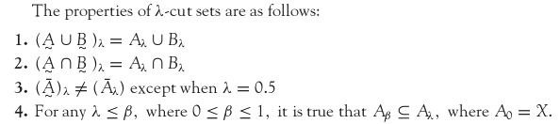
LAMBDA CUT FOR FUZZY SETS

Slide 4


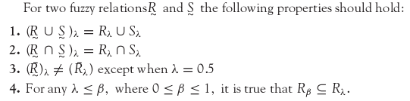
LAMBDA CUT FOR FUZZY RELATIONS

Slide 5
METHODS OF DEFUZZIFICATION
Defuzzification is the process of conversion of a fuzzy quantity into a precise quantity. Defuzzification methods include:
        Max-membership principle,
        Centroid method,
        Weighted average method,
        Mean-max membership,
        Center of sums,
        Center of largest area,
        First of maxima, last of maxima.

Slide 6
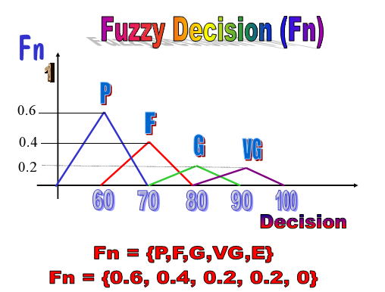
FUZZY DECISION

Slide 7
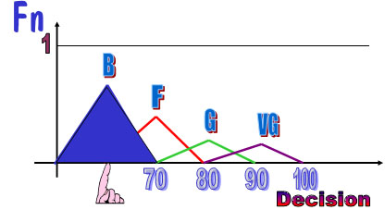
MAX MEMBERSHIP METHOD
        Fuzzy set with the largest membership value is selected.
        Fuzzy decision: Fn = {P, F. G, VG, E}
        Fn = {0.6, 0.4, 0.2, 0.2, 0}
        Final decision (FD) = Poor Student
        If two decisions have same membership max, use the average of the two.

Slide 8
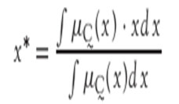
CENTROID METHOD
This method is also known as center-of-mass, center-of-area, or center-of-gravity method. It is the most commonly used defuzzification method. The defuzzified output x* is defined as
where the symbol ∫ denotes an algebraic integration.

Slide 9
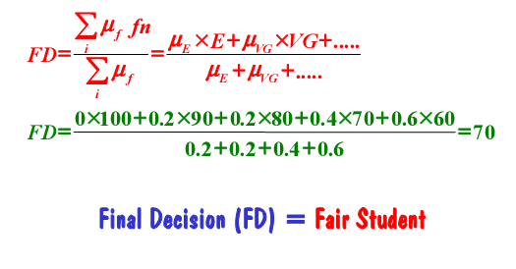
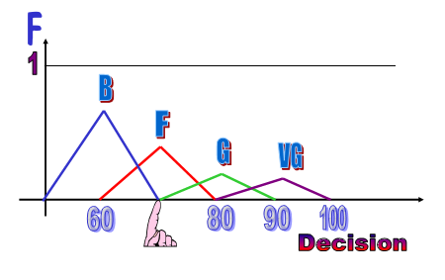
WEIGHTED AVERAGE METHOD

Slide 10
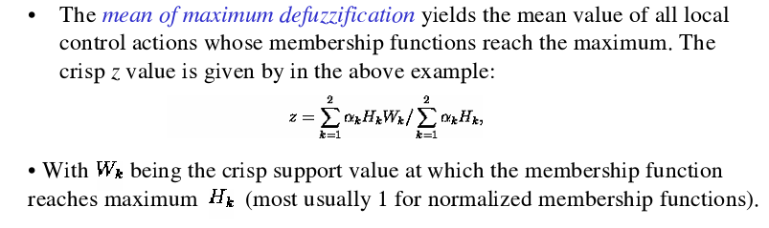
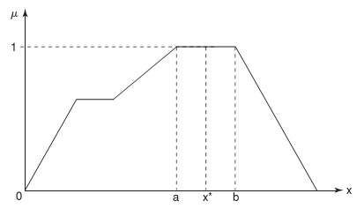

MEAN MAX MEMBERSHIP METHOD

Slide 11
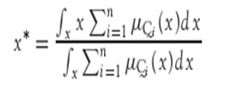
CENTER OF SUMS
This method employs the algebraic sum of the individual fuzzy subsets instead of their unions. The calculations here are very fast but the main drawback is that the intersecting areas are added twice. The defuzzified value x* is given by

Slide 12


CENTER OF LARGEST AREA
This method can be adopted when the output consists of at least two convex fuzzy subsets which are not overlapping. The output in this case is biased towards a side of one membership function. When output fuzzy set has at least two convex regions then the center-of-gravity of the convex fuzzy subregion having the largest area is used to obtain the defuzzified value x*. This value is given by
where is the convex subregion that has the largest area making up

Slide 13
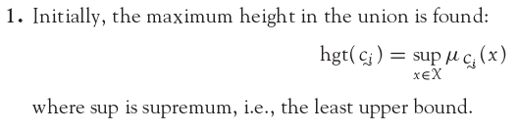
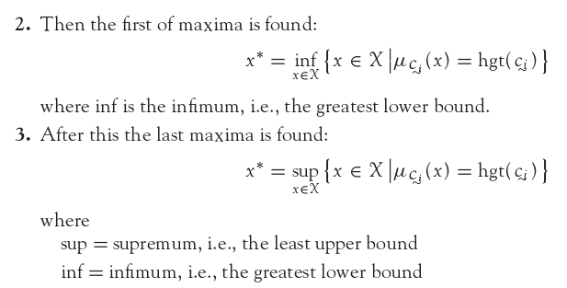
FIRST OF MAXIMA (LAST OF MAXIMA)
The steps used for obtaining crisp values are as follows:

Slide 14
SUMMARY
Defuzzification process is essential because some engineering applications need exact values for performing the operation.
Example: If speed of a motor has to be varied, we cannot instruct to raise it “slightly”, “high”, etc., using linguistic variables; rather, it should be specified as raise it by 200 rpm or so, i.e., a specific amount of raise should be mentioned.
The method of defuzzification should be assessed on the basis of the output in the context of data available.

