Slide 1
Data Analysis and Interpretation

Slide 2
Statistics in Research
The role of statistics in research is to function as a tool in designing research, analysing its data and drawing conclusions therefrom.

Slide 3
Two major areas of statistics
Descriptive statistics: concern the development of certain indices from the raw data.
Inferential statistics: concern with the process of generalisation. Also known as sampling statistics.
  Mainly concerned with two major type of problems:
    The estimation of population parameters,
    The testing of statistical hypotheses.

Slide 4
Important statistical measures
To summarise the survey/research data are:
  Measures of central tendency or statistical averages;
    Mean, Median and Mode
  Measures of dispersion;
    Variance, Standard deviation
  Measures of asymmetry (skewness);
  Measures of relationship; and
  Other measures.
    Index numbers, Time series analysis

Slide 5
Elements/Types of Analysis
Analysis means the computation of certain indices or measures along with searching for patterns of relationship that exist among the data groups.
In case of survey or experimental data, it involves estimating the values of unknown parameters of the population and testing of hypotheses for drawing inferences.

Slide 6
Categories of Analysis
Descriptive analysis and Inferential analysis
  Descriptive analysis is the study of distributions of one variable.
  Provides us the profiles of companies, work groups, persons and other subjects on any of a multiple of characteristics such as size. Composition, efficiency, preferences, etc.”
  This sort of analysis may be in respect of one variable (described as unidimensional analysis), or in respect of two variables (described as bivariate analysis) or in respect of more than two variables (described as multivariate analysis).

Slide 7
Correlation analysis
Studies the joint variation of two or more variables for determining the amount of correlation between two or more variables.
Important in most social and business researches.

Slide 8
Causal analysis
Concerned with the study of how one or more variables affect changes in another variable.
A study of functional relationships existing between two or more variables.
This analysis can be termed as regression analysis.
More important in experimental researches.

Slide 9
Multivariate Analysis
Multiple regression analysis:
  Adopted when the researcher has one dependent variable which is presumed to be a function of two or more independent variables.
  The objective of this analysis is to make a prediction about the dependent variable based on its covariance with all the concerned independent variables.

Slide 10
Contd…
Multiple discriminant analysis:
  Appropriate when the researcher has a single dependent variable that cannot be measured, but can be classified into two or more groups on the basis of some attribute.
  The objective of this analysis happens to be to predict an entity’s possibility of belonging to a particular group based on several predictor variables.

Slide 11
Contd…
Multivariate analysis of variance (or multi-ANOVA):
  An extension of two-way ANOVA, wherein the ratio of among group variance to within group variance is worked out on a set of variables.

Slide 12
Contd…
Canonical analysis:
  Used in case of both measurable and non-measurable variables for the purpose of simultaneously predicting a set of dependent variables from their joint covariance with a set of independent variables.

Slide 13
Contd…
Inferential analysis
  Concerned with the various tests of significance for testing hypotheses in order to determine with what validity data can be said to indicate some conclusion or conclusions.
  Also concerned with the estimation of population values.
  Interpretation (i.e., the task of drawing inferences and conclusions) is performed.

Slide 14
What is a Hypothesis?
A mere assumption or some supposition to be proved or disproved.
A hypothesis may be defined as
  a proposition or a set of proposition set forth as an explanation for the occurrence of some specified group of phenomena
  either asserted merely as a provisional conjecture to guide some investigation or
  accepted as highly probable in the light of established facts.

Slide 15
Contd…
A research hypothesis is a predictive statement, capable of being tested by scientific methods, that relates an independent variable to some dependent variable.

Slide 16
Example
“Students who receive counselling will show a greater increase in creativity than students not receiving counselling” Or
“the automobile A is performing as well as automobile B.”

Slide 17
Characteristics of hypothesis
Should be clear and precise.
Should be capable of being tested.
Should state relationship between variables.
Should be limited in scope and must be specific.
Should be stated in simple terms so that the same is easily understandable by all concerned.
Should be consistent with most known facts.
Should be amenable to testing within a reasonable time.
Must explain the facts that gave rise to the need for explanation.

Slide 18
Basic Concepts Concerning Testing Of Hypotheses
Null hypothesis (H0) and alternative hypothesis (Ha)
If we are to compare method A with method B about its superiority, if we proceed on the assumption that both methods are equally good, then this assumption is termed as the null hypothesis.
As against this, we may think that the method A is superior or the method B is inferior, we are then stating what is termed as alternative hypothesis.

Slide 19
Contd…
Test the hypothesis that the population mean (µ) is equal to the hypothesised mean (µH0) = 100. H0 : µ= µH0 = 100.
If our sample results do not support this null hypothesis, we should conclude that something else is true.
      Rejecting the null hypothesis is known as alternative hypothesis.
The set of alternatives to the null hypothesis is referred to as the alternative hypothesis.

Slide 20
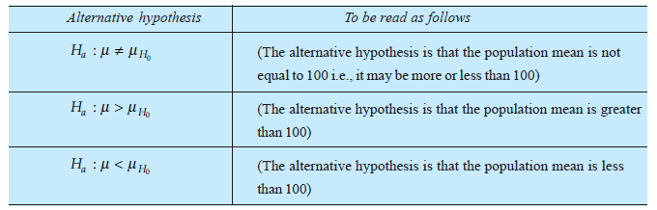
Contd…
  If we accept H0, then we are rejecting Ha and if we reject H0, then we are accepting Ha.
Possible alternative hypotheses are;
The null hypothesis and the alternative hypothesis are chosen before the sample is drawn

Slide 21
Considerations in the choice of null hypothesis
Alternative hypothesis is usually the one which one wishes to prove and the null hypothesis is the one which one wishes to disprove.
If the rejection of a certain hypothesis when it is actually true involves great risk, it is taken as null hypothesis because then the probability of rejecting it when it is true is α (the level of significance) which is chosen very small.
Null hypothesis should always be specific hypothesis i.e., it should not state about or approximately a certain value.
In hypothesis testing we proceed on the basis of null hypothesis, keeping the alternative hypothesis in view.

Slide 22
Contd…
The level of significance
  Significance level is the maximum value of the probability of rejecting H₀ when it is true
  Usually determined in advance before testing the hypothesis.
Decision rule or test of hypothesis
  Given a hypothesis H₀ and an alternative hypothesis H_{a}.
  Rule according to which we accept H₀ (i.e., reject H_{a}) or reject H₀ (i.e., accept H_{a}) is decision rule.
Type I and Type II errors
  Reject H₀ when H₀ is true – Type I
  Accept H₀ when H₀ is not true – Type II

Slide 23
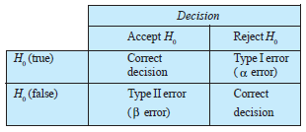
Contd…
Type I error means rejection of hypothesis which should have been accepted
Type II error means accepting the hypothesis which should have been rejected.
Type I error is denoted by α (alpha) known as α error, also called the level of significance of test;
Type II error is denoted by ᵦ (beta) known as ᵦ error.

Slide 24
Contd…
Two-tailed and One-tailed tests
  A two-tailed test rejects the null hypothesis if, say, the sample mean is significantly higher or lower than the hypothesised value of the mean of the population.
  Such a test is appropriate when the null hypothesis is some specified value and the alternative hypothesis is a value not equal to the specified value of the null hypothesis.
  Symbolically, the two tailed test is appropriate when we have H0: µ=µH0 and Ha:µ≠µH0 0which may mean µ>µH0 or µ<µH0
  Thus, in a two-tailed test, there are two rejection regions*, one on each tail of the curve

Slide 25
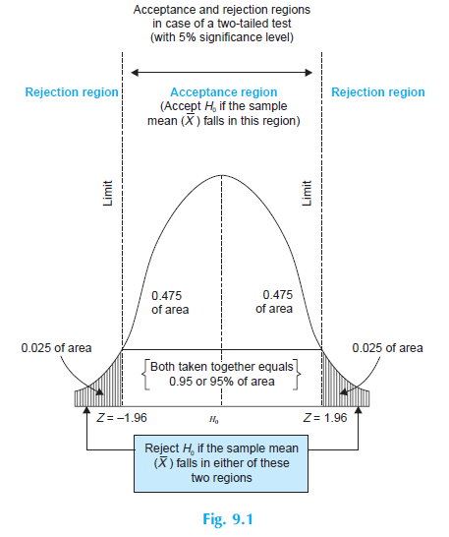

Slide 26
Contd…
If the significance level is 5 per cent and the two-tailed test is to be applied, the probability of the rejection area will be 0.05 (equally splitted on both tails of the curve as 0.025) and that of the acceptance region will be 0.95 as shown in the above curve.
If we take µ = 100 and if our sample mean deviates significantly from 100 in either direction, then we shall reject the null hypothesis;
But if the sample mean does not deviate significantly from µ , in that case we shall accept the null hypothesis.

Slide 27
Contd…
A one-tailed test would be used when we are to test, say, whether the population mean is either lower than or higher than some hypothesised value.
If H0: µ=µH0 and Ha:µ<µH0 then a left-tailed test is used.

Slide 28
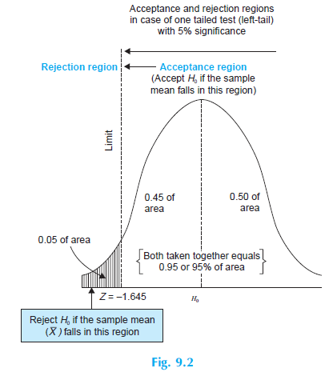

Slide 29
Contd…
If our µ = 100 and if our sample mean deviates significantly from100 in the lower direction, we shall reject H0, otherwise we shall accept H0 at a certain level of significance.
If the significance level in the given case is kept at 5%, then the rejection region will be equal to 0.05 of area in the left tail as has been shown in the above curve.

Slide 30
Contd…
If H0: µ=µH0 and Ha:µ>µH0 then a right-tailed test is used.
We then do one tailed test (right tail) and the rejection region will be on the right tail of the curve

Slide 31
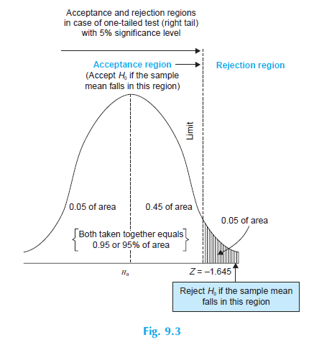

Slide 32
Contd…
If our µ = 100 and if our sample mean deviates significantly from 100 in the upward direction, we shall reject H0, otherwise we shall accept the same.
If in the given case the significance level is kept at 5%, then the rejection region will be equal to 0.05 of area in the right-tail as has been shown in the above curve.

Slide 33
Procedure for Hypothesis testing
The main question is:
  Whether to accept the null hypothesis or not to accept the null hypothesis?
The various steps involved in hypothesis testing are:

Slide 34
i) Making a formal statement:
  The step consists in making a formal statement of the null hypothesis (H₀) and also of the alternative hypothesis (H_{a}).
  Example:
  Mr. Mohan of the Civil Engineering Department wants to test the load bearing capacity of an old bridge which must be more than 10 tons, in that case he can state his hypotheses as under:
  Null hypothesis H₀ 0 : µ = 10 tons
  Alternative Hypothesis H_{a} a: µ > 10 tons

Slide 35
(ii) Selecting a significance level:
The hypotheses are tested on a pre-determined level of significance.
In practice, either 5% level or 1% level is adopted for the purpose.
The factors that affect the level of significance are:
  (a)the magnitude of the difference between sample means;
  (b) the size of the samples;
  (c)the variability of measurements within samples; and
  (d)whether the hypothesis is directional or non-directional

Slide 36
(iii) Deciding the distribution to use:
The next step in hypothesis testing is to determine the appropriate sampling distribution.
The choice generally remains between normal distribution and the t-distribution.

Slide 37
(iv) Selecting a random sample and computing an appropriate value:
Another step is to select a random sample(s) and compute an appropriate value from the sample data concerning the test statistic utilizing the relevant distribution.

Slide 38
(v) Calculation of the probability:
Then calculate the probability that the sample result would diverge as widely as it has from expectations, if the null hypothesis were in fact true.

Slide 39
(vi) Comparing the probability:
Another step consists in comparing the probability thus calculated with the specified value for α , the significance level.
If the calculated probability is equal to or smaller than the α value in case of one-tailed (and α/2 in case of two-tailed test), then reject the null hypothesis, but if the calculated probability is greater, then accept the null hypothesis.

Slide 40
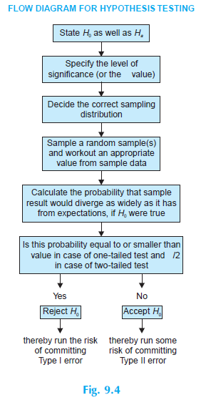

Slide 41
Tests of hypotheses
(a)Parametric tests or standard tests of hypotheses; and
  Parametric tests usually assume certain properties of the parent population from which we draw samples.
  Parametric tests require measurement equivalent to at least an interval scale.
(b)Non-parametric tests or distribution-free test of hypotheses.
  Non-parametric tests do not depend on any assumption about the parameters of the parent population.
  Besides, most non-parametric tests assume only nominal or ordinal data

Slide 42
Important parametric tests
    z-test, t-test, χ²-test and F-test
    In all these tests the source of data is considered to be normally distributed.

Slide 43
Z-test
Based on the normal probability distribution.
It is used for judging the significance of several statistical measures, particularly the mean.
The relevant test statistic, z, is worked out and compared with its probable value at a specified level of significance for judging the significance of the measure concerned.
This test is used even when binomial distribution or t-distribution is applicable on the presumption that such a distribution tends to approximate normal distribution as ‘n’ becomes larger.

Slide 44
Uses..
Comparing the mean of a sample to some hypothesised mean for the population in case of large sample, or when population variance is known.
Judging the significance of difference between means of two independent samples in case of large samples, or when population variance is known.
Comparing the sample proportion to a theoretical value of population proportion.
Judging the difference in proportions of two independent samples when n happens to be large.
Judging the significance of median, mode, coefficient of correlation and several other measures.

Slide 45
t-test
Based on t-distribution
It is considered as an appropriate test for judging the significance of a sample mean .
Also for judging the significance of difference between the means of two samples in case of small sample(s) when population variance is not known.
The relevant test statistic, t, is calculated from the sample data and then compared with its probable value based on t-distribution at a specified level of significance for concerning degrees of freedom for accepting or rejecting the null hypothesis.

Slide 46
χ2 – test
Based on chi-square distribution
It is a parametric test used for comparing a sample variance to a theoretical population variance.

Slide 47
F-test
Based on F-distribution and is used to compare the variance of the two-independent samples.
This test is also used in the context of analysis of variance (ANOVA) for judging the significance of more than two sample means at one and the same time.
It is also used for judging the significance of multiple correlation coefficients.
  Test statistic, F, is calculated and compared with its probable value for accepting or rejecting the null hypothesis.

Slide 48

Hypothesis testing of Means
Population normal, population infinite, sample size may be large or small but variance of the population is known, Ha may be one-sided or two-sided:
Test statistic

Slide 49
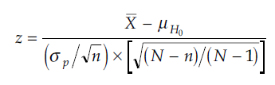
Contd…
Population normal, population finite, sample size may be large or small but variance of the population is known, H_{a} may be one-sided or two-sided:
Test statistic
      (using finite population multiplier)

Slide 50
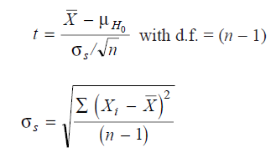
Contd…
Population normal, population infinite, sample size small and variance of the population unknown, H_{a} may be one-sided or two-sided:
Test statistic

Slide 51


Contd…
Population normal, population finite, sample size small and variance of the population unknown, and H_{a} may be one-sided or two-sided:
Test statistic
Where

Slide 52


Contd…
Population may not be normal but sample size is large, variance of the population may be known or unknown, and Ha may be one-sided or two-sided:
Test statistic
OR
(This applies in case of finite population when variance is not known, we use σs in place of σp in this formula)
(This applies in case of infinite population when variance of the population is known but when variance is not known, we use σ_{s} in place of σ_{p} in this formula.)

Slide 53
Hypothesis Testing for Differences Between Means
The null hypothesis for testing of difference between means is generally stated as
  H0 : µ1 = µ2 ,
    where µ1 is population mean of one population and µ2 is population mean of the second population, assuming both the populations to be normal populations.
Alternative hypothesis may be of not equal to or less than or greater than type.

Slide 54
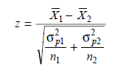

Contd…
Population variances are known or the samples happen to be large samples:
Test Statistic
  In case σp1 and σp2 are not known, use σs1 and σs2 respectively

Slide 55




Contd…
Samples happen to be large but presumed to have been drawn from the same population whose variance is known:
  The test statistic
  In case σp is not known, use

Slide 56
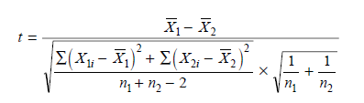

Contd…
Samples happen to be small samples and population variances not known but assumed to be equal:
  The test statistic
  where d.f.= n1+n2-2
  OR

Slide 57
Hypothesis Testing For Comparing Two Related Samples
Paired t-test is a way to test for comparing two related samples,
  Involving small values of n
  does not require the variances of the two populations to be equal,
  the assumption that the two populations are normal
For a paired t-test, it is necessary that the observations in the two samples be collected in the form of matched pairs
Appropriate in a before-and-after-treatment study.

Slide 58

Applying the test…
First work out the difference score for each matched pair,
Then find out the average of such differences D, along with the sample variance of the difference score.
If the values from the two matched samples are denoted as X_{i} and Y_{i} and the differences by D_{i} (D_{i} = X_{i} – Y_{i}),
The mean of the differences:

Slide 59


Contd…
The variance of the differences
Assuming the said differences to be normally distributed and independent; the test statistic
n = Number of matched pairs
D = Mean of differences
σ_{diff} . = Standard deviation of differences

Slide 60
Hypothesis Testing of Proportions
In case of qualitative phenomena, we have data on the basis of presence or absence of an attribute(s).
Sampling distribution may take the form of binomial probability distribution.
  Mean=n.p
  Standard Deviation = √(n.p.q)
    where
    p = the probability of success,
    q =the probability of failure such that p + q = 1
    n= the size of the sample.

Slide 61

Contd…
Mean Proportion of Success = (n.p)/n=p
Standard deviation of the proportion of successes

Slide 62


Contd…
When n is large, binomial distribution tends to become normal distribution
  Test Statistic

Slide 63
Hypothesis Testing for Difference Between Proportions
If two samples are drawn from different populations, one may be interested in knowing whether the difference between the proportion of successes is significant or not.
Start with the hypothesis that the difference between the proportion of success in sample one (p₁^) and the proportion of success in sample two (p₂^) is due to fluctuations of random sampling.
The null hypothesis is

Slide 64
Contd…
The test statistic

Slide 65
Contd…
Then, we construct the rejection region(s) depending upon the H_{a} for a given level of significance and on its basis we judge the significance of the sample result for accepting or rejecting H₀.

Slide 66
Testing the difference between proportion based on the sample and the proportion given for the whole population:
Work out the standard error of difference between proportion of persons possessing an attribute in a sample and the proportion given for the population as

Slide 67
Contd…
Standard error of difference between sample proportion and population proportion or

Slide 68
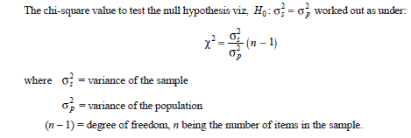
Hypothesis Testing for Comparing a Variance to some Hypothesised Population Variance
The test used for comparing a sample variance to some theoretical or hypothesised variance of population is known as chisquare test and the test statistic symbolised as χ².

Slide 69
Contd…
Then by comparing the calculated value of χ² with its table value for (n – 1) degrees of freedom at a given level of significance, we may either accept H₀ or reject it.
If the calculated value of χ² is equal to or less than the table value, the null hypothesis is accepted; otherwise the null hypothesis is rejected.
This test is based on chi-square distribution which is not symmetrical and all the values happen to be positive.

Slide 70
Testing the Equality of Variances of Two Normal Populations
Use F-test based on F-distribution.
The null hypothesis happens to be:
σ_{p1}² ,σ_{p2}² representing the variances of two normal populations.
This hypothesis is tested on the basis of sample data and the test statistic F is found, using σ_{s1}² ,σ_{s2}^{2 ,} the sample estimates for σ_{p1}² ,σ_{p2}² .

Slide 71
Contd…
The test statistic
While calculating F, σ_{s1}² is treated > σ_{s2}² which means that the numerator is always the greater variance.

Slide 72
Contd…
When we use the F-test, we presume that
  the populations are normal;
  samples have been drawn randomly;
  observations are independent; and
  there is no measurement error.
The object of F-test is to test the hypothesis whether the two samples are from the same normal population with equal variance or from two normal populations with equal variances.
F-test was initially used to verify the hypothesis of equality between two variances, but is now mostly used in the context of analysis of variance.

Slide 73
Hypothesis Testing of Correlation Coefficients
Test whether the correlation coefficient calculated on the basis of sample data is indicative of significant correlation.
In case of simple correlation coefficient:
  with (n – 2) degrees of freedom ryx being coefficient of simple correlation between x and y.

Slide 74
Contd…
In case of partial correlation coefficient:
  with (n – k) degrees of freedom, n being the number of paired observations and k being the number of variables involved, r_{p} happens to be the coefficient of partial correlation

Slide 75
Contd…
In case of multiple correlation coefficient:
where R is any multiple coefficient of correlation, k being the number of variables involved and n being the number of paired observations
v1 = k – 1 = degrees of freedom for variance in numerator.
v2 = n – k = degrees of freedom for variance in denominator.

Slide 76
Chi-square as a Non-parametric Test
Chi-square test require only the degrees of freedom.
  Used as a test of goodness of fit.
χ² test enables to see how well does the assumed theoretical distribution (such as Binomial distribution, Poisson distribution or Normal distribution) fit to the observed data.

Slide 77
Contd…
If the calculated value of χ² is less than the table value at a certain level of significance, the fit is considered to be a good one.
This means the divergence between the observed and expected frequencies is attributable to fluctuations of sampling.
But if the calculated value of χ² is greater than its table value, the fit is not considered to be a good one.

Slide 78
Standard Error
The standard deviation of sampling distribution of a statistic is known as its standard error (S.E) and is considered the key to sampling theory.
The utility of the concept of standard error in statistical induction arises on account of the following reasons:

Slide 79
Contd…
1. The standard error helps in testing whether the difference between observed and expected frequencies could arise due to chance.
  If a difference is less than 3 times the S.E., the difference is supposed to exist as a matter of chance
  If the difference is equal to or more than 3 times the S.E., chance fails to account for it, and we conclude the difference as significant difference.
  Based on the fact that at ± 3 (S.E.) the normal curve covers an area of 99.73 per cent.

Slide 80
  If the estimated parameter differs from the calculated statistic by more than 1.96 times the S.E., the difference is taken as significant at 5 per cent level of significance (95 per cent confidence).
  Hence with 95 per cent confidence the said difference is not due to fluctuations of sampling
  If the difference is less than 1.96 times the S.E., then it is considered not significant at 5 per cent level and we can say with 95 per cent confidence that it is because of the fluctuations of sampling.

Slide 81
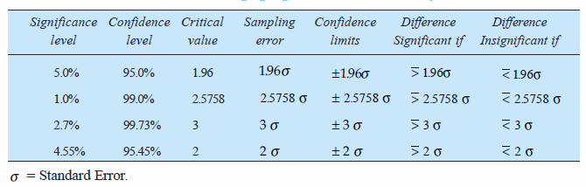
Sampling Error
The product of the critical value at a certain level of significance and the S.E. is often described as ‘Sampling Error’ at that particular level of significance.

Slide 82
Contd…
The standard error gives an idea about the reliability and precision of a sample.
  Smaller the S.E., the greater the uniformity of sampling distribution and hence, greater is the reliability of sample.
  The size of S.E. varies inversely with the size of the sample.

Slide 83
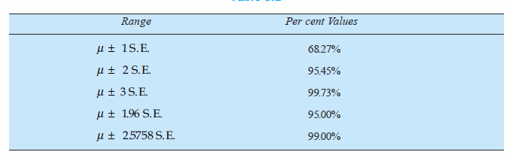
Contd…
The standard error enables us to specify the limits within which the parameters of the population are expected to lie with a specified degree of confidence. (confidence interval).
Such an interval is usually known as confidence interval.
The following table gives the percentage of samples having their mean values within a range of population mean.

Slide 84
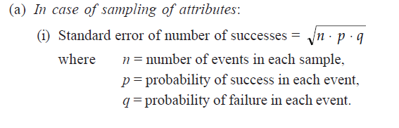

Computing the Standard Errors

Slide 85
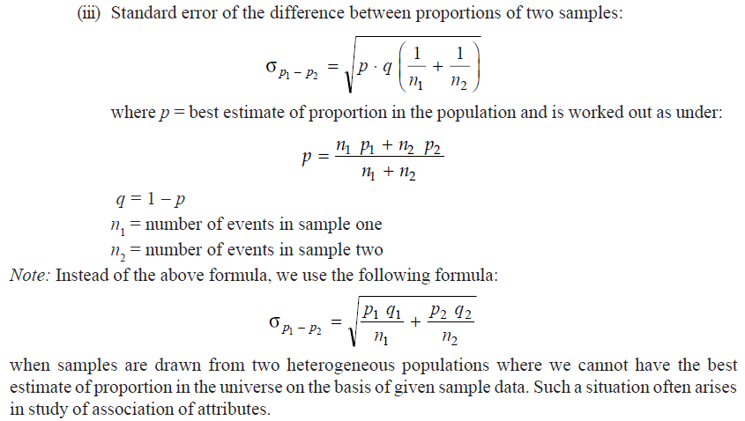
Contd…

Slide 86
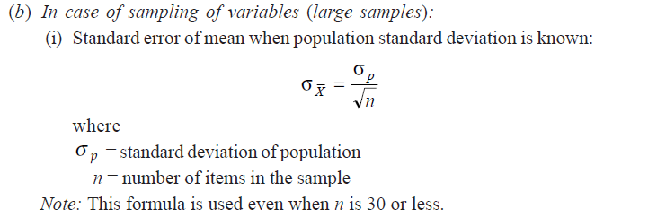
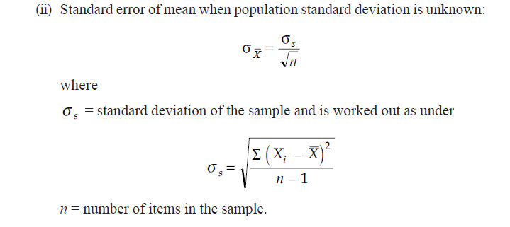

Slide 87
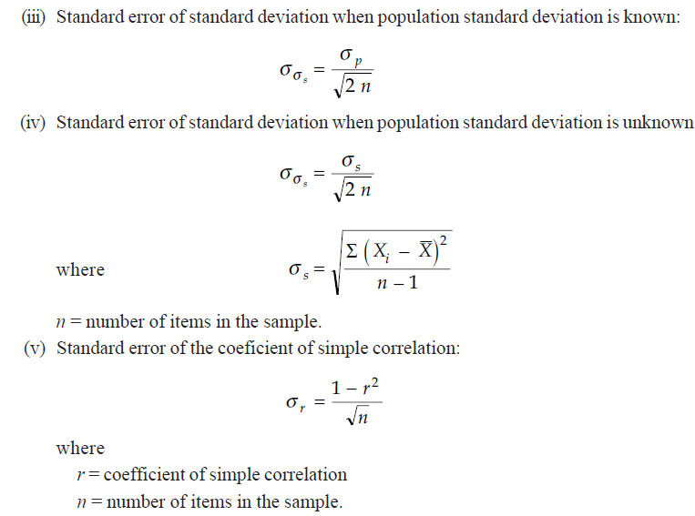
Contd…

Slide 88
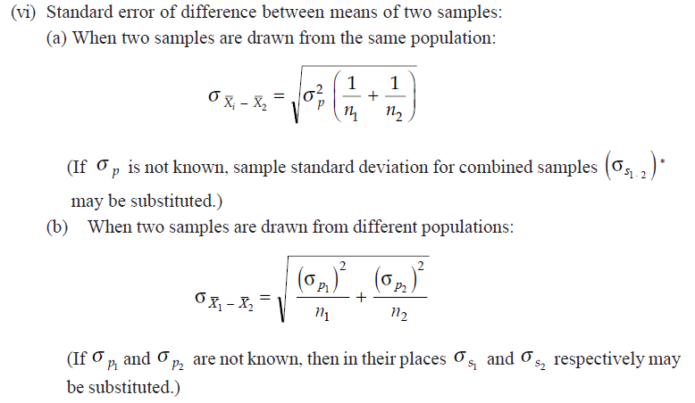
Contd…

Slide 89
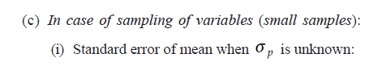
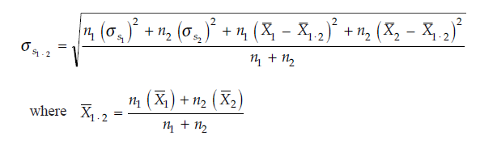
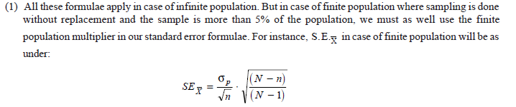
Contd…

Slide 90
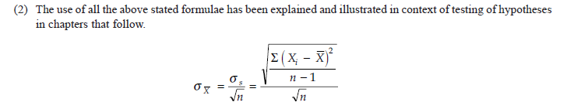
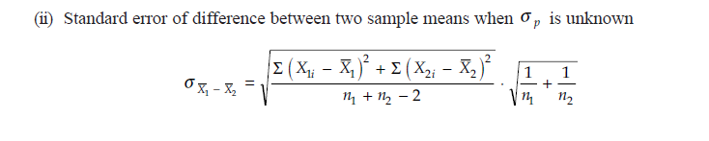

Slide 91
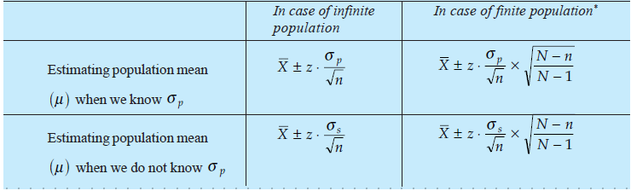
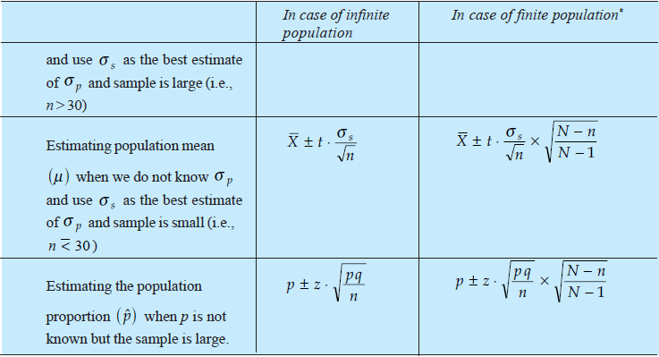

Slide 92
Discriminant analysis
Technique to discriminate between two or more mutually exclusive and exhaustive groups on the basis of some explanatory variables.
These groups are known a-priori.
When the criterion variable has two categories, the technique is known as two-group discriminant analysis.
When three or more categories are involved, the technique is referred as multiple discriminant analysis.

Slide 93
Contd…
Helps researchers to understand how consumers differ with respect to demographic and psychographic characteristics.
Used to predict group membership.
Banks use discriminant analysis to discriminate between the customers who default and who repay the loan in time, based on their age, income, assets, number of dependents and previous outstanding loan, etc.

Slide 94
Factor Analysis
Most often used multivariate technique of research studies pertaining to social and behavioural sciences.
Applicable when there is a systematic interdependence among a set of observed variables.
If researcher is interested in finding out something more fundamental which creates this commonality.

Slide 95
Contd…
Ex: income, education, occupation and dwelling area.
Infer some factor that which summarizes the commonality of all the four variables.
Technique used for this purpose is factor analysis.
Factor analysis resolves a large set of measured variables into few categories known as factors.
Allows researcher to group variables into factors.
The derived factors may be treated as new variables.

Slide 96
Path Analysis
Introduced by the biologist Sewall Wright for decomposing the total correlation between any two variables in a causal system.
Based on a series of multiple regression analyses with the added assumption of causal relationship between independent and dependent variables.
Path analysis makes use of standardized partial regression coefficients (known as beta weights) as effect coefficients.

Slide 97
