Slide 1
MODULE 3
Data analysis and interpretation

Slide 2
STATISTICS IN RESEARCH
Tool in designing research, analysing its data and drawing conclusions there from.
Summarise the collected/classified data
Major areas of statistics
  Descriptive statistics: concern the development of certain indices from the raw data
  Inferential statistics: concern with the process of generalisation. Also known as sampling statistics
    Mainly concerned with two major type of problems:
      The estimation of population parameters,
      The testing of statistical hypotheses.
Notes:
Indices are a useful way of more simply expressing large numbers.

Slide 3
Important Statistical Measures
Measures of central tendency or statistical averages;
  Mean, Median and Mode
Measures of dispersion;
  Varience, Standard deviation
Measures of asymmetry (skewness);
Measures of relationship; and
Other measures.
  Index numbers, Time series analysis

Slide 4
Data analysis and interpretation
Computation of certain indices or measures along with searching for patterns of relationship that exist among the data groups.
Particularly in case of survey or experimental data, involves estimating the values of unknown parameters of the population and testing of hypotheses for drawing inferences.
Categorised as;
  Descriptive analysis and Inferential analysis
    Descriptive analysis is largely the study of distributions of one variable.
      Provides profiles of companies, work groups, persons and other subjects on any of a multiple of characteristics such as size. Composition, efficiency, preferences, etc.”
      This sort of analysis may be in respect of one variable (described as unidimensional analysis), or in respect of two variables (described as bivariate analysis) or in respect of more than two variables (described as multivariate analysis).

Slide 5
Contnd…
Correlation analysis
  Studies the joint variation of two or more variables for determining the amount of correlation between two or more variables.
  Important in most social and business researches
Causal analysis
  Concerned with the study of how one or more variables affect changes in another variable.
  A study of functional relationships existing between two or more variables.
  This analysis can be termed as regression analysis.
  More important in experimental researches.

Slide 6
multivariate analysis
Multiple regression analysis:
  Has one dependent variable which is presumed to be a function of two or more independent variables.
  The objective of this analysis is to make a prediction about the dependent variable based on its covariance with all the concerned independent variables.
Multiple discriminant analysis:
  Has a single dependent variable that cannot be measured, but can be classified into two or more groups on the basis of some attribute.
  The object of this analysis happens to be to predict an entity’s possibility of belonging to a particular group based on several predictor variables.
Multivariate analysis of variance (or multi-ANOVA):
  An extension of two-way ANOVA, wherein the ratio of among group variance to within group variance is worked out on a set of variables.

Slide 7
Canonical analysis:
  In case of both measurable and non-measurable variables for the purpose of simultaneously predicting a set of dependent variables from their joint covariance with a set of independent variables.
Inferential analysis
  Inferential analysis is often known as statistical analysis.
  Concerned with the various tests of significance for testing hypotheses in order to determine with what validity data can be said to indicate some conclusion or conclusions.
  Also concerned with the estimation of population values.
  Interpretation (i.e., the task of drawing inferences and conclusions) is performed.

Slide 8
Hypothesis
A mere assumption or some supposition to be proved or disproved.
Defined as
  a proposition or a set of proposition set forth as an explanation for the occurrence of some specified group of phenomena
  either asserted merely as a provisional conjecture to guide some investigation
  or accepted as highly probable in the light of established facts.
A research hypothesis is a predictive statement, capable of being tested by scientific methods, that relates an independent variable to some dependent variable.
Notes:
Conjecture- a statement which is unproven, but thought to be true

Slide 9
Characteristics
Should be clear and precise.
Should be capable of being tested.
Should state relationship between variables.
Should be limited in scope and must be specific.
Should be stated as far as possible in most simple terms so that the same is easily understandable by all concerned.
Should be consistent with most known facts.
Should be amenable to testing within a reasonable time.
Must explain the facts that gave rise to the need for explanation.

Slide 10
Testing of Hypothesis - Basic Concepts
Null hypothesis (H0) and alternative hypothesis (Ha)
  If we are to compare method A with method B about its superiority.
    if we proceed on the assumption that both methods are equally good, then this assumption is termed as the null hypothesis.
    As against this, we may think that the method A is superior or the method B is inferior, we are then stating what is termed as alternative hypothesis.
  If our sample results do not support this null hypothesis, we should conclude that something else is true.
  The set of alternatives to the null hypothesis is referred to as the alternative hypothesis.
  Chosen before the sample is drawn

Slide 11
Example
Test the hypothesis that the population mean (µ) is equal to the hypothesised mean (µH0) = 100.
  Null hypothesis is that the population mean is equal to the hypothesised mean 100
  H0 : µ= µH0 = 100.
  If the sample results do not support this null hypothesis
    Conclude that something else is true.
      Rejecting the null hypothesis is known as alternative hypothesis.
      The set of alternatives to the null hypothesis is referred to as the alternative hypothesis.
  If we accept H0, then we are rejecting Ha and if we reject H0, then we are accepting Ha.

Slide 12
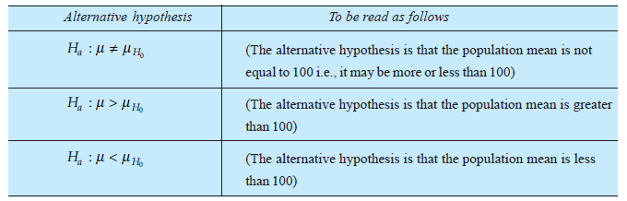
Possible alternative hypotheses are;
Considerations in the choice of null hypothesis;
  Alternative hypothesis is usually the one which one wishes to prove and the null hypothesis is the one which one wishes to disprove.
  If the rejection of a certain hypothesis when it is actually true involves great risk, it is taken as null hypothesis because then the probability of rejecting it when it is true is α (the level of significance) which is chosen very small.
  Null hypothesis should always be specific hypothesis i.e., it should not state about or approximately a certain value.
Hypothesis testing is proceeded on the basis of null hypothesis.

Slide 13
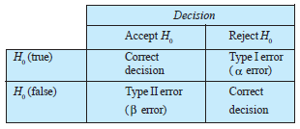
Contnd..
The level of significance
  Significance level is the maximum value of the probability of rejecting H0 when it is true
    Usually determined in advance before testing the hypothesis.
Decision rule or test of hypothesis
  Rule according to which we accept H0 (i.e., reject Ha) or reject H0 (i.e., accept Ha).
    The number of items to be tested and the criterion for accepting or rejecting the hypothesis
Type I and Type II errors
  Reject H0 when H0 is true – α error; level of significance of test.
  Accept H0 when H0 is not true – β error
  Both types of errors cannot be reduced simultaneously.

Slide 14
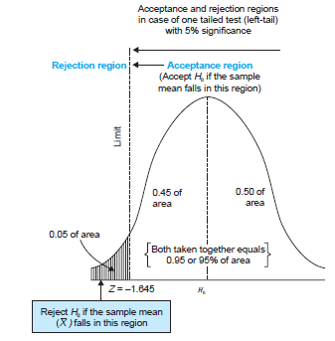
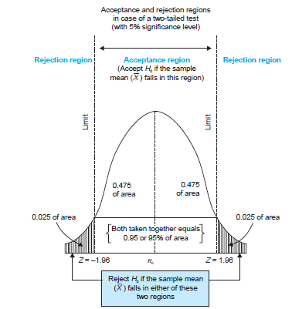
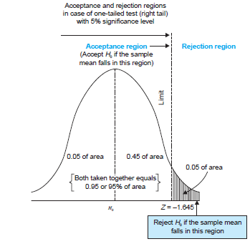
Two-tailed
  There are two rejection regions, one on each tail of the curve
One-tailed tests
  left-tailed test
  right-tailed test

Slide 15
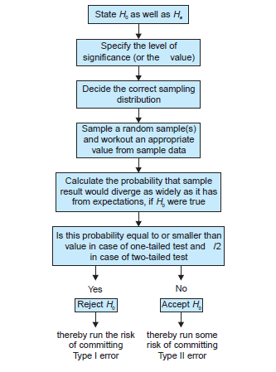
PROCEDURE FOR HYPOTHESIS TESTING

Slide 16
Sampling Distribution
All values of a particular statistic of each sample, together with their relative frequencies will constitute the sampling distribution of the particular statistic.
Important Sampling Distributions
  sampling distribution of mean;
  sampling distribution of proportion;
  student’s ‘t’ distribution;
  F distribution;
  Chi-square distribution

Slide 17
Sampling distribution of mean
Probability distribution of all the possible means of random samples of a given size that we take from a population.
If samples are taken from a normal population N(µ,σp);
  The sampling distribution of mean µ = µ
  Standard deviation = σp√n
When sampling is from a population which is not normal;
  the sampling distribution of mean tends quite closer to the normal distribution, provided the number of sample items is large
To reduce the sampling distribution of mean to unit normal distribution
  Write normal variate z = ( - µ)/(σp/ √n) for the sampling distribution

Slide 18
Sampling distribution of proportion
Plot a probability distribution of the said proportions to obtain the sampling distribution of proportion.
If p represents the proportion of successes and q the proportion of failures (or q = 1 – p)
If p is treated as a random variable,
  The sampling distribution of proportion of successes has a mean = p with standard deviation =
For the binomial distribution
  Variate of the sampling distribution of proportion z =

Slide 19

Student’s t-distribution
Use t distribution for the sampling distribution of mean,
  when population standard deviation (σp)is not known
  the sample is of a small size (i.e., n < 30).
  t variable =( - µ)/(σs / √n)
  Where

Slide 20
The variable t differs from z
  use sample standard deviation in the calculation of t,
  use standard deviation of population in the calculation of z.
There is a different t distribution for every possible sample size.

Slide 21
F distribution
If σs1 and σs2 are the variances of two independent samples of size n1 and n2 respectively taken from two independent normal populations, having the same variance.
Then F = (σs1)²/(σs2)²
where (σs1)² = Σ( 1i - 1 )²/n1-1
(σs2)² = Σ( 2i - 2 )²/n2-1
F ratio is computed in a way that the larger variance is always in the numerator.
Notes:
degrees of freedom is the number of values in the final calculation of a statistic that are free to vary

Slide 22
Chi-square (χ²) Distribution
When we deal with collections of values that involve adding up squares.
Variances of samples require us to add a collection of squared quantities and thus have distributions that are related to chi-square distribution.
If each one of a collection of sample variances,
  Divide them by the known population variance and
  Multiply these quotients by (n – 1), to get the distribution.
  (σs² / σp² )(n-1)
Not symmetrical and all the values are positive.
Must know the degrees of freedom for using chi-square distribution.

Slide 23

Used for judging the significance of difference between observed and expected frequencies
Also as a test of goodness of fit.

Slide 24
Tests of Hypotheses
Parametric tests or standard tests of hypotheses;
  Assume certain properties of the parent population from which we draw samples.
  Require measurement equivalent to at least an interval scale
  Important parametric tests
    z-test, t-test, χ2-test and f-test
  The source of data is considered to be normally distributed.
Non-parametric tests or distribution-free test of hypotheses.
  Do not depend on any assumption about the parameters of the parent population.
  Assume only nominal or ordinal data
  Need more observations

Slide 25
z-test
Used for judging the significance of several statistical measures, particularly the mean.
The relevant test statistic, z, is worked out and compared with its probable value at a specified level of significance for judging the significance of the measure concerned.
Uses
  When binomial distribution or t-distribution is applicable
    on the presumption that such a distribution tends to approximate normal distribution as ‘n’ becomes larger or when population variance is known.
  Comparing the mean of a sample to some hypothesised mean for the population.
  Judging he significance of difference between means of two independent samples
  Comparing the sample proportion to a theoretical value of population proportion or for judging the difference in proportions of two independent samples
  Judging the significance of median, mode, coefficient of correlation and several other measures.

Slide 26
t-test
  Based on t-distribution
  Considered in case of small sample(s) when population variance is not known
  In case two samples are related, use paired t-test.
  Used for judging the significance of the coefficients of simple and partial correlations.
  The relevant test statistic, t, is calculated and then compared with its probable value based on t-distribution at a specified level of significance for concerning degrees of freedom for accepting or rejecting the null hypothesis.

Slide 27
χ2 – test
  Based on chi-square distribution and as a parametric test is used for comparing a sample variance to a theoretical population variance.
F-test
  Based on F-distribution
  Used to compare the variance of the two-independent samples.
  This test is also used in the context of analysis of variance (ANOVA) for judging the significance of more than two sample means at one
  It is also used for judging the significance of multiple correlation coefficients.
  Test statistic, F, is calculated and compared with its probable value for accepting or rejecting the null hypothesis.

Slide 28

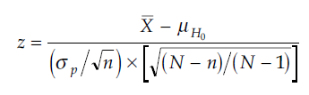
Hypothesis Testing of Means
Population normal, population infinite, sample size may be large or small but variance of the population is known, Ha may be one-sided or two-sided:
Test statistic
Population normal, population finite, sample size may be large or small but variance of the population is known, Ha may be one-sided or two-sided:
Test statistic
      (using finite population multiplier)

Slide 29
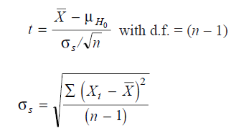


Contnd…
Population normal, population infinite, sample size small and variance of the population unknown, Ha may be one-sided or two-sided:
Test statistic
Population normal, population finite, sample size small and variance of the population unknown, and Ha may be one-sided or two-sided:
Test statistic
Where

Slide 30


Contnd…
Population may not be normal but sample size is large, variance of the population may be known or unknown, and Ha may be one-sided or two-sided:
Test statistic OR
(when variance is not known, we use σs in place of σp in this formula)
Example: Page No:202

Slide 31
Hypothesis Testing for Differences Between Means
The null hypothesis for testing of difference between means is generally stated as
  H0 : µ1 = µ2 ,
    where µ1 is population mean of one population and µ2 is population mean of the second population, assuming both the populations to be normal populations.
Alternative hypothesis may be of not equal to or less than or greater than type.

Slide 32
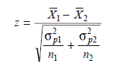

Population variances are known or the samples happen to be large samples:
Test Statistic
  In case σp1 and σp2 are not known, use σs1 and σs2 respectively

Slide 33




Samples happen to be large but presumed to have been drawn from the same population whose variance is known:
  The test statistic
  In case σp is not known, use

Slide 34
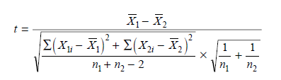

Samples happen to be small samples and population variances not known but assumed to be equal:
  The test statistic
  Where d.f.= n1+n2-2
  OR

Slide 35
Hypothesis Testing For Comparing Two Related Samples
Paired t-test is a way to test for comparing two related samples,
  small values of n
  does not require the variances of the two populations to be equal,
  the assumption that the two populations are normal
For a paired t-test, it is necessary that the observations in the two samples be collected in the form of what is called matched pairs
Appropriate in a before-and-after-treatment study.

Slide 36



First work out the difference score for each matched pair,
Then find out the average of such differences, along with the sample variance of the difference score.
If the values from the two matched samples are denoted as Xi and Yi and the differences by Di (Di = Xi – Yi),
The mean of the differences:
The variance of the differences
Assuming the said differences to be normally distributed and independent; the test statistic
n = Number of matched pairs

Slide 37



Hypothesis Testing of Proportions
In case of qualitative phenomena, data analysed on the basis of presence or absence of an attribute(s).
Sampling distribution may take the form of binomial probability distribution.
  Mean=n.p & Standard Deviation = √(n.p.q)
    Where
      p = the probability of success,
      q =the probability of failure such that p + q = 1
      n= the size of the sample.
  Mean Proportion of Success = n.p/n=p
  Standard deviation of the proportion of successes
When n is large binomial distribution tends to become normal distribution
  Test Statistic

Slide 38
Hypothesis Testing for Difference Between Proportions
Two samples are drawn from different populations.
Knowing whether the difference between the proportion of successes is significant or not.
Start with the hypothesis that the difference between the proportion of success in sample one and the proportion of success in sample two is due to fluctuations of random sampling.
The null hypothesis is
The test statistic

Slide 39
Then, construct the rejection region(s) depending upon the Ha for a given level of significance and on its basis we judge the significance of the sample result for accepting or rejecting H0.

Slide 40
Testing the difference between proportion based on the sample and the proportion given for the whole population:
  Standard error of difference between proportion of persons possessing an attribute in a sample and the proportion given for the population is worked out as

Slide 41
Hypothesis Testing for Comparing a Variance to Some Hypothesised Population Variance
Chi-square as a test for comparing variance
  Used to judge the significance of population variance.
  Take each one of a collection of sample variances, divided them by the known population variance and multiply these quotients by (n – 1).
χ²=
  The χ²-distribution is not symmetrical and all the values are positive.
  Required to know the degrees of freedom since for different degrees of freedom we have different curves.
  If the calculated value of χ² is less than the table value, the null hypothesis is accepted

Slide 42
Testing The Equality Of Variances
Of Two Normal Populations
Use F-test based on F-distribution.
The null hypothesis happens to be
The test statistic
While calculating F, σs1²is treated > σs2² which means that the numerator is always the greater variance.

Slide 43
When we use the F-test, we presume that
  the populations are normal;
  samples have been drawn randomly;
  observations are independent; and
  there is no measurement error.
The object of F-test is to test the hypothesis whether the two samples are from the same normal population with equal variance or from two normal populations with equal variances.
F-test was initially used to verify the hypothesis of equality between two variances, but is now mostly used in the context of analysis of variance.

Slide 44
Hypothesis Testing of Correlation Coefficients
Test whether the correlation coefficient calculated on the basis of sample data is indicative of significant correlation
In case of simple correlation coefficient:
  with (n – 2) degrees of freedom ryx being coefficient of simple correlation between x and y.
In case of partial correlation coefficient:
  with (n – k) degrees of freedom, n being the number of paired observations and k being the number of variables involved, rp happens to be the coefficient of partial correlation

Slide 45
In case of multiple correlation coefficient:
  where R is any multiple coefficient of correlation, k being the number of variables involved and n being the number of paired observations.
  v1 = k – 1 = degrees of freedom for variance in numerator.
  v2 = n – k = degrees of freedom for variance in denominator.

Slide 46
Chi-square as a Non-parametric Test
Require only the degree of freedom
  A test of goodness of fit
    χ² test enables to see how well does the assumed theoretical distribution (such as Binomial distribution, Poisson distribution or Normal distribution) fit to the observed data.
    When some theoretical distribution is fitted to the given data, we are always interested in knowing as to how well this distribution fits with the observed data.
      If the calculated value of χ² is less than the table value at a certain level of significance, the fit is considered to be a good one which means that the divergence between the observed and expected frequencies is attributable to fluctuations of sampling.
      But if the calculated value of χ² is greater than its table value, the fit is not considered to be a good one.

Slide 47
A test of independence
  Enables to explain whether or not two attributes are associated.
  Observed as well as theoretical or expected frequencies must be grouped

Slide 48
Standard Error
The standard deviation of sampling distribution of a statistic
Utility of the standard error
Helps in testing whether the difference between observed and expected frequencies could arise due to chance.
    If a difference is less than 3 times the S.E., the difference is supposed to exist as a matter of chance
    If the difference is equal to or more than 3 times the S.E., chance fails to account for it, and we conclude the difference as significant difference.
    Based on the fact that at ± 3 (S.E.) the normal curve covers an area of 99.73 per cent.
  If the estimated parameter differs from the calculated statistic by more than 1.96 times the S.E., the difference is taken as significant at 5 per cent level of significance (95 per cent confidence).
    Said difference is not due to fluctuations of sampling

Slide 49
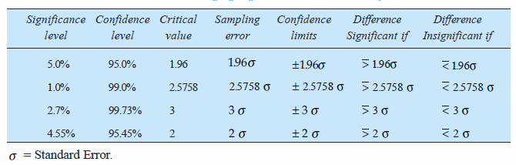
At that particular level of significance;
Sampling Error=the product of critical value and SE

Slide 50
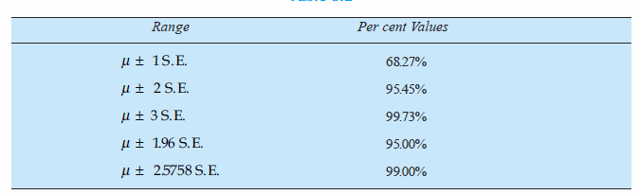
The standard error gives an idea about the reliability and precision of a sample.
  Smaller the S.E., the greater the uniformity of sampling distribution and hence, greater is the reliability of sample.
  The size of S.E. varies inversely with the size of the sample.
The standard error enables us to specify the limits within which the parameters of the population are expected to lie with a specified degree of confidence (confidence interval).

Slide 51


Computing the Standard Errors
Sampling of attributes
  Standard error of number of successes = √(n × p × q)
    where n = number of events in each sample,
      p = probability of success in each event,
    q = probability of failure in each event
  Standard error of proportion of successes = √((p.q)/n)
  Standard error of the difference between proportions of two samples= or
    where p = best estimate of proportion in the population and is worked out as under : p=(n1p1+n2p2)/(n1+n2), q=1-p
    n1 = number of events in sample one
    n2 = number of events in sample two

Slide 52






Contnd…
In case of sampling of variables (large samples):
  Standard error of mean when population standard deviation is
  known:
  Standard error of mean when population standard deviation is
  unknown: where
  Standard error of standard deviation when population standard deviation is known:
  Standard error of standard deviation when population standard deviation is unknown:

Slide 53
Standard error of the coefficient of simple correlation:
Standard error of difference between means of two samples:
  Two samples are drawn from the same population:
  Two samples are drawn from different populations:

Slide 54
In case of sampling of variables (small samples):
Standard error of mean when σp is unknown:
Standard error of difference between two sample means when σp is unknown

Slide 55
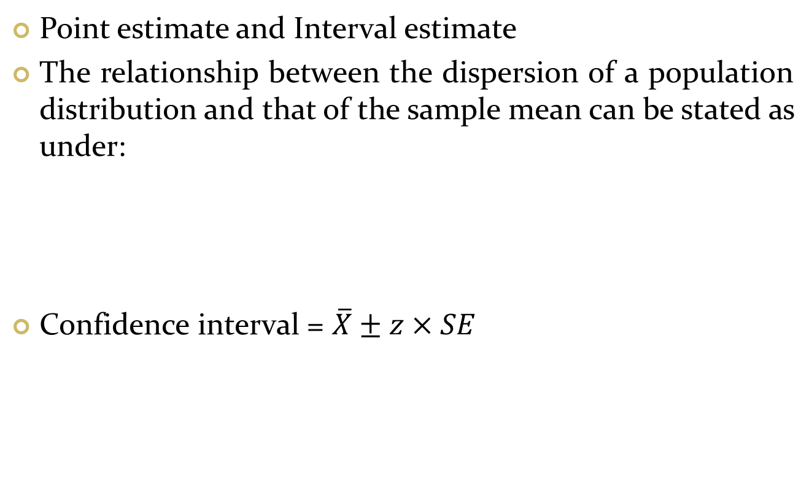
Estimating The Population Mean
Point estimate and Interval estimate
The relationship between the dispersion of a population distribution and that of the sample mean can be stated as under:
Confidence interval = $\overline{X}±z×SE$

Slide 56
Estimating Population Proportion
Confidence interval for population proportion

