Slide 1
Module II

Slide 2
INTRODUCTION
SGML is a meta-markup language-It is a language for defining markup language .
Developed in the early 1980s; In 1986 SGML was approved by ISO std.
HTML was developed using SGML in the early 1990s - specifically for Web documents.
Problems with HTML:
1. HTML is defined to describe the general form and layout of information without considering its meaning.
2. Fixed set of tags and attributes. Given tags must fit every kind of document.
3. There are no restrictions on arrangement or order of tag appearance in document.

Slide 3
For example, an opening tag can appear in the content of an element, but its corresponding closing tag can appear after the end of the element in which it is nested.
Eg : <b> Now <i> is </b> the time </i>
One solution to the first problems is to allow for group of users with common document needs to define their own tags and attributes and then use the SGML standard to define a new markup language to meet those needs.

Slide 4
Problem with using SGML:
1. It‘s too large and complex to use and it is very difficult to build a parser for it. SGML includes a large number of capabilities that are only rarely used.
2. A program capable of processing SGML documents would be very large and costly to develop.
3. SGML includes large number of capabilities that are rarely used
A better solution: Define a simplified version of SGML and allow users to define their own markup languages based on it. XML was designed to be that simplified version of SGML.

Slide 5
INTRODUCTION TO XML
XML is not a replacement for HTML . Two have different goals
HTML is a markup language used to describe the layout of any kind of information
XML is a meta-markup language that provides framework for defining specialized markup languages
HTML Syntax
<html>
<head><title>name</title></head><body>…… </body>
XML Syntax
<name>
<first> nandini </first>
<last> sidnal </last>
</name>

Slide 6
XML is a very simple and universal way of storing and transferring any textual kind
XML does not predefine any tags
XML tag and its content, together with closing tag is called element
XML has no hidden specifications
XML based markup language is called tag set
Document that uses XML based markup language is called XML document
An XML processor is a program that parses XML documents and provides the parts to an application

Slide 7
What is XML?
XML stands for EXtensible Markup Language
XML is a markup language much like HTML
XML was designed to carry data, not to display data
XML tags are not predefined. You must define your own tags
XML is designed to be self-descriptive
XML is a W3C Recommendation
XML is not a replacement for HTML.

Slide 8
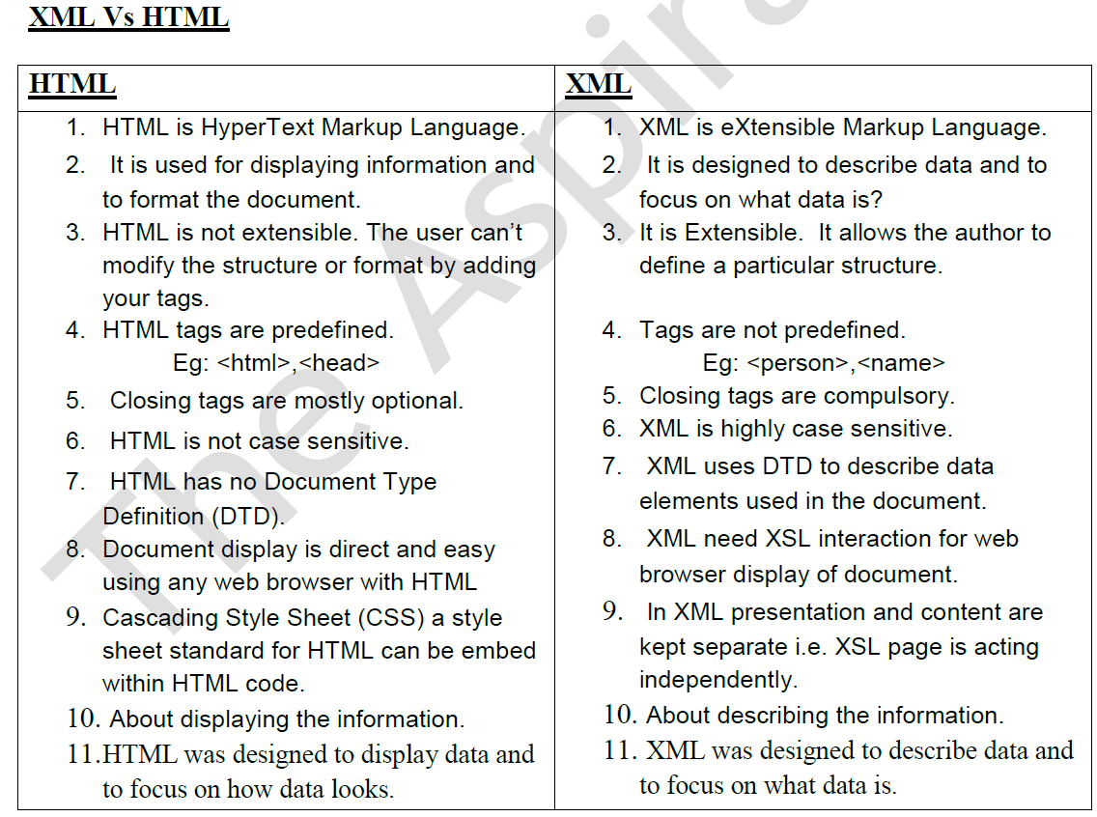

Slide 9
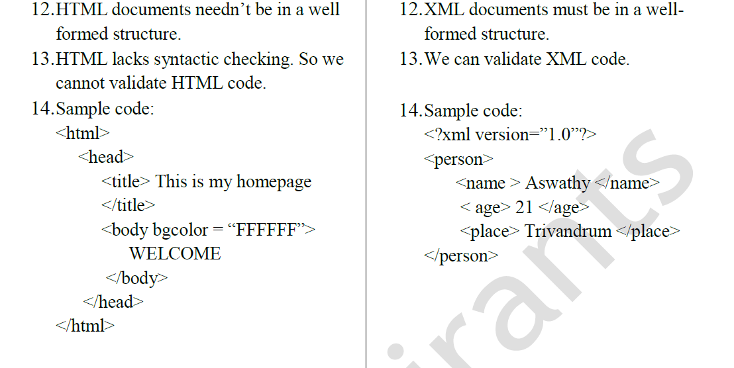

Slide 10
XML as a Subset of SGML
SGML is a very powerful, very general and a standard markup language. But with that power comes the increased complexity.
XML is a subset of SGML intended to make SGML” light “ enough for use on web.
As XML is a proper subset of SGML, all XML documents are valid SGML documents .But not all SGML documents are valid XML document.
SGML is intended to be absolutely independent of any applications

Slide 11
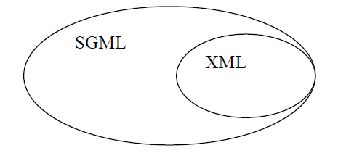

Slide 12
XML can be considered as SGML-Lite: 20% of SGML's complexity, 80% of its capacity.
XML is a lightweight cut-down version of SGML i.e. XML uses only the most commonly-used SGML features.
XML becomes a smaller language than SGML because the designers of XML removed some specification in SGML that was not needed for web delivery.
XML will not replace either SGML or HTML; XML is compatible with both.
HTML and XML are both based on SGML.

Slide 13
XML SYNTAX
The syntax of XML can be thought of at two distinct levels.
1. There is the general low-level syntax of XML that imposes its rules on all XML documents.
2. The other syntactic level is specified by either document type definitions or XML schemas. These two kinds of specifications impose structural syntactic rules on documents written with specific XML tag sets.
DTDs and XML schema specify the set of tags and attributes that can appear in particular document or collection of documents, and also the order and various arrangements in which they can appear.

Slide 14
Levels of syntax
Well-formed documents applies basic XML rules on all its
documents
Valid documents are well-formed and also specified by
DTDs or XML schemas
DTDs or XML schemas specify the set of tags that can appear in a particular document/documents
Well-formed XML documents
All XML documents begin with XML declaration. [ it is
not a processing instruction]
<?xml version =“1.0” encoding=“utf-8” ?>
Basic rules in XML are same as XHTML

Slide 15
XML with correct syntax is "Well Formed" XML.
XML validated against a DTD is "Valid" XML.
A "Valid" XML document is a "Well Formed" XML document, which also conforms to/ suitable with the rules of a Document Type Definition (DTD):
The DOCTYPE declaration, is a reference to an external DTD file.
XML DTD
defines the legal building blocks of an XML document
Can be inline in XML or as an external reference
XML Schema
an XML based alternative to DTD, more powerful
Support namespace and data types

Slide 16
All XML document must begin with XML declaration. It identifies the document as being XML and provides the version no. of the XML standard being used. It will also include encoding standard. It is a first line of the XHTML document.
XML names must begin with a letter or underscore and can include digits, hyphens, and periods.
XML tag names are case sensitive. , the tag <Letter> is different from the tag <letter>.
There is no length limitation for tag names.
Space is Preserved in XML
HTML truncates multiple white-space characters to one single white-space
Comments in XML: <!-- This is a comment -->

Slide 17
Every XML document defines a single root element, whose opening tag must appear on the first line of XML code.
Elements must be nested inside the root element.
In HTML, you might see improperly nested elements:
<b><i>This text is bold and italic</b></i>
In XML, all elements must be properly nested within each other:
<b><i>This text is bold and italic</i></b>

Slide 18
XML tags can have attributes, which are specified with name/value assignments. XML Attribute Values must be enclosed with single or double quotation marks.

Slide 20
XML EXAMPLE
<?xml version = 1.0 encoding = utf-8?>
<ad>
<year>1960</year>
<make>Cessna</make>
<model>Centurian</model>
<color>Yellow with white trim</color>
<location>
<city>Gulfport</city>
<state>Mississippi</state>
</location>
</ad>

Slide 21
When designing an XML document, the designer is often faced with the choice between adding a new attribute to an element or defining a nested element.
<!-- A tag with one attribute -->
<patient name = "Maggie Dee Magpie">
...
</patient>

Slide 22
<!-- A tag with one nested tag -->
<patient>
<name> Maggie Dee Magpie </name>
...
</patient>

Slide 23
<!-- A tag with one nested tag, which contains three nested tags -->
<patient>
<name>
<first> Maggie </first>
<middle> Dee </middle>
<last> Magpie </last>
</name>
...
</patient>
Here third one is a better choice because it provides easy access to all of the parts of data.

Slide 24
SGML Features
The term SGML stands for Standard Generalized Markup Language
It is a system for defining the markup language.
SGML is a meta language .It facilitates the creation of other languages.
SGML is extensible .
SGML specifies the rules for tagging elements.
It is widely used to manage large document that are subject to frequent revisions and need to be print in different format.

Slide 25
Authors can mark up their document by representing structural, presentational and semantic information along with the content.
HTML is an application of SGML because HTML was created using SGML standards.

Slide 26
The Syntax of XML
General XML Syntax
XML documents have data elements, markup declarations (instructions for the XML parser), and processing instructions (for the application program that is processing the data in the document)
All XML documents begin with an XML declaration:
<?xml version = "1.0" encoding = utf-8?>
XML comments are just like HTML comments
XML names:
- Must begin with a letter or an underscore
- They can include digits, hyphens, and periods
- There is no length limitation
- They are case sensitive (unlike HTML names)

Slide 27
TWO VIEWS OF AN XML DOCUMENT
XML documents have both logical and a physical structures, which must nest properly to be well-formed. XML documents consist of storage units (entities).
The overall structure of any given XML document can be looked at in two distinct ways .Firstly it has a Logical structure and side by side with the logical structure XML document have a Physical structure.

Slide 28
Logical structure
Viewed from this angle an XML document is a hierarchy of information .
It enlists the elements to be included in a document and in the order in which they have to be included .
At the very top of the tree is called Root element from which all the further logical structure develops .
Thus it refers to the organization of the different parts of a document , ie it indicates how a document is built.

Slide 29
<PcForSale>
<item type=”PC”>
<Maker>Acme PC Inc</Maker>
<Brand>Acme Deluxe</Brand>
<storage>
<RAM units=”MB”>72</RAM>
<HardDisk units=”GB”>10</HardDisk>
</storage>
<CPU >Speed 500 GHz </CPU>
</item>
</PcForSale>

Slide 30
The logical structure is the layer above the physical structure .At this level an XML document consists of
optional prolog,
root element, and
an optional epilog.
The first structural element in XML document that precedes the first start-tag is collectively known as prolog. The prolog is everything that occurs before the root element starts .
The XML declaration identifies the version of the XML specification to which the document conforms .The sample document begins with the XML declaration <?xml version = ”1.0”?>
If the XML document is going to be associated with a Document Type Definition then the prolog will contain a Document Type Declaration.

Slide 31
The Document Type Declaration is the area of the prolog used to declare element types ,attributes ,entities and so on .
It takes the following general form:<!DOCTYPE … > .It consists of markup code that indicates the grammar rule .It can also point to an external file that contains all or part of DTD.
The following code adds a Document Type Declaration to the sample document
<?xml version= ”1.0”?>
<!DOCTYPE catalog SYSTEM “catalog.dtd”>
The above statement conveys the XML parser that the document is of the class ‘catalog’ and conforms to the rules formed in the DTD files named ‘catalog.dtd’ .

Slide 32
Root Element :-
The root element of an XML document is the element that contains all other element in the document.
<?xml version= ”1.0”?>
<message>
<hello> Welcome to XML</hello>
</message>
Here message is the root element.
The root element can be empty.
<?xml version= ”1.0”?>
< message />

Slide 33
Epilog
The epilog is everything that occurs after the root element ends.
The word epilog is used here to name that area which can contain processing instruction, comments or white space.

Slide 34
Physical Structure
The physical structure of an XML document is composed of all the content used in the document .
A single XML document can be made up of a number of distinct physical storage units known as Entities .
An Entity is a unit building blocks of XML document.
The full document is rooted in the entity known as Document Entity.
An entity can be part of the XML document or external to the document .Each entity is identified by a unique name and contains its own content from a single character inside the document to a large file that exists outside the document.

Slide 35
An XML processor sees an XML document as a series of characters, which reads in a series fashion .when it sees something called Entity Reference ,it reads the name of the entity and replaces the entity reference with the actual text or graphic or other type of media that is referred to.

Slide 36
Types of Entities
1)Predefined Entity
In XML certain character (< ,> , /) are used specifically for marking up the document .It cannot be interpreted as Character data ,so cannot be used as content .
use Entity Reference to insert the character into the document like (&lt;,&gt; ,&amp etc)
<myelement>7 &gt; 2</myelement>

Slide 37
2) Parsed Entity
It contains text data that becomes part of the XML document once the data is processed .Parsed entity is intended to be read by the XML processor which will extract the content. After the content is extracted it becomes part of the document at the location of the entity reference.
Eg: publisher information (PUB1) entity can be declared as
<!ENTITY PUB1 “BPB Publishers”>
Whenever the entity declaration is referenced in the document it will be replaced by its content .First insert an ampersand (&) and then enter entity name followed by (;) for entity reference.
<publisher>This book is from &PUB1;</publisher>

Slide 38
3)Unparsed Entity
The contents may be a binary file or image that is not directly interpreted by the XML processor .Unparsed entity requires a notation. Notation identifies the format or type or resource to which the entity is declared.
<!ENTITY myimage SYSTEM “1.gif” NDATA GIF>

Slide 39
4) External Entity
It refers to a storage unit in its declaration by using a SYSTEM or public identifier.
It provides a pointer to a location at which entity can be found.
<!ENTITY myimage SYSTEM http://www.abc.com/image/1.gif NDATA GIF>
In this example the XML processor must read the file 1.gif to retrieve the content of this entity.

Slide 40
CREATING XML DOCUMENT
There are seven forms of markup that can occur in XML document.
1)Start and End Tags
2)Attribute Assignment
3)Entity References
4)Comments
5)CDATA section
6)Processing Instruction
7)Document Type Declaration

Slide 41
XML Document structure
XML document often uses two auxiliary files:
1. An XML document often uses two auxiliary files:
One to specify the structural syntactic rules ( DTD / XML schema)
One to provide a style specification ( CSS /XSLT Style Sheets)
XML documents (and HTML documents) are made up by the following building blocks:
Elements, Tags, Attributes, Entities, PCDATA, and CDATA

Slide 42
Elements
Elements are the main building blocks of both XML and HTML documents. Elements can contain text, other elements, or be empty.
Tags
Tags are used to markup elements. A starting tag like <element_name> mark up the beginning of an element, and an ending tag like </element_name> mark up the end of an element.
Examples:
A body element: <body>body text in between</body>.
A message element: <message>some message in between</message>

Slide 43
Elements can be nested, and all elements must be nested within a single root element. Nested elements are termed child elements. Elements must be nested correctly, with child elements enclosed within their parent opening and closing element tags, as follows:
<Year>2000
<Month>January</Month>
<Month>February</Month>
</Year>
Empty (open) elements contain no content. An empty or open element can be used to mark sections of the document for the processor. Empty elements can contain attributes used. An empty element has the following syntax; the element name is followed by a slash.
<Year/>

Slide 44
<greeting> Starts a greeting element
</introduction> Ends an introduction element
<Joe Black> Bad start tag .No space allowed
<42> Element name cannot begin with number
</ Product> No space allowed b/w slash and element name

Slide 45
Attributes
Attributes provide extra information about elements. Attributes are placed inside the start tag of an element. Attributes come in name/value pairs.
The following "img" element has an additional information about a source file:
<img src="computer.gif" />
The name of the element is "img".
The name of the attribute is "src". The value of the attribute is "computer.gif". Since the element itself is empty it is closed by a " /".

Slide 46
Attribute Assignment: Meaning
1) <fruit type=”apple”>: type attribute have value “apple
2) <fruit type=’apple’> : Single quotes can also be used
3) <table border=2> : Invalid.Attributes must be quoted
4) <animal leg=”4” blood=”cold”>:
The leg attribute has the value 4,blood attribute has the value . White space within start tag are ignored by the parser.

Slide 47
PCDATA
PCDATA means parsed character data.
Think of character data as the text found between the start tag and the end tag of an XML element.
PCDATA is text that will be parsed by a parser. Tags inside the text will be treated as markup and entities will be expanded.

Slide 48
CDATA
CDATA also means character data. CDATA is text that will NOT be parsed by a parser.
Tags inside the text will NOT be treated as markup and entities will not be expanded.

Slide 49
ENTITY
An XML document consist of one or more entities that are logically related collection of information,
Entities range from a single special character to a book chapter
An XML document has one document entity
All other entities are referenced in the document entity

Slide 50
Reasons to break a document into multiple entities.
1. Good to define a Large documents as a smaller no. of parts easier to manage .
2. If the same data appears in more than one place in the document, defining it as a entity allows any no. of references to a single copy of data.
3. Many documents include information that cannot be represented as text, such as images. Such information units are usually stored as binary data. Binary entities can only be referenced in the document entities ie XML document cannot include binary data.

Slide 51
Entity names:
No length limitation
Must begin with a letter, a dash, or a colon
Can include letters, digits, periods, dashes, underscores, or colons
A reference to an entity has the form name with prepended ampersand and appended semicolon: &entityname;
Eg. &apple_image;
processor parses the document it will replace the entity reference with actual characters and will not interpret characters as markup.

Slide 52
Five Built-in Entity
Entity Reference Interpretation
&lt; <
&gt; >
&amp; &
&apos; ‘
&quot; “

Slide 53
If several predefined entities must appear near each other in a document, it is better to avoid using entity references. Character data section can be used.
The content of a character data section is not parsed by the XML parser, so it can include any tags.
The form of a character data section is as follows: <![CDATA[content]]> // no tags can be used since it is not parsed
For example, instead of Start &gt;&gt;&gt;&gt; HERE &lt;&lt;&lt;&lt;
Use <![CDATA[Start >>>> HERE <<<<]]>

Slide 54
<![CDATA[content]]>
Ex1:<Document><![CDATA[ if a<b and b<c then a<c]] ></Document>
Between the start of the section ” <![CDATA[ ” and end of the section “]]>” all character data is passed directly to the application .
comments are not recognized in a CDATA section.
Here the parser has detected the presence of a CDATA section and waved the entire string “a<b and b<c then a<c” through the application directly.

Slide 55
DOCUMENT TYPE DECLARATION
A Document Type Declaration is a statement embedded in an XML document whose purpose is to acknowledge the existence and location of Document Type Definition(DTD).
Document Type Declaration is a statement that points to the Document Type Definition(DTD) .
Document Type Definition is a set of rules that defines the structure of an XML document where as a Document Type Declaration is a statement that tells the parser which DTD to use for checking and validation.

Slide 56
All Document Type Declaration starts with a string “<!DOCTYPE ”
The Document Type Declaration can be external or internal
If external the DTD must be specified either as SYSTEM or PUBLIC.
If PUBLIC the DTD can be used by anyone by referring the URL.
If SYSTEM that means it resides on local hard disk and may not be available for use by other application.

Slide 57
Document Type definitions
A DTD is a set of structural rules called declarations.
DTDs define an XML document's structure (e.g., what elements,attributes, etc. are permitted in the document)
These rules specify a set of elements, along with how and where they can appear in a document
Purpose: provide a standard form for a collection of XML documents an define a markup language for them.
DTD provide entity definition.
With DTD, application development would be simpler.
Not all XML documents have or need a DTD

Slide 58
A DTD is a sequence of declarations.
Each declaration has the form
<!Keyword ……..>
Four possible keywords are
ELEMENT- used to define tags
ATTLIST – used to define tag attributes
ENTITY- used to define entities
NOTATION – used to define datatype notations

Slide 59
DECLARING ELEMENTS
Every element in a valid XML document must have an element type declared in the DTD.
To validate an XML document ,a validating parser needs to know three things about each element
What the element type is named
What elements of that type can contain(content model)
What attributes an element of that type has associated
Both the element type name and its content model are declared together in what is known as Element Type declaration

Slide 60
Element Type declaration must start with the string “ <!ELEMENT
Syntax of an element declaration for elements that contain elements is:
<!ELEMENT element_name (list of names of child elements)>
Eg: <!ELEMENT memo (from,to,date,re,body)>
In many cases it is necessary to specify the number of times the child elements may appear

Slide 61
+ - one or more occurences
* - zero or more occurences
? - zero or one occurrence
Eg DTD Declaration
<!ELEMENT person (parent+, age, spouse?, sibling* )>
The leafs node of a DTD specify the datatypes of the content of their parent nodes ,which are elements.
In most cases the content of an element is type PCDATA
PCDATA is a string of any printable characters except < or > or &
<! ELEMENT element-name(#PCDATA)>
Eg: <!ELEMENT parent (#PCDATA)>

Slide 62
Two other content types can be specified: EMPTY &
ANY.
EMPTY type used to specify that element has no content
The ANY type is used when the element may contain literally any element.(may have any combination of element in any order)
Notes:
9

Slide 63
DECLARING ATTRIBUTES
An attribute declaration must include the name of the element to which the attribute belongs, the attribute name and its type.
Syntax
<!ATTLIST element-name attribute_name attribute type [default-value]>
If More than one attribute
< !ATTLIST element_name attribute_name1 attribute_type default_value_1
attribute_name 2 attribute_type default_value_2 …>
Attribute type :There are ten different types, but we will consider only CDATA

Slide 64
Possible Default value for attributes:
Value - value ,which is used if none is specified in an element
#Fixed value - value ,which every element have and can‘t be changed
# Required - no default value is given ,every instance must specify a value
#Implied - no default value is given ,the value may or may not be specified

Slide 65
Example :
<!ATTLIST car doors CDATA "4">
<!ATTLIST car engine_type CDATA #REQUIRED>
<!ATTLIST car make CDATA #FIXED "Ford">
<!ATTLIST car price CDATA #IMPLIED>
The following xml element is valid for this DTD
<car doors = "2" engine_type = "V8">
...
</car>
Attribute that include fixed in the DTD may or may not be specified in particular element instances

Slide 66
DECLARING ENTITIES
Two kinds:
1) A general entity can be referenced anywhere in the content of an XML document
Ex: Predefined entities are all general entities.
2) A parameter entity can be referenced only in DTD.
General Form of entity declaration.
<!ENTITY [%] entity_name "entity_value">
% when present it specifies entity is a parameter entity
Example :
<!ENTITY jfk "John Fitzgerald Kennedy">
A reference above declared entity: &jfk;

Slide 67
If the entity value is longer than a line, define it in a separate file (an external text entity)
General Form of external entity declaration
<!ENTITY entity_name SYSTEM file_location">
SYSTEM specifies that the definition of the entity is in a different file.

Slide 68
<?xml version = "1.0" encoding = "utf-8"?>
<!-- planes.dtd - a document type definition for the planes.xml document, which specifies a list of used airplanes for sale -->
<!ELEMENT planes_for_sale (ad+)>
<!ELEMENT ad (year, make, model, color, description, price?, seller, location)>
<!ELEMENT year (#PCDATA)>
<!ELEMENT make (#PCDATA)>
<!ELEMENT model (#PCDATA)>
<!ELEMENT color (#PCDATA)>
<!ELEMENT description (#PCDATA)>

Slide 69
<!ELEMENT price (#PCDATA)>
<!ELEMENT seller (#PCDATA)>
<!ELEMENT location (city, state)>
<!ELEMENT city (#PCDATA)>
<!ELEMENT state (#PCDATA)>
<!ATTLIST seller phone CDATA #REQUIRED>
<!ATTLIST seller email CDATA #IMPLIED>
<!ENTITY c "Cessna">
<!ENTITY p "Piper">
<!ENTITY b "Beechcraft">

Slide 70
Some xml parsers check documents that have DTDs to ensure that the document conform to the structure specified in the DTDs.
These parsers are called validating parsers.
Not all XML parsers are validating parsers
If the document conforms to the DTD , the document is called valid xml document.

Slide 71
DTD
The DTD associated to an XML file can be:
Internal: when rule are inserted directly in to the same XML document
External: when the rules are contained in an external file
Internal and External: when some rules are inserted directly in to the same XML document and other rules are contained in an external file
Generally ,external files containing the DTD rules for an XML document have the extension “.dtd” .

Slide 72
INTERNAL DTD
The DTD section contains the rules an XML document must comply with to be a valid document.
This section can be inserted directly in to the XML document. If the DTD’s are internal then the syntax is<!DOCTYPE root-element [<!internal type definition>]>
Internal DTD’s are also known as Internal Subset. This is a sample XML document with internal DTD

Slide 73
<?xml version=”1.0”?>
<!DOCTYPE mail [ <!ELEMENT mail(to,from,heading,body)>
<!ELEMENT to (#PCDATA)>
<!ELEMENT from (#PCDATA)>
<!ELEMENT heading (#PCDATA)>
<!ELEMENT body (#PCDATA)>]>
<mail>
<to>Rani</to>
<from>Ravi</from>
<heading>Remainder</heading>
<body>About our parents Wedding Anniversary</body>
</mail>

Slide 74
The DTD is interpreted as follows:
1) <!DOCTYPE mail →indicates that mail is the root element
2) <!ELEMENT mail →Root element mail has 4 sub elements
3) <!ELEMENT to →Sub element ‘to’ will be of type PCDATA
4) PCDATA →Element contain only text data
5) # →# is reserved character indicates that #PCDATA is a reserved word

Slide 75
EXTERNAL DTD
The DTD section can be placed in an external file. If the Document Type Declaration is external then the DTD must be specified either as SYSTEM or PUBLIC in the Document Type Declaration.
If the DTD’s are external then the syntax is
<!DOCTYPE root-element SYSTEM “DTD_file_URL”>
or
<!DOCTYPE root-element PUBLIC “public_id” “DTD_file_URL”>

Slide 76
If SYSTEM the DTD resides on the local hard disk and may not be available for use by other applications. If PUBLIC the DTD can be used by anyone by referring the URL . The public_id is unique for standard DTD files on the web.

Slide 77
//mail.xml
<?xml version=”1.0”?>
<!DOCTYPE mail SYSTEM “mail.dtd”>
<mail>
<to>Rani</to>
<from>Ravi</from>
<heading>Remainder</heading>
<body>About our parents Wedding Anniversary</body>
</mail>
//mail.dtd
<?xml version=”1.0”?>
<!DOCTYPE mail [
<!ELEMENT mail(to,from,heading,body)>
<!ELEMENT to (#PCDATA)>
<!ELEMENT from (#PCDATA)>
<!ELEMENT heading (#PCDATA)>
<!ELEMENT body (#PCDATA)>]>

Slide 78
Disadvantages of DTD
DTDs are not written in well-formed XML, so they cannot be analyzed with an XML processor.
Supports only 10 data types, none of which is numeric .
Does not handle mixed content easily.
Cannot create user defined data types .
Cannot specify the limitations of the data contained within an element.
For example an element represents time , a DTD can only specify it as a text.
◆ XML Schema is an alternative to DTDs.

Slide 79
XML Schemas
XML Schema is an XML document, so it can be parsed with an XML parser.
DTDs have several Disadvantages:
They do not use XML syntax
They do not support namespaces
Do not allow restrictions on the form of data that can be content of a particular tag. That is data types cannot be strictly specified
Example date vs. string
Schema provide far more control over data types than do DTD’s.
Designed to allow any DTD to be automatically converted to an equivalent XML schema

Slide 80
Purpose of XML schema
Schema Defines the elements that can appear within the document and the attributes that can be associated with an element.
Defines the structure of the document, which elements are child elements of others, in which the child elements can appear and the no. of child elements.
Schema specifies the data type of every element and attribute of its instance XML documents.
Defines whether an element is empty or can include text.
Define default values for attributes.
Elements in a DTD are all global. Data declaration in an XML schema can be either local or global.

Slide 81
1. Schema Fundamentals
A schema is similar to class definition; an xml document that conforms to the structure defined in the schema is similar to an object of the schema’s class.

Slide 82
2. Defining a Schema
The root of an XML Schema document is the <schema> tag
Attributes of <schema> tag
xmlns attribute specify namespace for the schema of schemas from which the schema’s elements and attributes will be drawn. Also specify a prefix used for the names in the schema.
xmlns:xsd=“http://www.w3.org/2001/XMLSchema”
A target Namespace attribute specify name of the namespace defined by the schema.
target Namespace=“http://cs.uccs.edu/planeSchema”
An elementFormDefault attribute with the value “qualified” to indicate that all elements defined in the target namespace must be namespace qualified (either with a prefix or default) when used
elementFormDefault=“qualified”

Slide 83
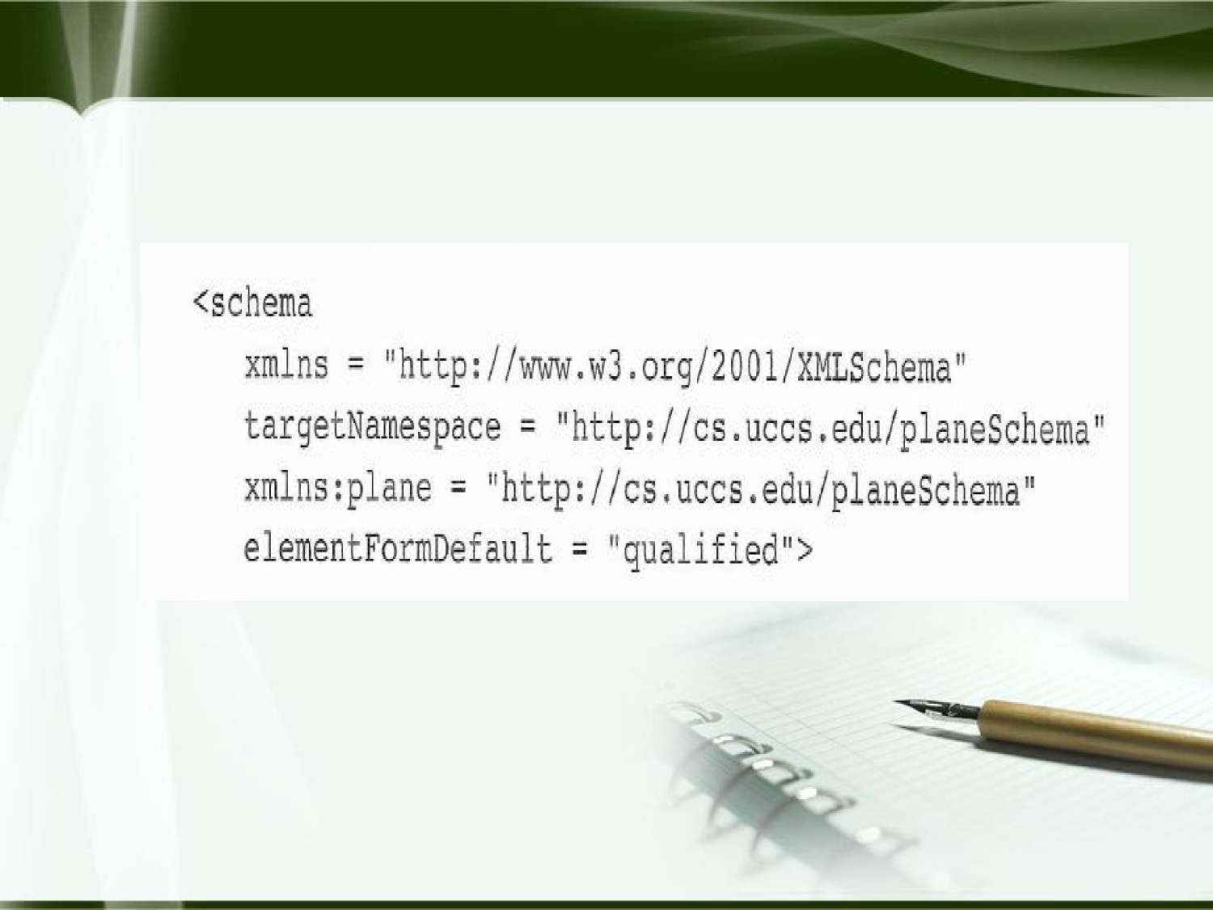
Schema Example

Slide 84
3. Defining a Schema Instance
An instance of a schema must include specifications of the
namespaces it uses. These are given as attribute in the root tag.
The xmlns attribute declares a namespace for an element and its
descendants
<element xmlns[:prefix]=“URI”>
The element itself may not be in the namespace
Multiple elements may be defined
The attribute, schemaLocation is used to name the standard namespace for instances.
Which takes two values: the namespace of the schema and the file name of the schema. Both separated by space.

Slide 85
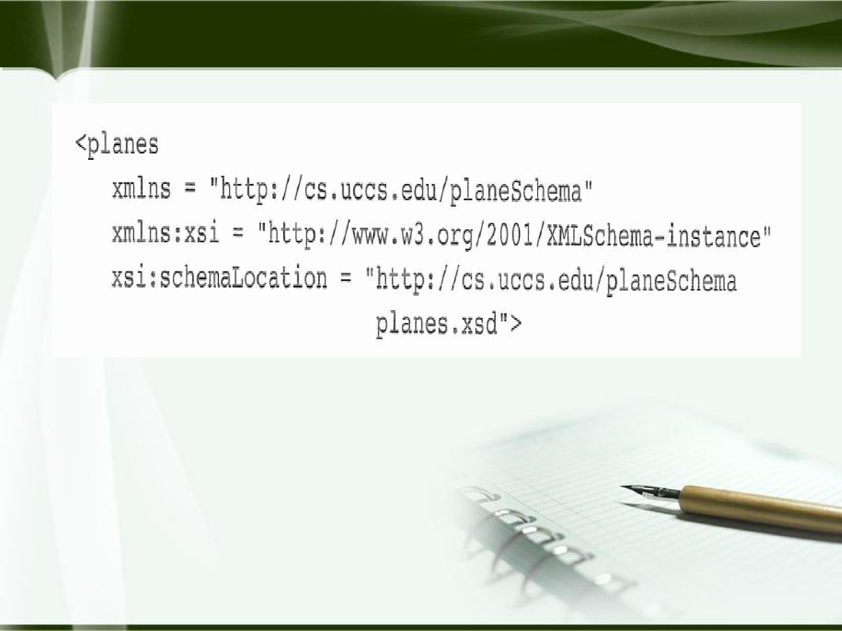
Example: XML Instance

Slide 86
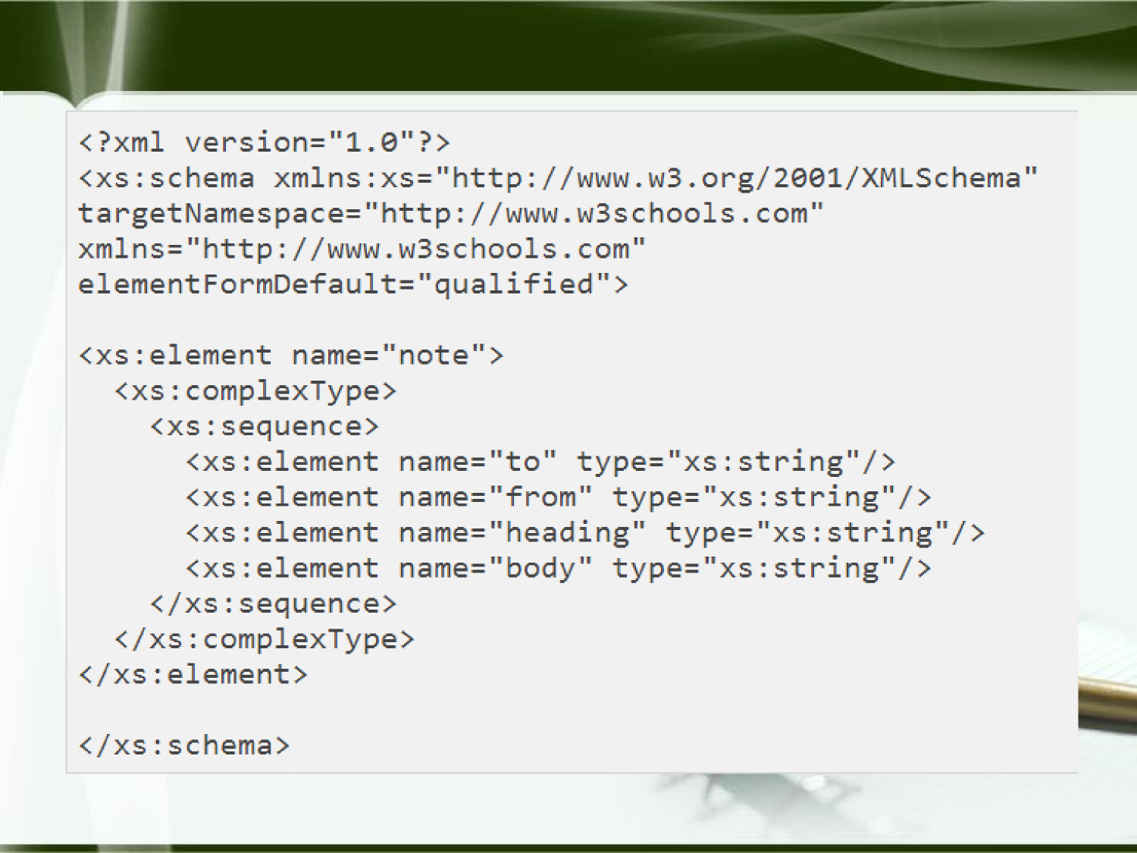
XML Schema Example. Note.xsd

Slide 87
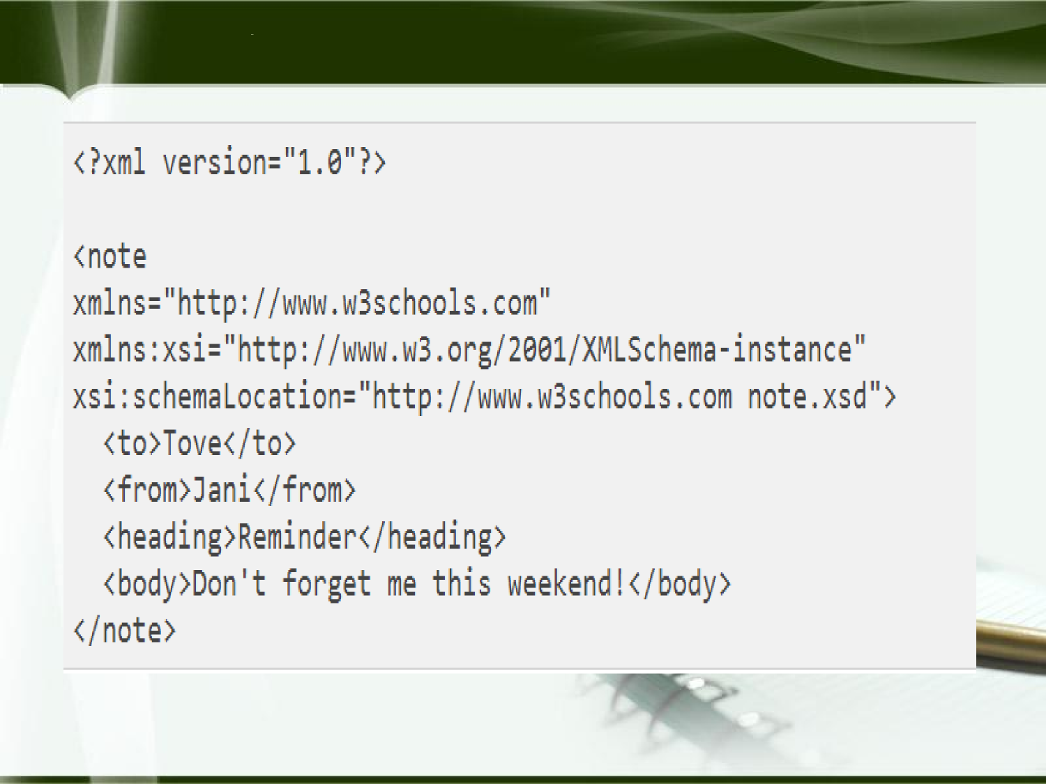
A Reference to an XML Schema

Slide 88
Data Types
Simple Data types – its content is restricted to string. This cannot have nested attributes or nested elements.
Complex Data types – can have attributes and include other data types as elements.

Slide 89
Simple type
Elements are defined in an XML schema with the <element> tag, which is from the XMLSchema namespace.
Attributes of <element>
Name – name of the element to be added
Type – type of the content allowed in element
Default – supply default value
Fixed – constant values are given
Eg- <xsd: element name=“engine” type=“xsd:string” fixed=“single wing”/>
<engine> single wing </engine>

Slide 90
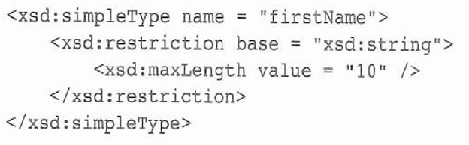
• A simple user defined data type is described in a <simpleType>
element.
The constrains in derived types are given in terms of the facets
of the basic type
Facets must be specified in the content of restriction element

Slide 91
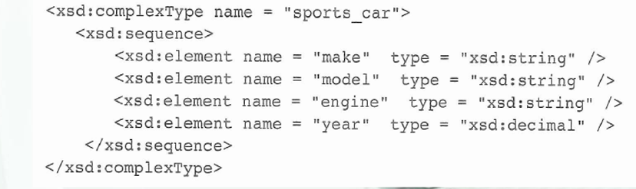
Complex Type
Complex type are defined with the <complexType> tag.
The sequence element is used to contain an ordered group of elements
A complex type whose elements are an unordered group is defined in an all element .

Slide 92
XML NAMESPACE
XML Namespaces provide a method to avoid element name conflicts.
In XML, element names are defined by the developer. This often results in a conflict when trying to mix XML documents from different XML applications.
This XML carries HTML table information:
<table>
<tr>
<td>Apples</td> <td>Bananas</td>
</tr>
</table>
This XML carries information about a table (a piece of furniture):
<table>
<name>African Coffee Table</name> <width>80</width>
<length>120</length>
</table>

Slide 93
If these XML fragments were added together, there would be a name conflict. Both contain a <table> element, but the elements have different content and meaning.
An XML parser will not know how to handle these differences.
DTDs do not support namespaces very well.
Namespaces can be declared in the elements where they are used or in the XML root element
The purpose is to give the namespace a unique name.

Slide 94
Solving the Name Conflict Using a Prefix
Name conflicts in XML can easily be avoided using a name prefix.
This XML carries information about an HTML table, and a piece of furniture:
<h:table>
<h:tr>
<h:td>Apples</h:td>
<h:td>Bananas</h:td>
</h:tr>
</h:table>

Slide 95
<f:table>
<f:name>African Coffee Table</f:name>
<f:width>80</f:width>
<f:length>120</f:length>
</f:table>
In the example above, there will be no conflict because the two <table> elements have different names.

Slide 96
XML Namespaces - The xmlns Attribute
The namespace declaration for an element has the following syntax-
<element_name xmlns[:prefix]="URI“ >

Slide 97
Namespaces can be declared in the elements where they are used or in the XML root element:
<root xmlns:h="http://www.w3.org/TR/html4/"
xmlns:f="http://www.w3schools.com/furniture">
<h:table>
<h:tr>
<h:td>Apples</h:td>
<h:td>Bananas</h:td>
</h:tr>
</h:table>
<f:table>
<f:name>African Coffee Table</f:name>
<f:width>80</f:width>
<f:length>120</f:length>
</f:table>
</root>

Slide 98
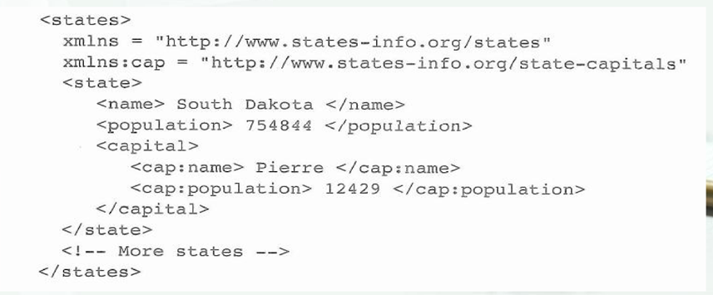
Default Namespaces
In any namespace declaration one of the namespace can be specified as default
Defining a default namespace for an element saves us from using prefixes in all the child elements. It has the following syntax:
xmlns="namespaceURI“

Slide 99
XSLT Style Sheets
eXtensible Style sheet language (XSL)
A family of specifications for transforming XML documents. It consist of three standards:
XSLT: specifies how to transform documents(xml to xhtml)
XPath: specifies how to select parts of a document and compute values like to find an element that has a particular value
XSL-FO: specifies a target XML language describing the printed page
XSLT describes how to transform XML documents into other XSL documents such as XHTML
XSLT can be used to transform to non-XML documents as well

Slide 100
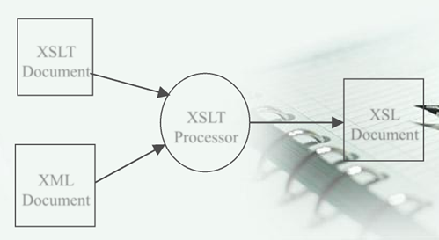
Overview of XSLT
A functional style programming language
The XSLT document is the program to be executed and XML document is the input data to the program.
An XSLT processor takes an XML document and XSLT document as input and produces output based on the specifications of an XSLT document ie XSL document.
XSL Document/output document can be stored for further use by other applications or can be immediately displayed on browser

Slide 101
XSLT Structure
An XSLT document contains templates XPath is used to specify patterns of elements to which the
templates should apply
The content of a template specifies how the matched element should be processed.
Each template has a section of XSLT “code” which is “executed” when match to the template is found in the XML document.
The XSLT processor will look for parts of the input document that match a template and apply the content of the template when a match is found
Two models
Template-driven -*works with highly regular data
Data-driven -* works with more loosely structured data with a irregular & recursive structure

Slide 102
XSL Transformations for Presentation
One of the most common applications of XSLT is to transform an XML document into an XHTML document for display
1. A XSLT style sheet can be associated with an XML document by using a processing instruction
<?xml-stylesheet type=“text/xsl” href=“stylesheet-name”?>
The example xslplane.xml is an xml file with data about a single plane. The file is linked to the style sheet xslplane.xsl

Slide 103
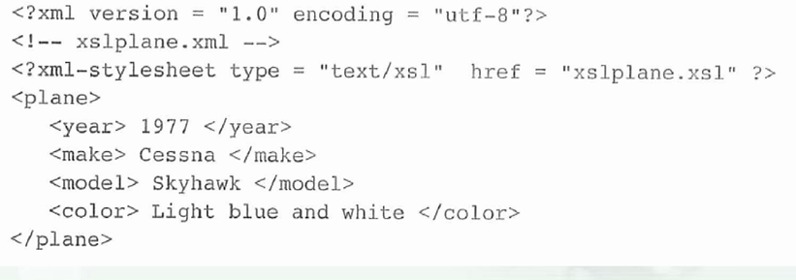

Slide 104
XSLT Organization
Root element of XSLT is <stylesheet > Specifies namespaces for XSL and for non-XSLT elements included in the stylesheet that defines the transformation.
<xsl:stylesheet xmlns:xsl =
"http://www.w3.org/1999/XSL/Format"
xmlns = "http://www.w3.org/1999/xhtml">
Elements in XSLT itself will have the prefix xsl:
Elements from XHTML will have no prefix (default namespace)

Slide 105
3. XSLT Templates
There must be at least one <template> element in an style sheet
The template opening tag includes a match attribute .
The value of the match attribute is an XPath expression which specifies to which nodes the template applies
Two standard choices for the match expression of the first template
‘/’ to match the root node of the entire document structure
‘root-tag’ to match the root element of the document
The first template is applied automatically
All other templates are applied only in response to
<apply-template> elements

Slide 106
4. Xpath Node Selection
An XPath expression beginning with a / specifies nodes in an absolute position relative to the document root node
Otherwise, the expression specifies nodes relative to the current node, that is the node being processed before the matched node
<xsl:template match=“year”>
The expression ‘.’ refers to the current node
The <apply-templates> or <template> tag uses the select attribute to choose which nodes should be matched to templates <template> tag includes two kind of elements
Those that contains the content
Those that specify the content to be copied from XML document

Slide 107
5. Producing Transformation Output
Elements not belonging to XSLT and other text will be copied to the output when the containing template is applied
The <value-of> tag causes the select attribute value to be evaluated and the result is put into the output
The value of an element is the text contained in it and in sub-elements
The value of an attribute is the value
Example xslplane.xsl transforms the xslplane.xml file into XHTML for display purposes
If the style sheet is in the same directory as the XML file,
some browsers will pick up the transformation and apply it

Slide 108
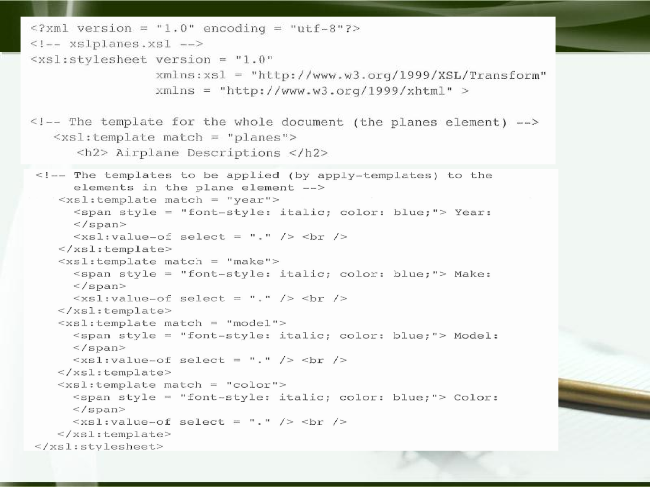

Slide 109
Processing Repeated Elements
File xslplanes.xml contains data about multiple airplanes
The style sheet xslplanes.xsl uses a <for-each> element to process each plane element in the source document
A sort element could be included to sort output
The element
<xsl:sort select=“year” data-type=“number”/>
Specifies sorting by year (numeric)
Sorted as text
<xsl:sort select=“year” data-type=“text”/>

Slide 110
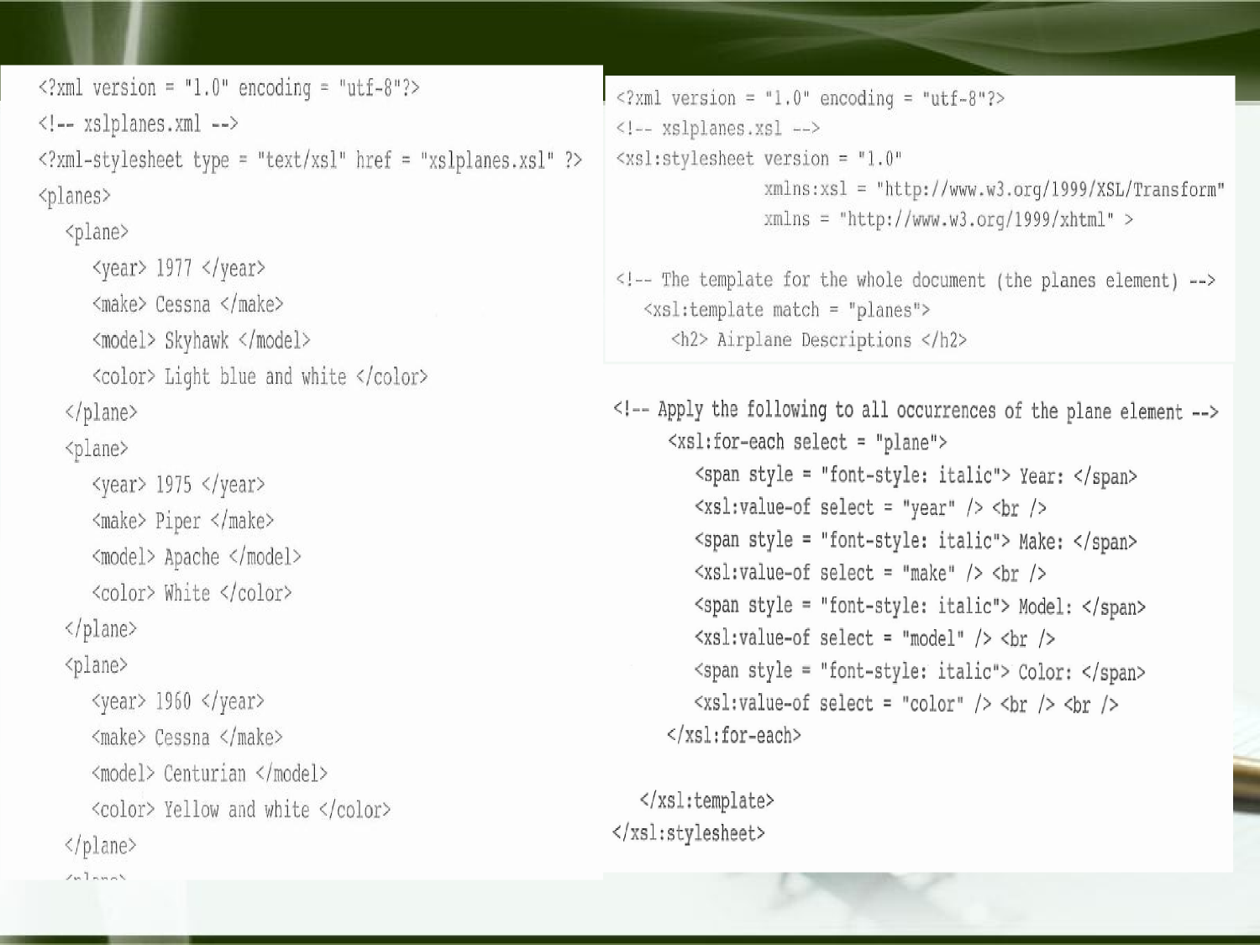

Slide 111
STORING XML DATA IN HTML DOCUMENT
Data island:
An XML data island is Extensible Markup Language (XML) embedded in an HTML document.
The data can be located in external XML files or internally coded.
In an external data island, data and presentation of data are being seperated(xml and html).
The HTML element xml is used to embed XML in HTML documents.
Data islands are created by assigning an ID attribute to the xml tag.

Slide 112
The example below creates a data island using an external XML file. The source src attribute specifies the data file location.
<xml id="customers" src="customers.xml”>
The following example creates an internal data island in a simplified HTML document.
<html><body>
<xml id="customers">
<customer>
<name>Font Factory</name>
<name>BeBop Grafix</name>
</customer>
</xml></body></html>

Slide 113
IE's XML parser creates a data island from an XML document by storing the data as a Data Source Object (DSO). Interactions between data islands and the Web page are controlled by the DSO.

Slide 114
DISPLAYING XML DATA IN HTML BROWSER AS HTML TABLES
Binding tables for display purposes:
One of the most powerful features of binding data islands is the ability to bind HTML tables.
The element attributes datasrc, datafld, dataformats, and datapagesize allow IE (Internet Explorer) to display bound data.
The datasrc attribute specifies the data island source with a URI.
The datafld attribute specifies elements in the XML data source.
The datasrc attribute links an HTML element to a DSO. The attribute property specifying the unique identifier of a DSO must be prefixed by a number sign (#).

Slide 115
The datafld attributes reference specific elements in the XML data source. The following syntax is required:
<tag datasrc="#id" datafld="field_name">
The datasrc attribute can be used with the following elements: a, applet, button, div, frame, iframe, img, label, marquee, select, span, table, textarea, and the input tags (types button, checkbox, hidden, image, password, radio, and text).

Slide 116
//catalogs.xml
<?xml version="1.0"?>
<PCS>
<PC>
<NAME>Zenith</NAME>
<CAPACITY>100</CAPACITY>
<PRICE>20000</PRICE>
</PC>
<PC>
<NAME>DELL</NAME>
<CAPACITY>200</CAPACITY>
<PRICE>40000</PRICE>
</PC>

Slide 117
<PC>
<NAME>Acer</NAME>
<CAPACITY>300</CAPACITY>
<PRICE>35000</PRICE>
</PC>
</PCS>

Slide 118
//catalog1.html
<html>
<body>
<xml id="PCS" src="catalogs.xml">
</xml>
<table datasrc="#PCS" border="1" align="center">
<thead><th>Name</th><th>Capacity</th><th>Price</th></thead>
<tr><td><div datafld="NAME"></td>
<td><div datafld="CAPACITY"></td>
<td><div datafld="PRICE"></td>
</tr>
</table>
</body></html>
This table row is declared to contain three table cells .The datafld attribute is used to specify the name of the data field each cell will contain.

Slide 119
Name Capacity Price
Zenith 100 20000
DELL 200 40000
Acer 3oo 35000

Slide 120
Example 2
Product.xml
<?xml version="1.0" ?>
<Products>
<Item>
<Name>Coffee Cup Warmer</Name>
<Number>0001</Number>
<Price>15.00</Price>
</Item>
<Item>
<Name>42 Cup Coffee Brewing System</Name>
<Number>0015</Number>
<Price>473.00</Price>
</Item></Products>

Slide 121
In the following html document(saved as filename.html), external data island is used(product.xml)
<HTML>
<HEAD>
<TITLE>Show XML In Your HTML</TITLE>
</HEAD>
<BODY>
<XML ID="MyProducts" SRC="Product.xml"></XML>
<TABLE DATASRC="#MyProducts" BORDER="1">
<THEAD>
<TH>Item Name</TH>
<TH>Item Number</TH>
<TH>Price</TH>
</THEAD>

Slide 122
<TR>
<TD><Span DATAFLD="Name"/></TD>
<TD><SPAN DATAFLD="Number"/></TD>
<TD><SPAN DATAFLD="Price"/></TD>
</TR>
</TABLE>
</BODY>
</HTML>

Slide 123
Item Name | Item Number | Price
Coffee Cup Warmer | 0001 | 15.00
42 Cup Coffee Brewing System | 0015 | 473.00

Slide 124
DISPLAY HIERARCHICAL XML AS NESTED TABLES
Step1: create c1.xml
<?xml version="1.0"?>
<PCS><PC>
<NAME>Zenith</NAME>
<CAPACITY>
<RAM>10</RAM>
<DISK>200</DISK></CAPACITY>
<PRICE>20000</PRICE>
</PC>
<PC>
<NAME>DELL</NAME>
<CAPACITY><RAM>20</RAM>
<DISK>300</DISK></CAPACITY>
<PRICE>40000</PRICE>
</PC>
</PCS>

Slide 125
Step2: create the c1.html with the following content
<html><body>
<xml id="x" src="c1.xml"/>
<table datasrc="#x" border="1" align="center“ width=300>
<thead>
<th>Name</th>
<th>Capacity</th>
<th>Price</th>
</thead>

Slide 126
<tr><td><div datafld="NAME"></td>
<td>
<table datasrc="#x" datafld="CAPACITY" border="1" align="center" width=150>
<thead><th>RAM</th>
<th>DISK</th>
</thead>
<tr>
<td><div datafld="RAM"></td>
<td><div datafld="DISK"></td>
</tr>
</table>
</td><td><div datafld="PRICE"></td>
</tr>
</table>
</body></html>

Slide 127
