Slide 1

Chapter 2
Introduction to
XHTML

Slide 2
2.1 Origins and Evolution of HTML
HTML is a language for describing web pages. It uses markup tags to describe web pages .
HTML was defined using Standard Generalized Markup Language(SGML) which is an ISO standard notation for describing text – formatting languages.
SGML does not specify any particular formatting, rather it specifies the rules for tagging elements.
Original intent of HTML: General layout of documents that could be displayed by a wide variety of computers.

Slide 3
HTML Versions
Since the early days of the web, there have been many versions of HTML:
Version Year
HTML 1991
HTML 2.0 1995
HTML 4.0 1997
HTML 4.01 1999
XHTML 1.0 2000
XHTML 1.1 2001
HTML 5 2014

Slide 4
Reasons to use XHTML, rather than HTML:
  HTML has lack syntax rules, leading to careless and sometime ambiguous documents
  – XHTML syntax is much more strict, leading to clean and clear documents in a standard form
  HTML processors(browsers) do not even enforce the few syntax rule that do exist in HTML
  The syntactic correctness of XHTML documents can be validated.
Basic Syntax
Elements are defined by tags
  Tag format:
    Opening tag: <name>
    Closing tag: </name>
    - Most tags appear in pairs
  The opening tag and its closing tag together specify a container for the content they enclose

Slide 5
Basic Syntax (continued)
Not all tags have content
  If a tag has no content, its form is <name />
The container and its content together are called an element.
If a tag has attributes, they appear between its name and the right bracket of the opening tag
<a href="default.html"> this is a link </a>
Comment form: <!-- … -->
Comments increases the readability of programs.
Browsers ignore comments, unrecognizable tags, line breaks, multiple spaces, and tabs.
Tags are suggestions to the browser, even if they are recognized by the browser.

Slide 6
HTML Document structure
<!DOCTYPE html>
<html> <! -- defines the whole HTML document -- >
<head> <!--information about the page -->
<title>Page Title </title>
</head>
<body> <! -- defines the body of the HTML doc. -- >
page contents
</body>
</html>
The header describes the page and the body contains the page's contents
An HTML page is saved into a file ending with extension .html

Slide 7
XHTML
eXtensible Hypertext Markup Language

Slide 8
XHTML is in many ways similar to HTML, but is designed to work with the new eXtensibleMarkup Language, or XML.
XML is a structured set of rules for how one might define any kind of data to be shared on the web .
Features of XHTML
* XHTML elements must be properly nested
* XHTML requires strict adherence to coding rules
XHTML elements must always be properly closed
* XHTML elements must be in lowercase
* XHTML documents must have one root element
* Attribute names must be in lower case

Slide 9
XHTML Document Structure
Every XHTML document must begin with:
  <?xml version = ″1.0″ encoding =“utf-8”?>
  <!DOCTYPE html PUBLIC ″-//w3c//DTD XHTML 1.1//EN″
  http://www.w3.org/TR/xhtml11/DTD/xhtml11.dtd>
<html>, <head>, <title>, and <body> are required in every document
The whole document must have <html> as its root
html must have the xmlns attribute:
<html xmlns = ″http://www.w3.org/1999/xhtml″>
A document consists of a head and a body .
The <title> tag is used to give the document a title, which is normally displayed in the browser’s window title bar (at the top of the display)

Slide 10
DOCTYPE and xmlns
The purpose of DOCTYPE is to declare to browsers exactly what version of HTML was used to create the document.
It represents the Document Type Declaration (DTD), which defines the version of HTML used on the page.
 The general DOCTYPE declaration for HTML 4.0 is
 <! DOCTYPE HTML PUBLIC “-//W3C//DTD HTML 4.0 // EN”>
 The reason for the EN is that the HTML specification has not yet been developed in any language but English.
In HTML5 it is <! DOCTYPE html>
The XML namespace identifies the range of tags used by the XHTML document.

Slide 11
Basic Text Markup
Describes how the text content of an XHTML document can be
formatted with XHTML tags
Paragraphs
Line Breaks
Preserving white space
Headings
Block Quotes
Font styles & size
Character Entities
Horizontal Rules
Meta Element

Slide 12
Basic Text Markup
Text is normally placed in paragraph elements
1 .Paragraph Elements
  The <p> tag breaks the current line and inserts a blank line - the new line gets the beginning of the content of the paragraph
  The browser puts as many words of the paragraph’s content as will fit in each line
  <?xml version = ″1.0″ encoding= “utf-8”?>
  <!DOCTYPE html PUBLIC ″-//w3c//DTD XHTML 1.1//EN″
  http://www.w3.org/TR/xhtml11/DTD/xhtml11.dtd>
  <!-- greet.html
  A trivial document
  -->
  <html xmlns = ″http://www.w3.org/1999/xhtml″>
  <head> <title> Our first document </title>
  </head>
  <body>
  <p>
  Greetings from your Webmaster!
  </p>
  </body>
  </html>

Slide 13
2.4 Basic Text Markup (continued)
2.Line breaks
  The effect of the <br /> tag is the same as that of <p>, except for the blank line
  It can have no content therefore no closing tag!
Example of paragraphs and line breaks
  <p>
  Mary had a little lamb, <br />
  its fleece was white as snow.
  </p>
Typical display of this text:
  Mary had a little lamb,
  its fleece was white as snow.

Slide 14
3.Preserving whitespaces
To preserve white spaces in text
Text in a <pre> element preserves both spaces and line breaks. </pre>
It blocks the browser from eliminating multiple spaces
<p><pre>
Mary
had a
little
lamb
</pre></p>
Display(output)
Mary
had a
little
lamb

Slide 15
4. Headings
  Six sizes, 1 - 6, specified with <h1> to <h6>
  1, 2, and 3 use font sizes that are larger than the default font size
  4 uses the default size
  5 and 6 use smaller font sizes
<!-- headings.html
An example to illustrate headings
-->
<html xmlns = ″http://www.w3.org/1999/xhtml″>
<head> <title> Headings </title>
</head>
<body>
<h1> Aidan’s Airplanes (h1) </h1>
<h2> The best in used airplanes (h2) </h2>
<h3> "We’ve got them by the hangarful" (h3)
</h3>
<h4> We’re the guys to see for a good used
airplane (h4) </h4>
<h5> We offer great prices on great planes
(h5) </h5>
<h6> No returns, no guarantees, no refunds,
all sales are final (h6) </h6>
</body>
</html>

Slide 16
2.4 Basic Text Markup (continued)

Slide 17
5.Blockquotes
  The Content of <blockquote> can be made to look different from the surrounding text
  set a block of text off from the normal flow and appearance of text
  Browsers often indent, and sometimes italicize

Slide 18
<?xml version = "1.0" encoding = "utf-8"?><!DOCTYPE html PUBLIC "-//W3C//DTD XHTML 1.1//EN" "http://www.w3.org/TR/xhtmlll/DTD/xhtmlll,dtd">
<!-- blockquote.html
An example to illustrate a blockquote -->
<html xmlns = "http://www.w3.org/1999/xhtml"><head><title> Blockquotes </title></head>
<body>
<p>
Abraham Lincoln is generally regarded as one of the greatest presidents of the U.S. His most famous speech was delivered in Gettysburg, Pennsylvania, during the Civil War. This speech began with </p>

Slide 19
<blockquote><p>
"Fourscore and seven years ago our fathers brought forth on this continent, a new nation, conceived in Liberty, and dedicated to the proposition that all men are created equal.
</p>
<P>
Now we are engaged in a great civil war, testing whether that nation or any nation so conceived and so dedicated, can long endure."
</p>
</blockquote>
<p>
Whatever one's opinion of Lincoln, no one can deny the enormous and lasting effect he had on the U.S. </p>
</body></html>

Slide 20
Display of blockquote.html
Abraham Lincoln is generally regarded as one of the greatest presidents of the U.S. His most famous speech was delivered in Gettysburg, Pennsylvania, during the Civil War. This speech began with
"Fourscore and seven years ago our fathers brought forth on this continent, a new nation, conceived in Liberty, and dedicated to the proposition that all men are created equal.
Now we are engaged in a great civil war, testing whether that nation or any nation so conceived and so dedicated, can long endure."
Whatever one's opinion of Lincoln, no one can deny the enormous and lasting effect he had on the U.S.

Slide 21
6.Font Styles and Sizes (can be nested)
  Boldface - <b>
  Italics - <i>
  Larger - <big>
  Smaller - <small>

Slide 22
2.4 Basic Text Markup (continued)
  The <big> sleet <big> in <big> <i> Crete
  </i><br /> lies </big> completely </big>
  in </big> the street
  The sleet in Crete
  lies completely in the street
    These tags are not affected if they appear in the content of a <blockquote>, unless there is a conflict (e.g., italics)
  Superscripts and subscripts
    Subscripts with <sub>
    Superscripts with <sup>
  Example: x<sub>2</sub><sup>3</sup>
  Display: x₂³

Slide 23
There are few tags for fonts that are still in widespread use,called content based style tags.They are called content based because the tag indicates the particular kind of text that appear in their content
The emphasis tag- <em>=Most browsers use italics for such content
The strong tag -<strong>= Browsers often set the content of strong elements in bold
The <code> = used to specify a monospace font usually used for program code
cost = quantity * price

Slide 24
XHTML tags are categorized into two
1)Block
2)Inline
Block tags breaks the current line so that its content appears in a new line
Eg: heading and blockquote tag
Inline tags does not implicitly include a line break except <br />
Eg: <em> and <strong>
Inline versus block elements
  Block elements CANNOT be nested in inline elements

Slide 25
2.4 Basic Text Markup (continued)
7.Character Entities
- To include special characters
Char. Entity Meaning
& &amp; Ampersand
< &lt; Less than
> &gt; Greater than
” &quot; Double quote
’ &apos; Single quote
¼ &frac14; One quarter
½ &frac12; One half
¾ &frac34; Three quarters
° &deg; Degree
(space) &nbsp; Non-breaking space
8.Horizontal rules
  <hr />
  - used to separate the parts of a document from each other making the document easier to read by placing horizontal line between them.
  - causes a line break and draws a line across the screen

Slide 26
9. The meta element
The meta element (for search engines) Used to provide additional information about a document, with attributes, not content
Two attributes that are used to provide information are name and content
<meta name = “Title” content = “Don Quixote” />
<meta name = “Author” content = “Michael Cox” />
<meta name = “keywords” content = “novel, Spanish Literature” />
Web search engines use the information provided with the meta element to categorize the web documents in their indices
So if the author of a document seeks widespread exposure for the document ,one or more meta elements are included to ensure that it will be found by at least some web searches

Slide 27
2.5 Images
GIF (Graphic Interchange Format)
  8-bit color (256 different colors)
JPEG (Joint Photographic Experts Group)
  24-bit color (16 million different colors)
Both use compression, but JPEG compression is better
Images are inserted into a document with the <img />(inline tag) tag with the src attribute which specifies the file containing the image and alt , which specifies text to be displayed when it is not possible to display the image
  - The alt attribute is required by XHTML
    Purposes:
      Non-graphical browsers
      Browsers with images turned off
  <img src = "comets.jpg" alt = "Picture of comets" />
The <img> tag has 30 different attributes, including width and height (in pixels)
Portable Network Graphics (PNG)
  Relatively new
  Should eventually replace both gif and jpeg

Slide 28
2.5 Images (continued)
<!-- image.html
An example to illustrate an image
-->
<html xmlns = ″http://www.w3.org/1999/xhtml″>
<head> <title> Images </title>
</head>
<body>
<h1> Aidan's Airplanes </h1>
<h2> The best in used airplanes </h2>
<h3> "We've got them by the hangarful“</h3>
<h2> Special of the month </h2>
<p>
1960 Cessna 210 <br />
577 hours since major engine overhaul <br />
1022 hours since prop overhaul
<br /><br />
<img src = "c210new.jpg"
alt = "Picture of a Cessna 210"/>
<br />
Buy this fine airplane today at a
remarkably low price <br />
Call 999-555-1111 today!
</p>
</body>
</html>

Slide 29
2.5 Images (continued)

Slide 30
2.6 Hypertext Links
Hypertext is the essence of the Web!
Link is the convenient way for the browser user to get from one document to any logically related document.
A hypertext link acts as a pointer to some resource.
The resource can be an XHTML document anywhere on the web, or it may be another place in the same document or be a specific place (rather than the top) in some other document
A link is specified with the href (hypertext reference) attribute of <a> (the anchor tag)
<a> tag is inline tag
  The content of <a> is the visual link in the document (clickable link)
  Links are implicitly rendered in a different color than the surrounding text. Sometimes they undelined

Slide 31
2.6 Hypertext Links (continued)
<!-- link.html
An example to illustrate a link
-->
<html xmlns = ″http://www.w3.org/1999/xhtml″>
<head> <title> Links </title>
</head>
<body>
<h1> Aidan's Airplanes </h1>
<h2> The best in used airplanes </h2>
<h3> "We've got them by the hangarful"
</h3>
<h2> Special of the month </h2>
<p>
1960 Cessna 210 <br />
<a href = "C210data.html">
Information on the Cessna 210 </a>
</p>
</body>
</html>

Slide 32
2.6 Hypertext Links (continued)

Slide 33
2.6 Hypertext Links (continued)
If the target is not at the beginning of the document, the target spot must be marked
Target labels can be defined in many different tags with the id attribute, as in
  <h1 id = "baskets"> Baskets </h1>
  The value of the id attribute must be unique within the document
The link to an id must be preceded by a pound sign (#); If the id is in the same document, this target could be
  <a href = "#baskets"> What about baskets? </a>
If the target is in a different document, the document reference must be included
  <a href = "myAd.html#baskets”> Baskets </a>
Links can have images:
<a href = "c210data.html“>
<img src = "smallplane.jpg"
alt = "Small picture of an airplane " />
</a>

Slide 34
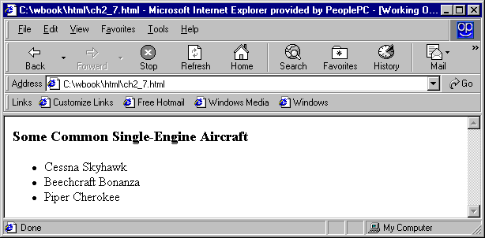
2.7 Lists
1. Unordered lists
Unordered list is represented using <ul> tag which is block tag.
Each item in a list is specified with the content of the <li> tag.
It can include nested lists.
When displayed each item is implicitly preceded with a bullet.
<h3> Some Common Single-Engine Aircraft </h3>
<ul>
<li> Cessna Skyhawk </li>
<li> Beechcraft Bonanza </li>
<li> Piper Cherokee </li>
</ul>
2. Ordered lists
Ordered lists are those in which the order of items is important
  Each item in the display is preceded by a sequence value
  The list is the content of the <ol> tag
  The default sequential values are Arabic numerals beginning with 1.

Slide 35
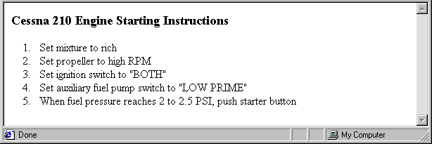
2.7 Lists (continued)
<h3> Cessna 210 Engine Starting Instructions </h3>
<ol>
<li> Set mixture to rich </li>
<li> Set propeller to high RPM </li>
<li> Set ignition switch to "BOTH" </li>
<li> Set auxiliary fuel pump switch to "LOW PRIME" </li>
<li> When fuel pressure reaches 2 to 2.5 PSI, push starter button </li>
</ol>
Nested lists
  Any type list can be nested inside any type list
  The nested list must be in a list item

Slide 36
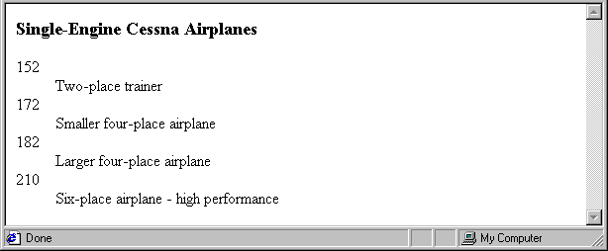
2.7 Lists (continued)
Definition lists (for glossaries, etc.-set of terms and their definitions)
  List is the content of the <dl> tag
  Terms being defined are the content of the <dt> tag
  The definitions themselves are the content of the <dd> tag
<h3> Single-Engine Cessna Airplanes </h3>
<dl >
<dt> 152 </dt>
<dd> Two-place trainer </dd>
<dt> 172 </dt>
<dd> Smaller four-place airplane </dd>
<dt> 182 </dt>
<dd> Larger four-place airplane </dd>
<dt> 210 </dt>
<dd> Six-place airplane - high performance
</dd>
</dl>

Slide 37
2.8 Tables
A table is a matrix of cells, each possibly having content
The cells can include almost any element
Some cells have row or column labels and some have data
A table is specified as the content of a <table> tag
A border attribute in the <table> tag specifies a border between the cells
If border is set to "border", the browser’s default width border is used
The border attribute can be set to a number, which will be the border width
Without the border attribute, the table will have no lines!
Tables are given titles with the <caption> tag, which can immediately follow <table> tag

Slide 38
2.8 Tables (continued)
Each row of a table is specified as the content of a <tr> tag
The row headings are specified as the content of a <th> tag
The contents of a data cell is specified as the content of a <td> tag
<body>
<table border = "border">
<caption> Fruit Juice Drinks </caption>
<tr>
<th> </th>
<th> Apple </th>
<th> Orange </th>
<th> Screwdriver </th>
</tr>
<tr>
<th> Breakfast </th>
<td> 0 </td>
<td> 1 </td>
<td> 0 </td>
</tr>
<tr>
<th> Lunch </th>
<td> 1 </td>
<td> 0 </td>
<td> 0 </td>
</tr>
</table>
</body>

Slide 39
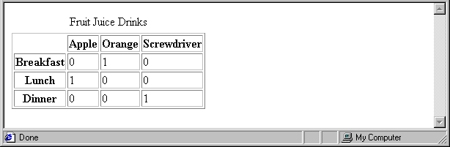
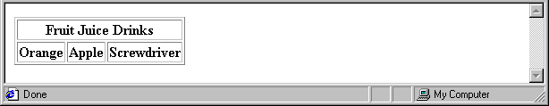
2.8 Tables (colspan)
A table can have two levels of column labels
  If so, the colspan attribute must be set in the <th> tag to specify that the label must span some number of columns
<tr>
<th colspan = "3"> Fruit Juice Drinks </th>
</tr>
<tr>
<th> Orange </th>
<th> Apple </th>
<th> Screwdriver </th>
</tr>

Slide 40
2.8 Tables (rowspan)
If the rows have labels and there is a spanning column label, the upper left corner must be made larger, using rowspan
<table border = "border">
<tr>
<td rowspan = "2"> </td>
<th colspan = "3"> Fruit Juice Drinks
</th>
</tr>
<tr>
<th> Apple </th>
<th> Orange </th>
<th> Screwdriver </th>
</tr>
…
</table>

Slide 41
2.8 Tables (align and valign Attributes)
The align attribute controls the horizontal placement of the contents in a table cell
  Values are left, right, and center
  align is an attribute of <tr>, <th>, and <td> elements
  The deafult alignment for th cells is center, for td cells , it is left.
  If the align attribute is specified in a <tr> tag it applies all the cells in the row. If it is included in a <th> or <td> tag , it only applies to that cell.
The valign attribute controls the vertical placement of the contents of a table cell
  Values are top, bottom, and center (default)
  valign is an attribute of <th> and <td> elements
  → SHOW cell_align.html and display it

Slide 42
<body>
<table border = “border”>
<caption>The align and valign attributes</caption>
<tr align = “center”>
<th> </th>
<th> Column Label </th>
<th> Another One </th>
<th> still Another One</th>
</tr>
<tr>
<th> align</th>
<td align = “left”> Left </td>
<td align = “center”> Center </td>
<td align = “right”> Right </td>
</tr>
<tr>
<th> valign </th>
<td>Default </td>
<td valign = “top”>Top </td>
<td valign= “bottom”>Bottom</td>

Slide 43
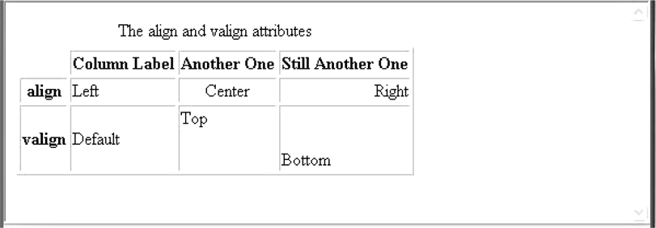

Slide 44
The cellpadding and cellspacing attributes
The cellspacing attribute of <table> is used to specify the distance between cells in a table
The cellpadding attribute of <table> is used to specify the spacing between the content of a cell and the inner walls of the cell.This is often used to prevent text in a cell from being to close to the edge of the wall.

Slide 45
cellspacing and cellpadding
<html xmlns = “http://www.w3.org/1999/xhtml”>
<head><title> Cell spacing and Cell padding</title></head>
<body>
<b>Table 1 (space = 10,pad = 30)</b><br /><br />
<table border = “5” cellspacing = “10” cellpadding = “30”>
<tr>
<td> Small spacing, </td>
<td> large spacing </td>
</tr>
</table>
<br /><br />
<b>Table 2(space=30 ,pad = 10)</b><br /><br />
<table border = “5” cellspacing = “30” cellpadding =“10”>
<tr>
<td>Large spacing, </td>
<td> small padding</td>
</tr></table></body></html>

Slide 46
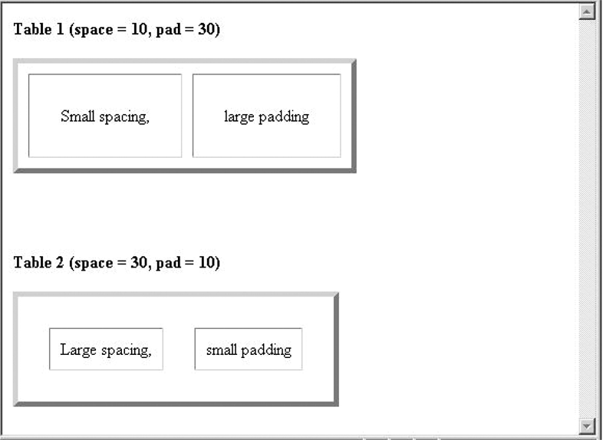

Slide 47
2.8 Tables (continued)
<table cellspacing = "50">
<tr>
<td> Colorado is a state of …
</td>
<td> South Dakota is somewhat…
</td>
</tr>
</table>
Table Sections
  Header, body, and footer, which are the elements: thead, tbody, and tfoot

Slide 48
2.9 Forms
A form is the usual way information is gotten from a browser to a server
HTML has tags to create a collection of objects that implement this information gathering
  The objects are called widgets or controls (e.g., radio buttons ,checkboxes,text ,password , reset, submit )
  All control tags are inline tags
  Most controls are used to gather information from the user in the form of either text or button selections
  Every form data requires submit button
When the Submit button of a form is clicked, the form data is encoded and are sent to the server for processing
1. The <form> Tag
All of the widgets, or components of a form are defined in the content of a <form> tag
  The only required attribute of <form> is action, which specifies the URL of the application on the web server that is to be called when the Submit button is clicked
  action = "http://www.cs.ucp.edu/cgi-bin/survey.pl"
    If the form has no action, the value of action is the empty string

Slide 49
2.9 Forms (continued)
The method attribute of <form> specifies one of the two possible techniques of transferring the form data to the server, get and post
The method attribute specifies how to send form-data to the server
Default is get
In both techniques the form data is coded into a text string when the user clicks the Submit button
2. The< input> tag
  Many of the commonly used controls such as text ,passwords checkboxes, Reset, Submit ,radio buttons etc. are created with the <input> tag
    The type attribute of <input> specifies the kind of widget being created such as checkbox, text, radio button etc
    All the previously listed controls except Reset and submit also require a name attribute which becomes the name of the value of the control within the form data.
    The controls for checkboxes and radio buttons require value attributes which initializes the value of the control

Slide 50
Textboxes as well as most other control elements should be labeled.
Labeling could be done by simply inserting text into the appropriate places in the form.
For eg:
Phone: <input type = “text” name = “phone” />
or
<label> Phone: <input type = “text”
name = “phone” /> </label>
Second method is better.
If the contents of the textbox should not be displayed when it is entered by the user, a password control can be used.
<input type= “password” name = “myPassword” size = “10” maxlength = “10” />
In this case, regardless of what characters are typed into a password control, only bullets or asterisks are displayed by the browser.

Slide 51
    Text
      - Text control is often used to gather information from the user such as the user’s name or address
      - Creates a horizontal box for text input
      - Default size is 20; it can be changed with the size attribute
      If more characters are entered than will fit, the box is scrolled (shifted) left
    <input type = "text" name = "Phone"
    size = “25“ />
  If you don’t want to allow the user to type more characters than will fit, set maxlength, which causes excess input to be ignored
    <input type = "text" name = "Phone"
    size = “25“ maxlength =“25” />

Slide 52
2.9 Forms (continued)
2. Checkboxes - to collect multiple choice input
  Every checkbox requires a name attribute and value attribute, which is the widget’s value in the form data when the checkbox is ‘checked’
    A checkbox that is not ‘checked’ (off) contribute no value to the form data
  By default, no checkbox is initially ‘checked’
  To initialize a checkbox to ‘checked’, the checked attribute of checkbox must be set to "checked"

Slide 53
2.9 Forms (continued)
Widgets (continued)
Grocery Checklist
<form action = "">
<p>
<input type = "checkbox" name ="groceries"
value = "milk" checked = "checked">
Milk
<input type = "checkbox" name ="groceries"
value = "bread">
Bread
<input type = "checkbox" name = "groceries"
value= "eggs">
Eggs
</p>
</form>
3. Radio Buttons – Closely related to checkbox buttons except that only one radio button can be ‘checked’ at a time
    Every button in a radio button group MUST have the same name

Slide 54
2.9 Forms (continued)
Widgets (continued)
3. Radio Buttons (continued)
  If no button in a radio button group is ‘pressed’, the browser often ‘presses’ the first one
Age Category
<form action = "">
<p>
<input type = "radio" name = "age"
value = "under20" checked = "checked"> 0-19
<input type = "radio" name = "age"
value = "20-35"> 20-35
<input type = "radio" name = "age"
value = "36-50"> 36-50
<input type = "radio" name = "age"
value = "over50"> Over 50
</p>
</form>

Slide 55
2.9 Forms (continued)
4. Menus - created with <select> tags
There are two kinds of menus, those that behave like checkboxes and those that behave like radio buttons (the default)
A menu is specified with <select> tag
The name attribute of <select> is required
The size attribute of <select> can be included to specify the number of menu items to be displayed (the default is 1)
  If size is set to > 1 or if multiple is specified, the menu is displayed as a pop-up menu

Slide 56
2.9 Forms (continued)
Widgets (continued)
Menus (continued)
  Each item of a menu is specified with an <option> tag, whose pure text content (no tags) is the value of the item
  An <option> tag can include the selected attribute, which when assigned "selected” specifies that the item is preselected
Grocery Menu - milk, bread, eggs, cheese
<form action = "">
<p>
With size = 1 (the default)
<select name = "groceries">
<option> milk </option>
<option> bread </option>
<option> eggs </option>
<option> cheese </option>
</select>
</p>
</form>

Slide 57
2.9 Forms (continued)
Widgets (continued)
After clicking the menu:
After changing size to 2:

Slide 58
2.9 Forms (continued)
5. Text areas - created with <textarea> Tag
- it is used when multiline text area is needed
  Usually include the rows and cols attributes to specify the size of the text area
  Default text can be included as the content of <textarea>
  Example
  <body> <p>
Please provide your employment aspirations
<form action = "">
<p>
<textarea name = "aspirations" rows = "3”
cols = "40">
(Be brief and concise)
</textarea>
</p>
</form>

Slide 59
2.9 Forms (continued)
Widgets (continued)
5. Reset and Submit buttons(The Action Buttons)
  Both are created with <input> tag.
<input type = "reset" value = "Reset Form">
<input type = "submit” value = "Submit Form">
Submit has two actions:
  Encode the data of the form and send to the server.
  Request that the server execute the server-resident program specified as the value of the action attribute of <form>
  A Submit button is required in every form
--> SHOW popcorn.html and display it

Slide 60
2.10 Frames
Frames are rectangular sections of the display window, each of which can display a different document
Because frames are no longer part of XHTML, you cannot validate a document that includes frames
The <frameset> tag specifies the number of frames and their layout in the window
  <frameset> takes the place of <body>
  Cannot have both in the same document
  <frameset> must have either a rows attribute or a cols attribute, or both (usually the case)
  The possible values for rows and cols are numbers, percentages, and asterisks
    A number value specifies the row height in pixels
    A percentage specifies the percentage of total window height for the row
    An asterisk after some other specification gives the remainder of the height of the window

Slide 61
2.10 Frames (continued)
  Examples:
  <frameset rows = "150, 200, 300">
  <frameset rows = "25%, 50%, 25%">
  <frameset rows = "50%, 20%, *" >
  <frameset rows = "50%, 25%, 25%" cols = "40%, *">
The <frame> tag specifies the content of a frame
The first <frame> tag in a <frameset> specifies the content of the first frame, etc.
  Row-major order is used
  Content of each frame is specified with the src attribute
  Without a src attribute, the frame will be empty (such a frame CANNOT be filled later)
If <frameset> has fewer <frame> tags than frames, the extra frames are empty

Slide 62
2.10 Frames (continued)
Scrollbars are implicitly included if needed (they are needed if the specified document will not fit)
If a name attribute is included, the content of the frame can be changed later (by selection of a link in some other frame)
→SHOW frames.html
Note: the Frameset standard must be specified in the DOCTYPE declaration

Slide 63
Frames.html
<?xml version = "1.0" encoding = "utf-8"?>
<!DOCTYPE html PUBLIC "-//W3C/DTD XHTML 1.0 Frameset//EN" "http://www.w3.org/TR/xhtmll/DTD/xhtmll-frameset.dtd">
<!— frames.html
An example to illustrate frames —>
<html xmlns = "http://www.w3.org/1999/xhtml"><head><title> Frames </title></head>
<frameset cols = "20%, *">
<frame src = "contents.html" />
<frame src = "fruits.html" name = "descriptions"/></frameset>
</html>

Slide 64
List of links to the fruit description document - contents.html
<?xml version = "1.0" encoding = "utf-8"?>
<!DOCTYPE html PUBLIC "-//W3C//DTD XHTML 1.0 Transitional//EN" "http://www.w3.org/TR/xhtmll/DTD/xhtmll-transitional.dtd">
<!— contents.html
The contents of the first frame of frames.html,
which is the table of contents for the second frame -->
<html>
<head><title> Table of Contents Frame </title>
</head>
<body>
<h4> Fruits </h4><ul>
<li><a href = "apples.html" target = "descriptions”> apples </a>
</li>
<li><a href = "bananas.html" target = "descriptions”> bananas </a>
</li>
<li><a href = "oranges.html" target = "descriptions”>oranges </a>
</li></ul></body></html>

Slide 65
Initial document displayed in the second frame-fruits.html
<?xml version = "1.0" encoding = "utf-8"?><!DOCTYPE html PUBLIC "-//W3C//DTD XHTML 1.1//EN" "http://www.w3.org/TR/xhtmlll/DTD/xhtmlll.dtd">
<!— fruits.html
The initial contents of the second frame
of frames.html - a general description of fruit -->
chtml xmlns = "http://www.w3.org/1999/xhtml">
<head><title> General Information on Fruits </title></head>
<body><p>
A fruit is the mature ovary in a flowering plant.a fruit is clssified by several characteristcs.
</p>
</body>
</html>

Slide 66
Nested frames - to divide the screen in more interesting ways
→ SHOW nested_frames.html

Slide 67
<?xml version = "1.0" encoding = "utf-8"?>
<!DOCTYPE html PUBLIC "-//W3C//DTD XHTML 1.0 Frameset//EN" "http://www.w3.org/TR/xhtml1/DTD/xhtml1-frameset.dtd">
<!— nested_frames.html An example to illustrate nested frames
<html xmlns = "http://www.w3.org/1999/xhtml"><head><title> Nested frames </title></head>
<frameset cols = "40%,*">
<frameset rows = "50%, *">
<frame src = "framel.html" /><frame src = "frame2.html" /></frameset>
<frameset rows = "20%, 35%, *"><frame src = "frame3.html" /><frame src = "frame4.html" /><frame src = "frame5.html" /></frameset></frameset></html>

Slide 68
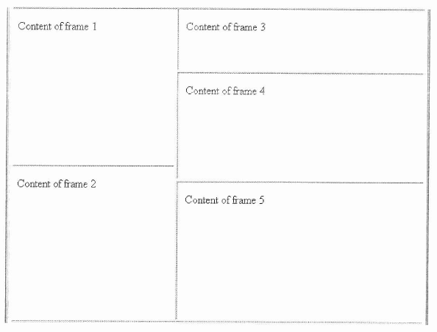

Slide 69
2.11 Syntactic Differences between HTML & XHTML
Case sensitivity
Closing tags
Quoted attribute values
Explicit attribute values
id and name attributes
Element nesting

