Slide 1
MODULE 2
Problem Solving Techniques

Slide 2
Syllabus
Problem Solving strategies – Problem analysis – formal definition of
problem – Solution – top- down design – breaking a problem into sub
problems- overview of the solution to the sub problems by writing step by
step procedure (algorithm) - representation of procedure by flowchart -
Implementation of algorithms – use procedures to achieve modularity. (This
part should initially look into problems in general instead of looking into
computer-solvable problems alone.)
Examples for algorithms and flow charts - at least 10 problems (starting
with non numerical examples, and numeric problems like factorial, largest
among three numbers, largest among N, Fibonacci etc.) must be discussed in
detail. (Class assignments and/or tutorials may be used to strengthen
understanding of this part. Chapters 4 and 5 of used for the teaching-learning process.)

Slide 3
Contents
Topic: Problem Solving Techniques
We will learn
      Problem Statement.
      Algorithm
        Types, Example
      Flowchart
        Symbols, Examples.

Slide 4
Problem:
Problem is an obstacle that hinders the achivement of a particular goal
Therefore to solve any problem,
Collect and analyze information and data
Talk with people familiar with the problem
If at all possible, view the problem first hand
Confirm all findings

Slide 5
Problem Solving
Problem Solving Steps:
1.Problem Definition
2.Problem Analysis
3.Algorithm & Flowchart Development
4.Coding or Programming
5. Testing or Debugging

Slide 6
Problem Definition
Must have a clear idea about the problem.this is done by answering following questions
1.What the computer program is expected to do?
2.What kind of data that it will use?
3.What processing has to be done with data?
4.What output does the user require?

Slide 7
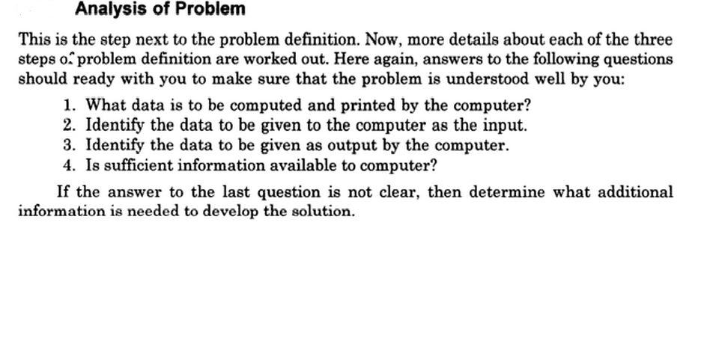
Problem Analysis

Slide 8
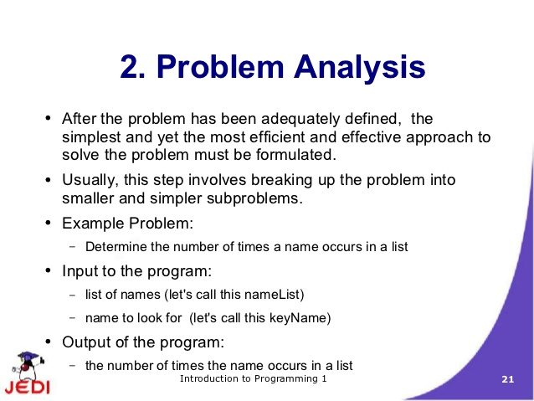

Slide 9
Algorithm
An algorithm is a procedure or formula for solving a problem.
Check the whether algorithm gives desired output

Slide 10
Flowchart:
What is a Flowchart?
The flowchart is a means of visually presenting the flow of control through an information processing systems, the operations performed within the system and the sequence in which they are performed.
It is a graphic representation of how a process works, showing, at a minimum, the sequence of steps.
Flowcharts are generally drawn in the early stages of formulating computer solutions.

Slide 11
CODING
Program coding is nothing but group of lines(instructions sets) in a language syntax which written correctly will produce a particular result.

Slide 12
Features of a good program
1. Readability: A good high-level language will allow programs to be written in some ways that resemble a quite-English description of the underlying algorithms. I
2. Portability: High-level languages, being essentially machine independent, should be able to develop portable software.
3. Brevity: Language should have the ability to implement the algorithm with less amount of code.
4. Error checking: Being human, a programmer is likely to make many mistakes in the development of a computer program. Many high-level languages enforce a great deal of error checking both at compile-time and at run-time.
5. Cost: The ultimate cost of a programming language is a function of many of its characteristics.
6. Familiar notation: A language should have familiar notation, so it can be understood by most of the programmers.
7. Modularity: It is desirable that programs can be developed in the language as a collection of separately compiled modules, with appropriate mechanisms for ensuring self-consistency between these modules.

Slide 13
Debugging
Debugging is a methodical process of finding and reducing the number of bugs, or defects, in a computer program thus making it behave as expected.

Slide 14
  PROMBLEM SOLVING
  TOP DOWN DESIGN
  MODULAR DEVELOPMENT

Slide 15
It’s easier to solve small problems than it is to solve big ones.
Computer programmers use a divide and conquer approach to problem solving:
a problem is broken into parts
those parts are solved individually
the smaller solutions are assembled into a big solution
These techniques are known as top-down design

Slide 16
Top-Down Design
Top-down design is the process of designing a solution to a problem by systematically breaking a problem into smaller, more manageable parts.

Slide 17
Top-Down Design
First, start with a clear statement of the problem or concept
– a single big idea.

Slide 18
Top-Down Design
Next, break it down into several parts.

Slide 19
Top-Down Design
Next, break it down into several parts.
If any of those parts can be further broken down, then the process continues…

Slide 20
Top-Down Design
… and so on.

Slide 21
Top-Down Design
The leaf nodes represent modules that need to
be developed and then recombined to create
the overall solution to
the original problem.
Top-down design leads to modular development.

Slide 22
Modular Development
Modular development is the process of developing software modules individually…

Slide 23
Modular Development
Modular development is the process of developing software modules individually…
…then combining the modules to form a solution to an overall problem.

Slide 24
Algorithms

Slide 25
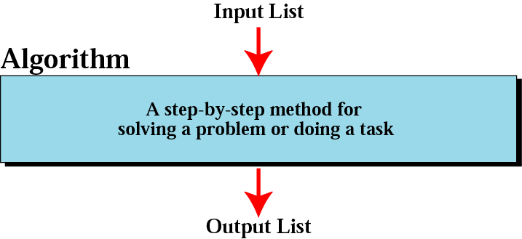
Informal definition of an algorithm
used in a computer

Slide 26
Algorithm to print hello world
Step 1:start
Step 2: Display “hello world”
Step 2:stop

Slide 27
Sum of two numbers
Step 1:start
Step 2 :Declare variables num1,num2,sum
Step 3:Read values num1 and num2
Step 4: Add num1 and num2 and assign result to sum
sum→num1+num2
Step 5:Display sum
Step 6:stop

Slide 28
Average of two numbers
Step 1:start
Step 2 :Declare variables num1,num2,avg
Step 3:Read values num1 and num2
Step 4: Add num1 and num2 and assign result to sum
Step5:Divide the result by 2
avg→(num1+num2)/2
Step 5:Display avg
Step 6:stop

Slide 29
Largest number
Step 1:start
Step 2 :Declare variables num1,num2,larg
Step 3:Read values num1 and num2
Step 4: if num1 is greater than num2
  then display num1 is larger
  else display num2 is larger
Step 5:stop

Slide 30
Sum of first n numbers
Step 1:start
Step 2 :Declare variables n ,count,sum
Step 3:Set variables count =1 and sum=0
Step 4:Read value of n
Step 5: Repeat steps 5.1 and 5.2 until count less than or equal to n
  Step 5.1 : sum→sum+count
  Step 5.2: count→count+1
Step 6:Display sum
Step 7:stop

Slide 31
THREE CONSTRUCTS

Slide 32
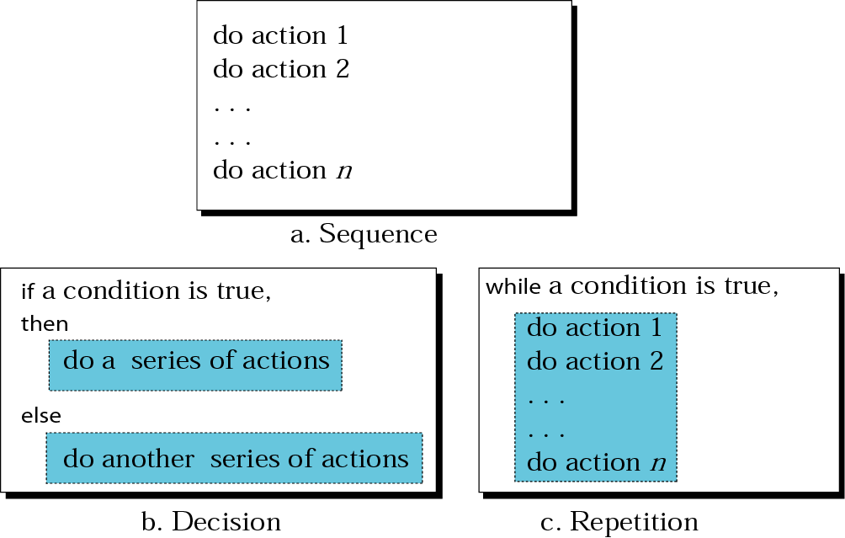
Three constructs

Slide 33
Try...
Write an algorithm
1.that will read the two sides of a rectangle and calculate its area.
2.to check whether a number is even or odd
3.to find factorial of a number
(n!=1*2*3*.....*n)
eg →5!=1*2*3*4*5=120

Slide 34
Factorial of a number
Step 1:start
Step 2 :Declare variables n ,count,fact
Step 3:Set variables count =1 and fact=1
Step 4:Read value of n
Step 5: Repeat steps 5.1 and 5.2 until count less than or equal to n
  Step 5.1 : fact→fact*count
  Step 5.2: count→count+1
Step 6:Display fact
Step 7:stop

Slide 35
Do...
Reverse a number
Prime or not
Fibonacci
Average heights of boys and girls in a class

Slide 36
Advantages of using an algorithm
Very easy to understand
Simple to implement
it has got a definite procedure.
it is independent of programming language.
it is easy to debug as every step is got its own logical sequence.
Intuitive approach of trial and error.
Code size is usually small.

Slide 37
Disadvantages of algorithm
Inefficient when there is lots of branching from one state.
Multiple function calls are expensive.
Requires large amount of space as the each function state needs to be stored.
it is time consuming & cumbersome as an algorithm is developed first which is converted into flowchart &then into a computer program.

Slide 38
Flowchart

Slide 39
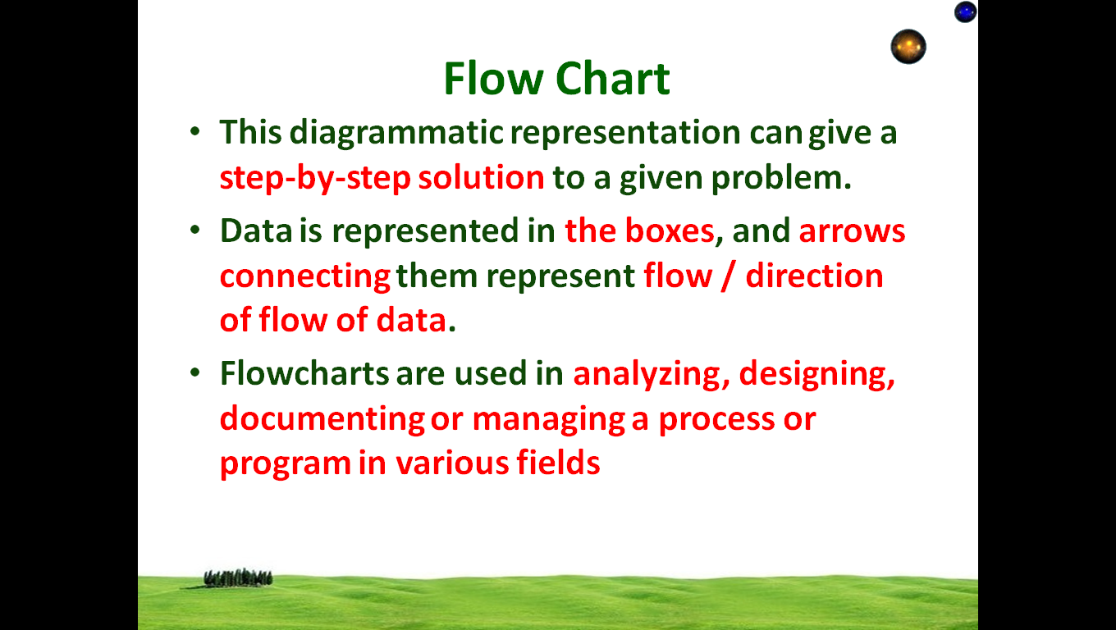

Slide 40
Flowchart (Contd…):
A set of useful standard Flowchart
symbols:
Rounded box
use it to represent an event which occurs automatically.
Rectangle or box
use it to represent an event which is controlled within the process. Typically this will be a step or action which is taken.
Diamond
use it to represent a decision point in the process.
Circle
use it to represent a point at which the flowchart connects with another process.

Slide 41
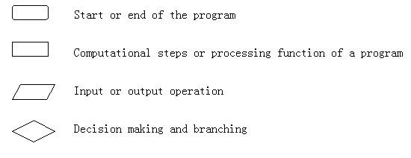
Guideline for drawing a flowchart:
Flowcharts are usually drawn using some standard symbols; Some standard symbols, which are frequently required for flowcharting many computer programs are shown below,-

Slide 42
Flowchart 1
START
A flowchart is a diagram that depicts the “flow of control” of a program.
Display message “Hello World”
STOP

Slide 43
Basic Flowchart Symbols
Rounded Rectangle
START
Display message “How many hours did you work?”
Notice there are three types of symbols in this flowchart:
  rounded rectangles
  parallelograms
  a rectangle
Each symbol represents a different type of operation.
Read Hours
Display message “How much do you get paid per hour?”
Parallelogram
Read PayRate
Multiply Hours by PayRate. Store result in GrossPay.
Rectangle
Display GrossPay
Rounded Rectangle
END

Slide 44
Basic Flowchart Symbols
START
Terminal
Display message “How many hours did you work?”
Terminals
  represented by rounded rectangles
  indicate a starting or ending point
Read Hours
Display message “How much do you get paid per hour?”
Read PayRate
Multiply Hours by PayRate. Store result in GrossPay.
START
Display GrossPay
END
Terminal
END

Slide 45
Basic Flowchart Symbols
START
Display message “How many hours did you work?”
Input/Output Operations
  represented by parallelograms
  indicate an input or output operation
Read Hours
Display message “How much do you get paid per hour?”
Input/Output Operation
Read PayRate
Multiply Hours by PayRate. Store result in GrossPay.
Display message “How many hours did you work?”
Read Hours
Display GrossPay
END

Slide 46
Basic Flowchart Symbols
START
Display message “How many hours did you work?”
Processes
  represented by rectangles
  indicates a process such as a mathematical computation or variable assignment
Read Hours
Display message “How much do you get paid per hour?”
Read PayRate
Multiply Hours by PayRate. Store result in GrossPay.
Multiply Hours by PayRate. Store result in GrossPay.
Process
Display GrossPay
END

Slide 47
Stepping Through the Flowchart
START
Display message “How many hours did you work?”
In the next seven slides we will step through each symbol in the flowchart. We will show the program output and the contents of the variables.
Read Hours
Display message “How much do you get paid per hour?”
Read PayRate
Multiply Hours by PayRate. Store result in GrossPay.
Variable Contents:
Hours: ?
PayRate: ?
GrossPay: ?
Display GrossPay
END

Slide 48
Stepping Through the Flowchart
START
Step 1: An Output Operation
Display message “How many hours did you work?”
How many hours did you work?
Screen Output
Read Hours
Display message “How much do you get paid per hour?”
Read PayRate
Multiply Hours by PayRate. Store result in GrossPay.
Variable Contents:
Hours: ?
PayRate: ?
GrossPay: ?
Display GrossPay
END

Slide 49
Stepping Through the Flowchart
START
Display message “How many hours did you work?”
How many hours did you work?
40
Step 2: An Input Operation
(User types 40)
Read Hours
Display message “How much do you get paid per hour?”
Read PayRate
Multiply Hours by PayRate. Store result in GrossPay.
Variable Contents:
Hours: 40
PayRate: ?
GrossPay: ?
The value 40 is stored in Hours.
Display GrossPay
END

Slide 50
Stepping Through the Flowchart
START
Display message “How many hours did you work?”
How much do you get paid per hour?
Screen Output
Read Hours
Display message “How much do you get paid per hour?”
Step 3: An Output Operation
Read PayRate
Multiply Hours by PayRate. Store result in GrossPay.
Variable Contents:
Hours: 40
PayRate: ?
GrossPay: ?
Display GrossPay
END

Slide 51
Stepping Through the Flowchart
START
Display message “How many hours did you work?”
How much do you get paid per hour? 20
Read Hours
Display message “How much do you get paid per hour?”
Step 4: Input Operation
(User types 20)
Read PayRate
Multiply Hours by PayRate. Store result in GrossPay.
Variable Contents:
Hours: 40
PayRate: 20
GrossPay: ?
The value 20 is stored in PayRate.
Display GrossPay
END

Slide 52
Stepping Through the Flowchart
START
Display message “How many hours did you work?”
How much do you get paid per hour? 20
Read Hours
Display message “How much do you get paid per hour?”
Step 5: The product of Hours times PayRate is stored in GrossPay
Read PayRate
Multiply Hours by PayRate. Store result in GrossPay.
Variable Contents:
Hours: 40
PayRate: 20
GrossPay: 800
Display GrossPay
The value 800 is stored in GrossPay.
END

Slide 53
Stepping Through the Flowchart
START
Display message “How many hours did you work?”
Your gross pay is 800
Screen Output
Read Hours
Display message “How much do you get paid per hour?”
Read PayRate
Multiply Hours by PayRate. Store result in GrossPay.
Variable Contents:
Hours: 40
PayRate: 20
GrossPay: 800
Step 6: An Output Operation
Display GrossPay
END

Slide 54
Three Flowchart Structures
Sequence
Selection
Iteration

Slide 55
Sequence Structure
A series of actions are performed in sequence
The pay-calculating example was a sequence flowchart.

Slide 56
Selection Structure
One of two possible actions is taken, depending on a condition.

Slide 57
Selection Structure
A new symbol, the diamond, indicates a yes/no question. If the answer to the question is yes, the flow follows one path. If the answer is no, the flow follows another path
NO
YES

Slide 58
Selection Structure
In the flowchart segment below, the question “is x < y?” is asked. If the answer is no, then process A is performed. If the answer is yes, then process B is performed.
NO
YES
x <y?
Process A
Process B

Slide 59
Selection Structure
The flowchart segment below shows how a decision structure of an if/else statement.
Flowchart
Code
NO
YES
if (x < y)
a = x * 2;
else
a = x + y;
x < y?
Calculate a as x plus y.
Calculate a as x times 2.

Slide 60
Iteration Structure
An iteration structure represents part of the program that repeats. This type of structure is commonly known as a loop.

Slide 61
Iteration Structure
Notice the use of the diamond symbol. A loop tests a condition, and if the condition exists, it performs an action. Then it tests the condition again. If the condition still exists, the action is repeated. This continues until the condition no longer exists.
YES
NO

Slide 62
Iteration Structure
In the flowchart segment, the question “is x < y?” is asked. If the answer is yes, then Process A is performed. The question “is x < y?” is asked again. Process A is repeated as long as x is less than y. When x is no longer less than y, the iteration stops and the structure is exited.
YES
x < y?
Process A
NO

Slide 63
Iteration Structure
The flowchart segment below shows an iteration structure e
Flowchart
Code
YES
while (x < y)
x++;
x < y?
Add 1 to x
NO

Slide 64
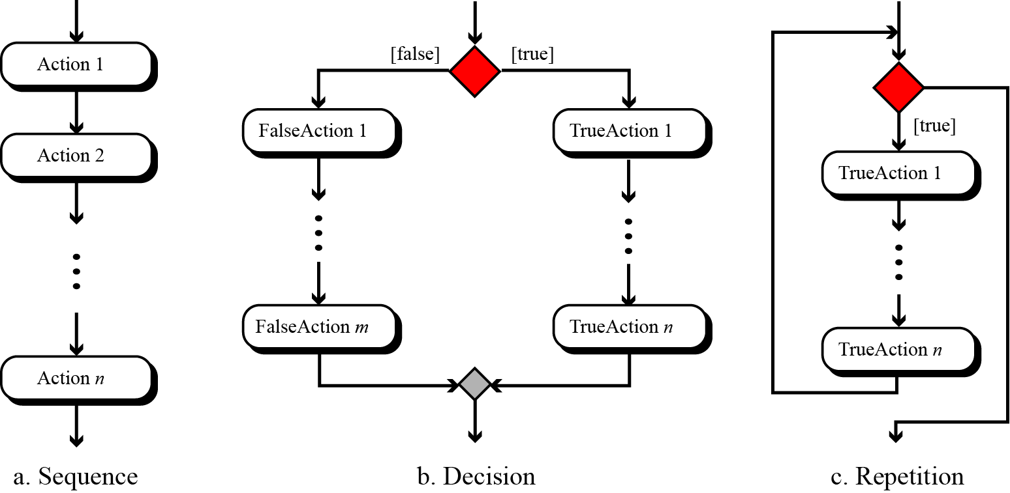
Figure : UML for three constructs

Slide 65
Connectors
Sometimes a flowchart will not fit on one page.
A connector (represented by a small circle) allows you to connect two flowchart segments.
A

Slide 66
Connectors
The “A” connector indicates that the second flowchart segment begins where the first segment ends.
START
A
END
A

Slide 67
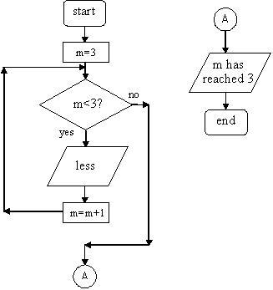
Connector eg

Slide 68
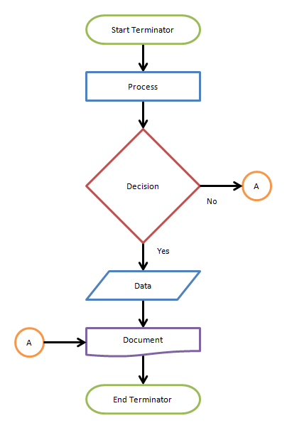
Connector eg

Slide 69
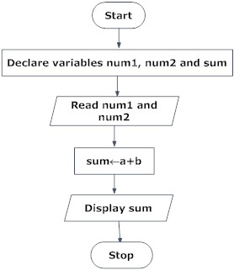
Sum of two numbers

Slide 70
Average of two numbers

Slide 71
Largest of two nos
START
READ NUM1,NUM2
IS NUM1>NUM2
NO
YES
Display num1
is greater
Display num2
is greater
STOP

Slide 72
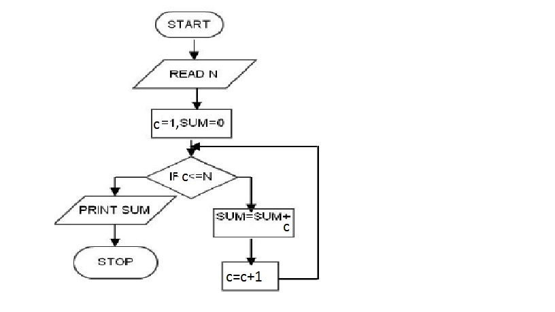
Sum of first n numbers
NO
YES

Slide 73
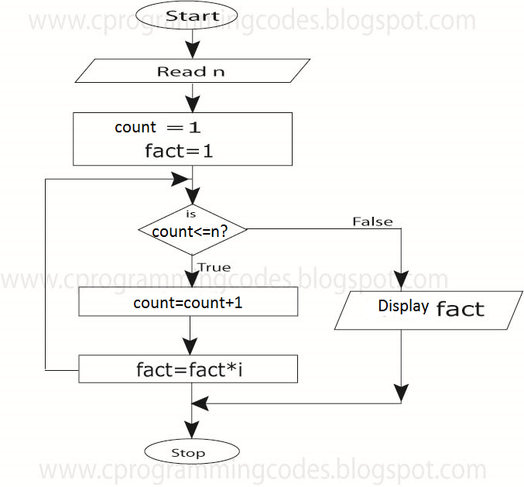
Factorial of a number

Slide 74
Try...
Draw flowchart
1.that will read the two sides of a rectangle and calculate its area.
2.to check whether a number is even or odd
3.to find factorial of a number
(n!=1*2*3*.....*n)
eg →5!=1*2*3*4*5=120

Slide 75
Do...
Reverse a number
Prime or not
Fibonacci
Average heights of boys and girls in a class

Slide 76
ADVANTAGES OF USING FLOWCHARTS:
Communication: Flowcharts are better way of communicating the logic of a system
Effective analysis: Problem can be analyzed in more effective way.
Proper documentation: Flowcharts serve as a good program documentation
Efficient Coding: Flowcharts act as a guide or blueprint during the systems analysis and program development phase.

Slide 77
ADVANTAGES OF USING FLOWCHARTS (Contd…):
Proper Debugging: Flowchart helps in debugging process.
Efficient Program Maintenance: The maintenance of operating program becomes easy with the help of flowchart.

Slide 78
LIMITATIONS OF USING FLOWCHARTS:
Complex logic: Sometimes, the program logic is quite complicated. In that case, flowchart becomes complex and clumsy.
Alterations and Modifications: If alterations are required the flowchart may require re-drawing completely.
Reproduction: As the flowchart symbols cannot be typed, reproduction of flowchart becomes a problem.

Slide 79
MORE ALGORITHMS & FLOWCHARTS

Slide 80
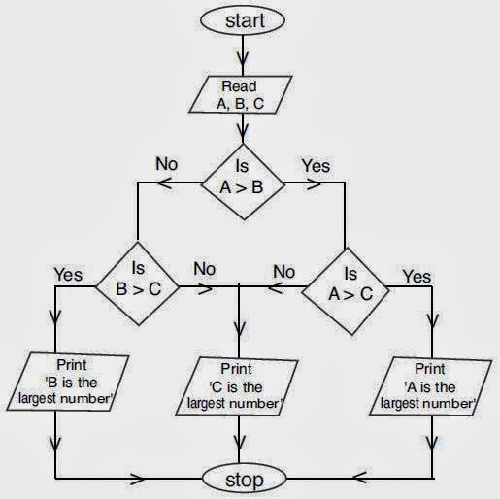
Largest of 3 nos--flowchart

Slide 81
Largest of 3 nos --algorithm
Step 1: Start
Step 2: Declare variables A,B,C
Step3: Read three numbers A, B, C
Step 4: Compare A with B
Step5: If A is larger compare it with C otherwise goto step 7
Step6: If A is larger than C then
display A is the largest, otherwise display C is the largest
and go to step 9
Step7: If A is smaller than or equal to B in the fourth step then B is compared with C.
Step8: If B is larger than C then
display B is the largest, otherwise display C is the largest
Step9: Stop

Slide 82
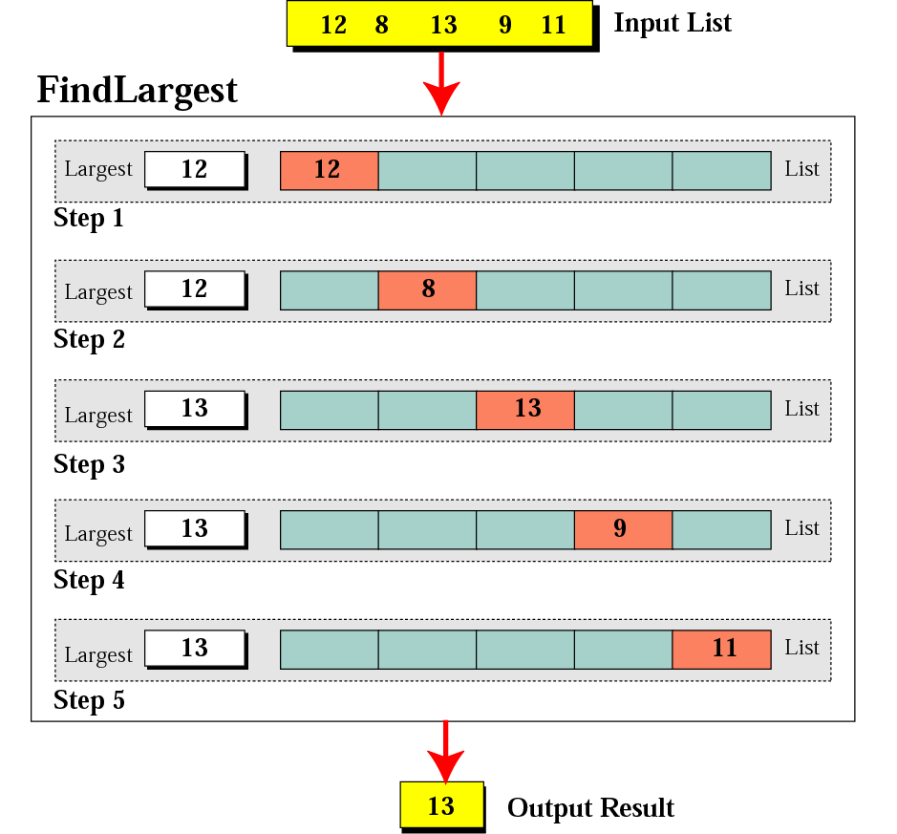
Figure 8-2
Finding the largest integer
among five integers

Slide 83
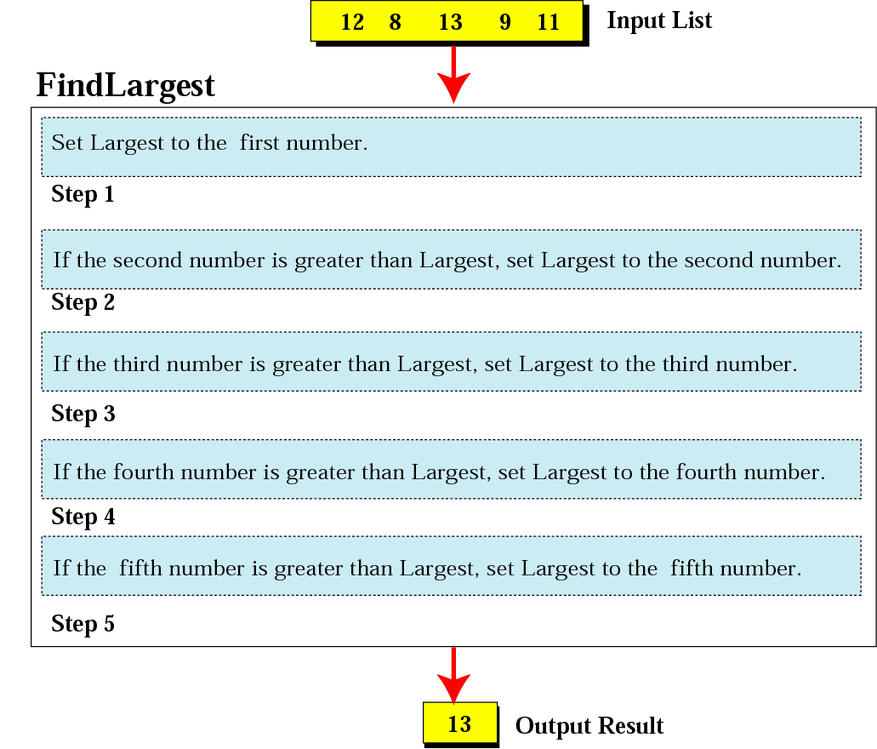
Figure 8-3
Defining actions in FindLargest algorithm

Slide 84
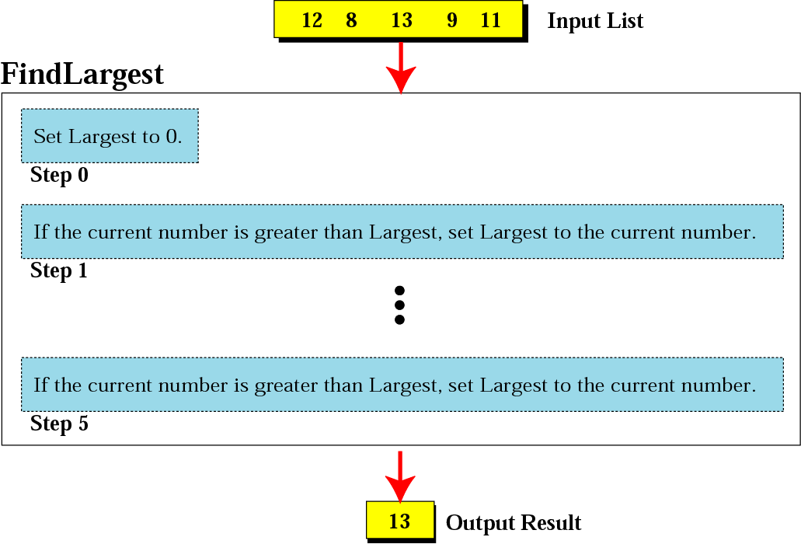
Figure 8-4
FindLargest refined

Slide 85
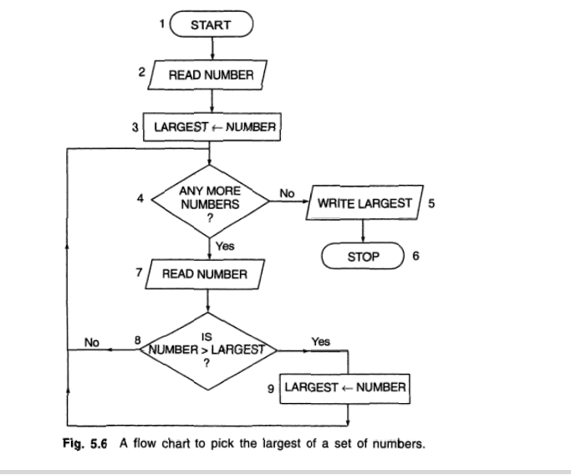
Largest of n nos --flow chart

Slide 86
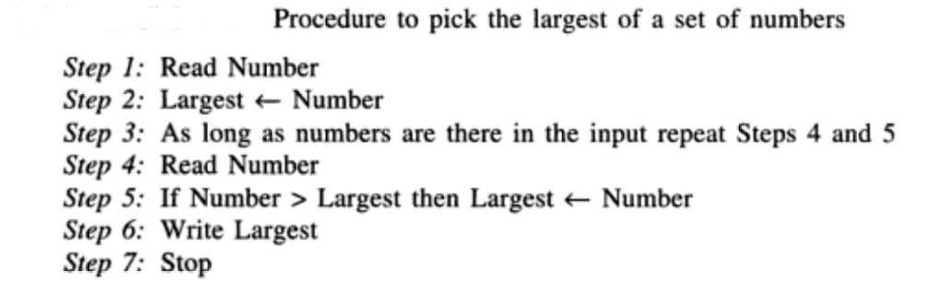
Largest of n nos --Algorithm

Slide 87
How to Generate Fibonacci Series?
Mathematically, the nth term of the Fibonacci series can be represented as:
t_{n} = t_{n-1} + t_{n-2}
Every subsequent term is the sum of previous two terms as follows:
First Term = 0
Second term = 1
Third Term = First + Second = 0+1 =1
Fourth term = Second + Third =1+1 = 2
Fifth Term = Third + Fourth = 2+1 = 3
Sixth Term= Fourth + Fifth = 3+2 = 5
Seventh Term = Fifth + Sixth = 3+5 = 8
Eighth Term = Sixth + Seventh = 5+8 = 13 … and so on to infinity!

Slide 88
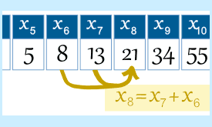
Fibonacci Series example

Slide 89
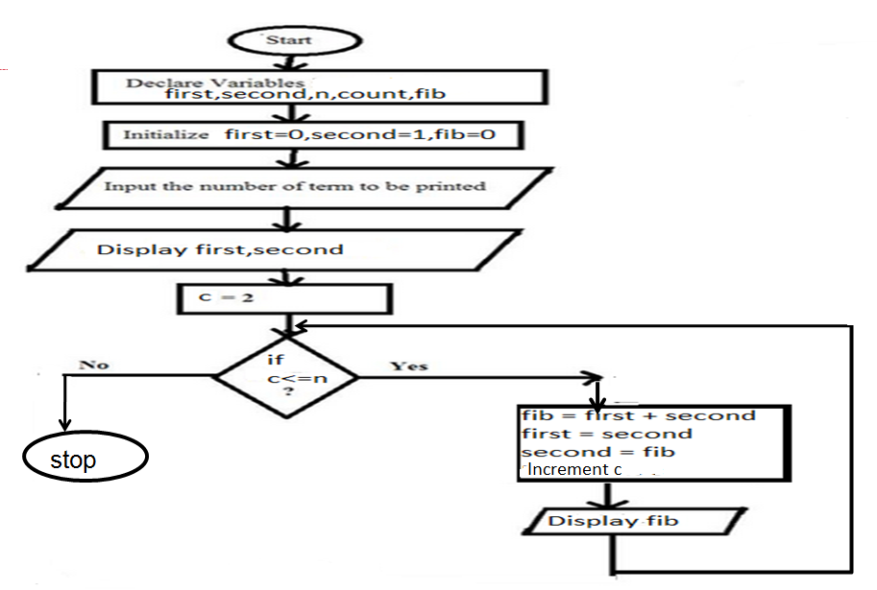
Fibonacci series –flowchart

Slide 90
Fibonacci Series --Algorithm
Step 1: Start
Step 2: Declare variables first,second, fib,n,count.
Step 3 : Read the number of terms of Fibonacci series to be printed to n
Step 3: Initialize variables first ←0, second ←1 ,count←2
Step 4: Display first and second
Step 5: Repeat the steps until count≤n
5.1: next←second+first
5.2: first←second
5.3: second←first
5.4: Display next
5.5 : Increment count
Step 6: Stop

