Slide 1
INTRODUCTION TO DIGITAL COMPUTERS

Slide 2
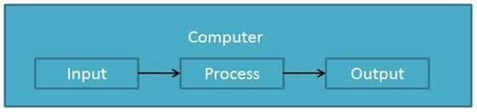
Introduction To Computers
Computer is an electronic data processing device which
  accepts and stores data input,
  processes the data input, and
  generates the output in a required format.

Slide 3
Accepts input, processes data, stores data, and produces output
Input refers to whatever is sent to a Computer system
Data refers to the symbols that represent facts, objects, and ideas
Processing is the way that a computer manipulates data
A computer processes data in a device called the central processing unit (CPU)

Slide 4
Digital and Analog Computer
Digital Computer
  uses distinct values to represent data.
  All information are represented using the digits 0s and 1s.
  Eg: computers used at homes and offices.
Analog Computers
  are the ones that represent data as variable across a continuous range of values
  They are used for measuring of parameters that vary continuously in real time, such as temperature, pressure and voltage.
  Eg: Earliest computers such as slide rule.

Slide 5
VON NEUMANN CONCEPT
Simple model of computer
In1940s, a mathematician called John Von Neumann developed a very basic model for computers.
Von Neumann divided a computer’s hardware into five primary components
The central processing unit (CPU)
Main memory
Secondary storage devices
Input devices
Output devices

Slide 6
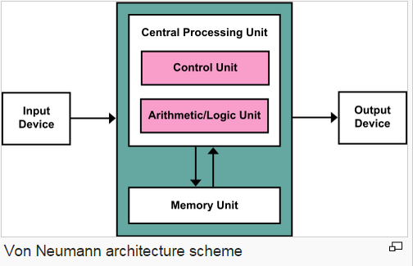
VON NEUMANN MODEL

Slide 7
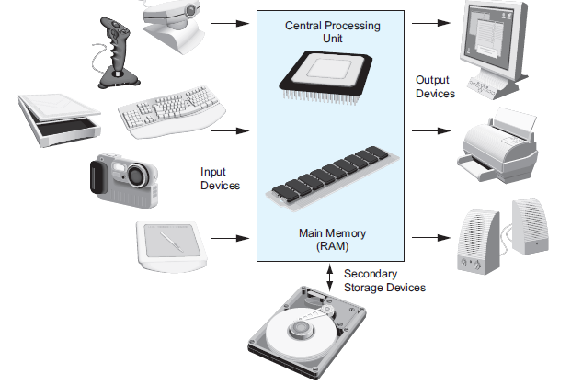

Slide 8
Functionalities of a computer
Any digital computer carries out five functions:
  Takes data as input.
  Stores the data/instructions in its memory and use them when required.
  Processes the data and converts it into useful information.
  Generates the output
  Controls all the above four steps.

Slide 9
Characteristics of Computer
Speed
  Computer is a very fast device that can process data at the rate of millions of instructions per sec.
  It is capable of performing calculation on very large amount of data.
  The computer has units of speed in microsecond, nanosecond, and even the picoseconds.
  It can perform millions of calculations in few seconds as compared to man who will spend many months for doing the same task.

Slide 10
Accuracy
  In addition to being very fast, computers are very accurate.
  Computers perform all jobs with 100% accuracy provided that correct input has been given.
  Eg: computers can accurately give the result of division of two numbers upto 10 decimal places.
Diligence
  Unlike human beings, a computer is free from monotony, tiredness and lack of concentration.
  It can work continuously without any error and boredom.
  It can do repeated work with same speed and accuracy.

Slide 11
Storage Capacity
  Memory is a very important characteristic of computers.
  Computer has much more storage capacity than human beings.
  It can store large amount of data and can also be retrieved whenever required.
  It can store any type of data such as images, videos, text, audio and many others.
Versatility
  A computer is a very versatile machine.
  A computer is very flexible in performing the jobs to be done.
  This machine can be used to solve the problems related to various fields.
  At one instance, it may be solving a complex scientific problem and the very next moment it may be playing a card game.

Slide 12
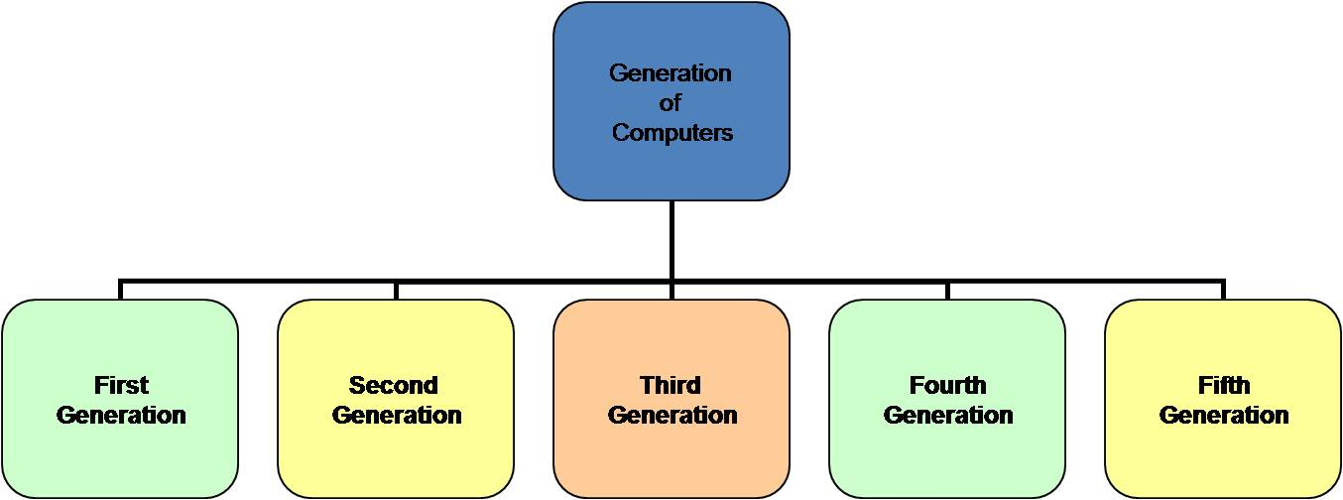
Generation of Computers
The evolution of computer from a large-sized simple calculating machine to a smaller powerful machine is defined in terms of generations of computer.
Each generation is based on a new technological development or advancement.

Slide 13
First Generation Computers (1940 – 1956)
Hardware : Vacuum tubes as circuits and magnetic drums for memory. Input through punch cards & output as printouts.
Software : Instructions were written in Machine language consisting of 0’s and 1’s.
Computing : computation time is in milliseconds
Physical Appearance: Enormous in size.
Application: Scientific applications
Issues: Lot of heat generated, consumed great deal of electricity, expensive and required constant maintenance.
Eg: UNIVAC,ENIAC, EDVAC

Slide 14
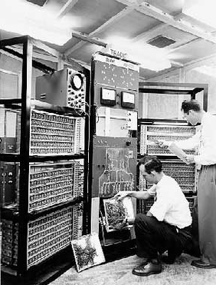
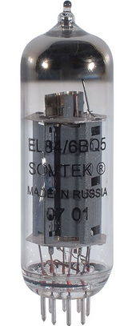

Slide 15
Second Generation Computers (1956 – 1963)
Hardware :Transistors replaced vacuum tubes, magnetic core technology for primary memory & magnetic tapes and disks for memory. Instructions were stored in memory of computer
Software : Assembly language which used mnemonics like add, sub etc were used
Computing : computation time is in microseconds.
Physical Appearance: Reduced in size.
Application: Not available for commercial use.
Issues: Lot of heat generated but less compared to previous generation.
Eg: PDP-8, IBM 1401, CDC 1604

Slide 16
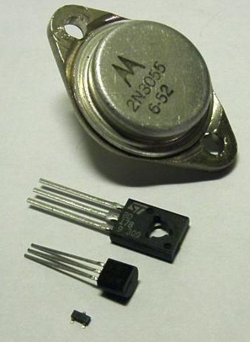
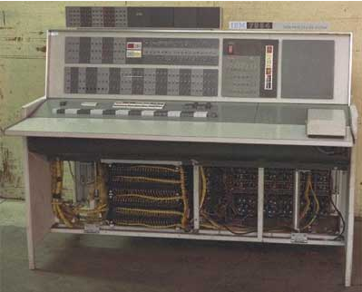

Slide 17
Third Generation Computers (1964 – 1971)
Hardware : Integrated Circuit chips (In an IC multiple transistors are placed on a silicon chip), Keyboard and monitor as input and output.
Software : Operating Systems allowed different applications to run at same time.HLL is used for programming
Computing : computation time is in nanoseconds.
Physical Appearance: Smaller in size.
Application: More accessible and hence were produced commercially.
Used less power and generated less heat, cost also reduced.
Eg: IBM 370, PDP11

Slide 18
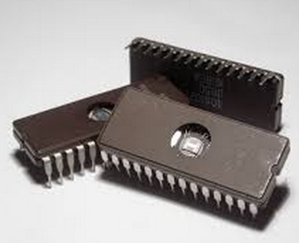
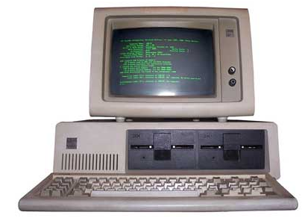

Slide 19
Fourth Generation Computers
Hardware : Microprocessors, RAM & magnetic storage as secondary storage
Software : Operating Systems like MS-DOS, MS-Windows, supported GUI.
Computing : computation time is in picoseconds.
Physical Appearance: Smaller in size.
Application: Widely available for home users.
Eg: Intel, IBM etc
Computers of this generation are portable and more reliable, generate less heat and require less maintenance.
Give rise to Personal Computer

Slide 20
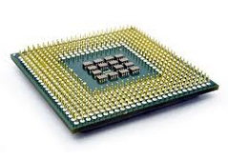
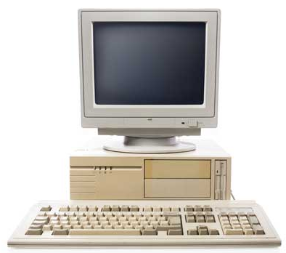

Slide 21
Fifth Generation of Computers
  Present and Beyond: Artificial Intelligence
  The goal of fifth-generation computing is to develop devices that respond to natural language input and are capable of learning.
  Based on Artificial Intelligence that is simulate human way of thinking and reasoning.
  Uses parallel processing that allow several instructions to be executed in parallel, instead of serial execution.
  Uses SLSI chips that are able to store millions of components on a single chip.
  Improved overall functions & performance aimed at making computers smaller, lighter, faster, of greater capacity, more flexible & more reliable.
  Are still in development, though there are some applications, such as voice recognition, that are being used today.

Slide 22
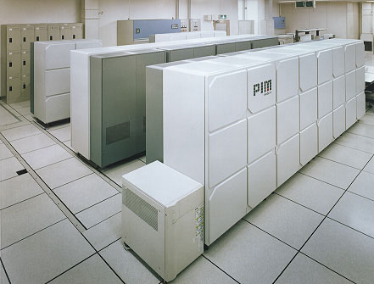
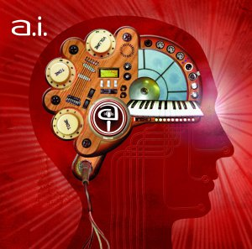

Slide 23
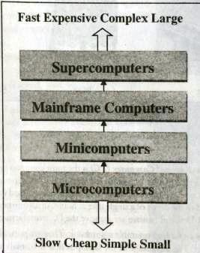
Classification of Computer
Computers are broadly classified into 4 categories based on their size and type
  Microcomputers
  Minicomputers
  Mainframe Computers
  Supercomputers

Slide 24
Microcomputers
Small in size.
Single user digital computer that consists of CPU, input unit, output unit, storage unit and software.
Much slower than the larger computers.
Used in small businesses, homes, and school/college classrooms.
Inexpensive and easy to use.
Also called PCs in short for Personal computers.
Eg: desktop computers, notebook computers or laptop, tablet computer, smart phones etc.

Slide 25
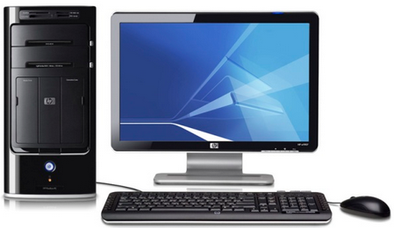
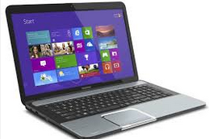
Types of Microcomputers are –
Desktop or Personal Computers
  most common type
  small enough to fit be placed on a desk.
  Not very expensive and is suited to the needs of single user at home, small business units and organizations.
  Apple, Microsoft, HP, Dell and Lenovo are some of PC manufacturers.
Laptop/Notebook Computers
  Small, portable, light weight computers.
  Has battery backup.
  Can store the same amount of data and having a memory of the same size as that of a personal computer.
  Costlier than desktop computers

Slide 26
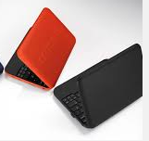
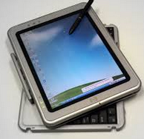
Netbook
  Smaller notebooks, low weight and low cost.
  They have no CD/DVD drives due to their small size.
  Designed for accessing web based applications.
  Word netbook is created as a blend of internet and notebook.
Tablet Computer
  Has features of the notebook computer
  Can accept input from a stylus or a pen instead of keyboard or mouse
  Portable computer

Slide 27
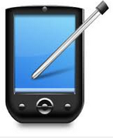
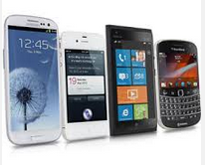
Handheld Computer or PDA
  Personal Digital Assistant is the smallest portable computer, not bigger than a cheque book, also known as palmtops.
  PDA uses pen or a stylus for input.
  Do not have a disk drive.
  Have limited memory and are less powerful.
  PDA’s can be connected to internet via a wireless connection
  Casio and Apple are manufacturers of PDA.
  These are used for keeping record of phone numbers, dates etc.
Smart Phones
  Cellular phones that function both as a phone and as a small PC.
  They may use a stylus or a pen, or may have a small keyboard.
  Connected to internet wirelessly.
  Apple, Blackberry, LG are some of manufacturers of smart phones.

Slide 28
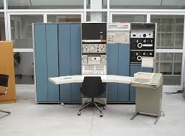
Minicomputers
A midsized computer.
Generally used in multi-user systems.
High processing speed and storage capacity when compared to microcomputers.
Can handle a great amount of data
Can support 4-200 users simultaneously.
Can support a number of terminals.
Users can access the minicomputer through their PC’s or terminal.
Used for real time applications in industry, research centers etc
Eg: PDP 11, IBM (8000 series)

Slide 29
Mainframe Computers
Multi-user, multi-programming and high performance computers.
They operate at a very high speed.
Very large storage capacity and can handle the workload of several hundreds of users.
Large and powerful systems generally used in centralized databases.
User accesses the mainframe computer via a terminal that may be dumb, intelligent terminal or a PC.
  A dumb terminal cannot store data or do processing. It has input and output device only.
  Intelligent terminal has input, output device and can do processing of its own but cannot store data.
  Both these terminals use processing power and storage facility of mainframe computer.

Slide 30
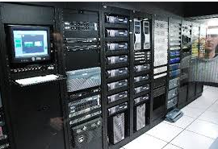
They are used in organizations like banks or companies which require frequent access to same data.
Eg: CDC 6000 and IBM ES000 series.

Slide 31
Super Computer
Fastest computers and the most powerful computer made till now.
High processing speed. Speed is measured in FLOPS (Floating Point Operations per second).
They are built by interconnecting thousands of processors that can work in parallel.
Used for very special, highly calculation-intensive tasks like scientific research, weather forecasting, quantum mechanical physics, climate research (global warming), biological research etc.
Major universities, military agencies and scientific research laboratories are heavy users.
Egs: IBM Roadrunner, IBM Blue gene, PARAM

Slide 32
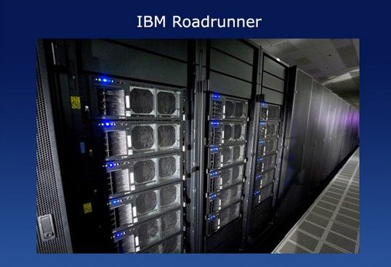
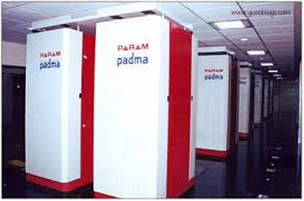

Slide 33
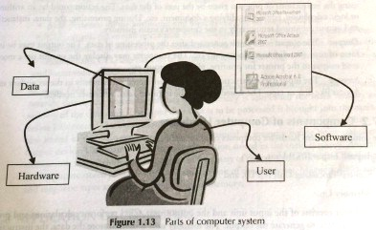
Computer System
Computer system consists of 4 parts :
Hardware
Software
Data
Users

Slide 34
Hardware
  Consists of physical or mechanical devices of the computer.
  Devices required for i/o, storage and processing of data comes under this category.
  Eg: keyboard, monitor, hard disk drive, floppy disk drive, printer, processor, motherboard etc.
Software
  Is a set of instructions that tells the computer about the tasks to be performed and how theses tasks are to be performed.
  A set of programs and documents form the software.
  Different software can be loaded on the same hardware to perform different kinds of tasks.

Slide 35
Data
  Raw facts or isolated values which by themselves have not much significance.
  Data is provided as i/p to the computer, which is processed to generate meaningful information..
  Eg: 29, jan and 1994 are processed by computer to give date of birth of a person.
Users
  Are the people who write computer programs or interact with the computer.
  Also known as skinware, liveware, humanware, or peopleware.
  Programmers, data entry operators, system analyst and computer hardware engineers.

Slide 36
Applications
Home
  Mostly to check mails
  Small documentation
  Gaming
  Music and Video
  To solve homework
  Photo Printouts using Good Printers
  Work from Home concept
Industry
  To develop software, mostly to automate the manual work.
  To provide necessary solution to clients’ needs
  Software is developed for the needs of networking, banking, business, retail etc.

Slide 37
Education
  Serves the purpose of Teaching Aids i.e. prepare notes and presentations.
  To Educate necessary skills demanded by Industries.
  To provide distance education using e-learning.
  Conduct online examinations.
  To give a demo or training.
  To convey messages using Internet.
Science and engineering
  To analyze large data acquired over a period of time
  To do complex floating point arithmetic operations.
  Designing and making drawings.
  Image Processing Applications.
  Research
Sports
  Used to watch a game, view scores
  Play games like chess.
  Also used for training players.

Slide 38
Entertainment
  Music Industry
  Games
  Movies – to watch and create.
  Can listen to music, download and share them
Advertisement
  Computers are used to create adds with special sound and visual effect.
  Advertisement can be displayed on different websites, emails can be sent and reviews of a product can be posted.
Medicine
  Medical history of patients is stored in computers.
  Medical researchers use to access information about the advances in the field.
  Medical equipments like Ultrasound, MRI scan uses computer as its integral part.
  Provide assistance to doctors in surgery. Eg laser surgery

Slide 39
Banking
  To store, access and modify huge amounts of data
  Paying bills become easy and time saving.
  online promotions
Government
  “Biometrics Attendance Monitoring”
  Weather Forecasting and military applications
  E- governance
  Online payment of taxes, Insurances
  Police dept uses computers to search for criminals using fingerprint matching.

Slide 40
COMPUTER HARDWARE

Slide 41
Hardware Components
The term hardware refers to all of the physical devices, or components, that a computer is made of.
A computer is not one single device, but a system of devices that all work together
A typical computer system hardware consists of the following major components:
• The central processing unit (CPU)
• Main memory
• Secondary storage devices
• Input devices
• Output devices

Slide 42
Central Processing Unit (CPU)
When a computer is performing the tasks that a program tells it to
do, we say that the computer is running or executing the program.
The central processing unit, or CPU, is the part of a computer that actually runs programs.
  Consists of Arithmetic Logic Unit(ALU) and Control Unit(CU).
    ALU performs all arithmetic & logic operations on i/p data.
    CU controls overall operations of computer

Slide 43
Main Memory
You can think of main memory as the computer’s work area. This is where the computer stores a program while the program is running, as well as the data that the program is working with.
Main memory is commonly known as random-access memory, or RAM. It is called this because the CPU is able to quickly access data stored at any random location in RAM.
RAM is usually a volatile type of memory that is used only for temporary storage while a program is running. When the computer is turned off, the contents of RAM are erased.

Slide 44
Secondary Storage Devices
Secondary storage is a type of memory that can hold data for long periods of time, even when there is no power to the computer.
Programs are normally stored in secondary memory and loaded into main memory as needed.
The most common type of secondary storage device is the disk drive.

Slide 45
Input Devices
Input is any data the computer collects from people and from other devices.
The component that collects the data and sends it to the computer is called an input device.
Common input devices are the keyboard, mouse, scanner etc

Slide 46
Output Devices
Output is any data the computer produces for people or for other devices. It might be a sales report, a list of names, or a graphic image.
The data is sent to an output device, which formats and presents it.
Common output devices are video displays and printers

Slide 47
CENTRAL PROCESSING UNIT

Slide 48
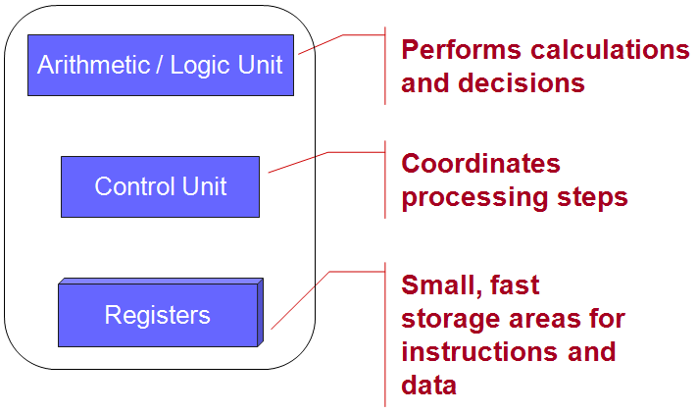
CPU consists of the following features:
  CPU is considered as the brain of the computer.
  It consists of ALU and CU.
  ALU performs arithmetic and logic operations on data.
  CU coordinates and controls the activity of other units of computer.
  CPU performs all types of data processing operations using the instructions and data obtained from memory.
  It stores data, intermediate results and instructions(program) in Registers.
  CPU is fabricated on a single IC chip.
  Also known as microprocessor.

Slide 49
Arithmetic Logic Unit
Consists of two units – Arithmetic Unit and Logic Unit
Arithmetic unit performs arithmetic operations like add, sub, mul etc.
Logic unit performs logic operations like comparison of numbers, letters etc. Also checks for >, < or = conditions.
ALU use registers to hold data that is being processed.

Slide 50
Registers
High speed storage areas within CPU. Speed is about 1-2 ns(nanosec)
Used to store data, instructions, addresses and intermediate results for processing.
Often referred as CPU’s working memory as they are directly accessed and manipulated by the CPU during instruction execution.
There are different registers :
  Accumulator (ACC) - contain operands for arithmetic and logic expressions and also stores their result.
  Instruction Register ( IR) – contains the current instruction most recently fetched.
  Program Counter (PC) – contains the address of next instruction to be processed.
  Memory Address Register (MAR) – contains the address of next location in the memory to be accessed.
  Memory Buffer Register (MBR) – temporarily stores data from memory or the data to be sent to memory.
  Data Register (DR) – stores the operands or any other data.
Number and size of registers determine the power and speed of CPU.
Size of register, called word size, indicates the amount of data with which the computer can work at a given time.
Least storage capacity.
Size of register may be 8, 16, 32 or 64 bits

Slide 51
Control Unit
This unit controls the operations of all parts of computer but does not carry out any actual data processing operations.
Functions of this unit are:
  It manages and coordinates all the units of the computer.
  It is responsible for controlling the transfer of data and instructions among other units of a computer.
  It obtains the instructions from IR register, interprets them, and directs the operation of the computer.
  It communicates with I/O devices for transfer of data or results from storage.
  It does not process or store data.
  It tells when to fetch the data and instructions, what to do, where to store results, , sequencing of events during processing etc.

Slide 52
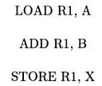
Instruction Set
An instruction set is the set of all basic operations that a processor can accomplish. Eg:
Instructions in the instruction set is in the language a processor can understand.
Instruction set is embedded in processor(hard wired), which determines machine language of processor.
Two processors are different if they have different instruction sets. So two processors are compatible only if the same machine level program can be run on both processors.
Microarchitecture is the processor design technique used for implementing instruction set.

Slide 53

Instruction Format
A Computer program is a set of instructions.
An instruction is designed to perform a task and is the elementary operation that the processor can accomplish.
An instruction is divided into groups called fields.
Common fields of an instruction are : Operation (op) code and operand code.
Operation code
  represents action that the processor must execute.
  It tells the processor what basic operations to perform.
Operand code
  defines the parameters of the action and depends on the operation.
  It specifies locations of the data or the operand on which the operation is to be performed.
  Can be data or memory address.

Slide 54

Eg: Instruction format for add command

Slide 55
Instruction Cycle
CPU executes each instruction in a series of steps, called instruction cycle.
An instruction cycle involves four steps –
Fetching : Processor fetches the instruction from the memory. Fetched instruction is placed in IR. PC holds the address of next instruction to be fetched and is incremented after each fetch.
Decoding : Instruction is broken into parts or decoded. Instruction is translated into commands so that they correspond to CPU’s instruction set.
Executing : Decoded instruction is executed. It performs the operation specified in the instruction.
Storing : CPU writes back the result of execution to computer’s memory.

Slide 56
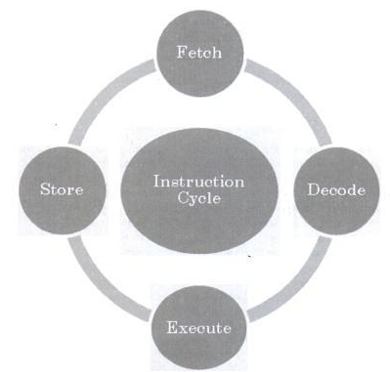

Slide 57
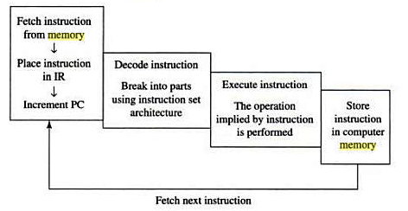
Instructions are of different categories. Some categories of instructions are :
  Memory access or transfer of data between registers.
  Arithmetic operations like addition and subtraction.
  Logic operations such as AND, OR and NOT.
  Control the sequence, conditional connections, etc
CPU performance is measured by the number of instructions it executes in a second. i.e MIPS, or BIPS

Slide 58
Microprocessor
Based on the instruction set, 2 classification exist
  Complex Instruction Set Computer(CISC)
  Reduced Instruction Set Computer(RISC)

Slide 59
CISC
CISC architecture hardwires the processor with complex instructions.
“High level” Instruction Set
  Increased number of instructions.
  Executes several “low level operations”. Ex: load, arithmetic operation, memory store.
  Also includes complex instructions that correspond to statements in high level language.
Instructions are of variable lengths. They use 8, 16 or 32 bits for storage.
Instructions take multiple clocks to execute as they are of variable lengths. Hence processing time is increased.
Eg: AMD, Cyrix are based on CISC.

Slide 60
RISC
RISC is a CPU design that recognizes only a limited number of instructions
  Executes a series of simple instructions instead of a complex instruction.
  Instructions are executed quickly.
Instruction size is fixed which is 32 bits.
Program execution is speeded up when compared to CISC.
RISC architecture has reduced production cost compared to CISC processors.
Eg: Apple Mac G3, PowerPC are based on RISC.

Slide 61
COMPUTER MEMORY

Slide 62
MEMORY REPRESENTATION
Computer memory stores data and instructions
Binary digit or bit is the basic unit of memory
A bit is a single binary digit, i.e. 0 or 1
A group of 8 bits form a byte
One byte is the smallest unit of data that is handled by the computer
One byte can store 2⁸ i.e. 256 different combinations of bit, that falls in the range 00000000 to 11111111
Group of bytes further combined to form word
A word can be a group of 2, 4 or 8 bytes

Slide 63
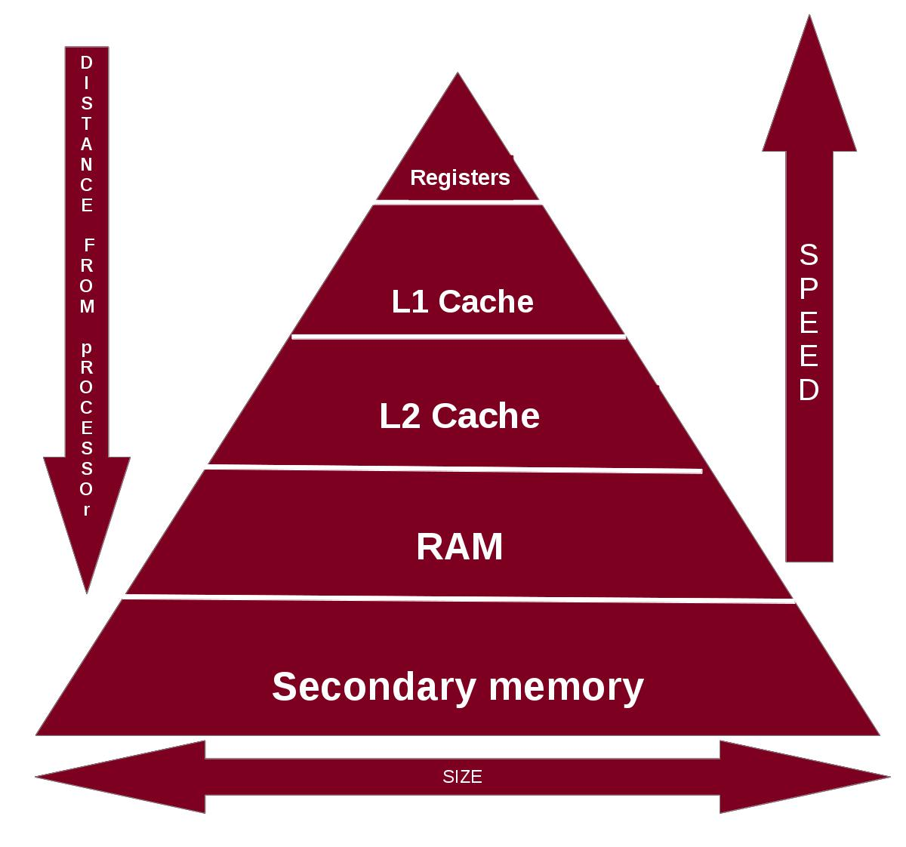
Memory hierarchy

Slide 64
Two broad categories of memory used in the computer are
  Internal Memory
    Registers
    Cache Memory
    Primary Memory/Main Memory
  Secondary Memory

Slide 65
Internal Memory
  Limited storage
  Temporary storage
  Fast access
  High cost
Secondary Memory
  High storage capacity
  Permanent storage
  Slower
  Low cost

Slide 66
registers
High speed storage area located inside the CPU
After CPU gets data and instructions from memory, it is moved to registers for processing.
Registers are often referred to as CPU’s working memory
Number and size of registers determine the power and speed of CPU.

Slide 67
Cache Memory
Placed between the CPU and RAM.
Faster than RAM.
It is used to hold data and instruction which are most frequently used by CPU.
During processing, CPU first checks cache for the required data. If data is not found then only it will check RAM.
less access time when compared to main memory.
Data is stored temporarily.
CPU has built in Level 1(L1) cache and level 2 (L2) cache. In addition there can also be a separate level 3(L3) cache.
Cache size varies from 256 KB(L1), 6 MB(L2), to 12 MB(L3) cache.
Cache memory is very expensive hence smaller in size.

Slide 68
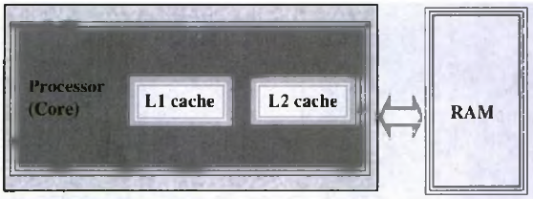

Slide 69
Primary Memory (RAM & ROM)
RAM (RANDOM ACCESS MEMORY)
  CPU gets data and instruction from RAM for processing.
  RAM is volatile memory. It stores data when computer is turned on. Data is lost in case power is switched off.
  RAM provides limited storage capacity due to high cost.
  RAM provides random access.
  Performance of RAM is affected by
    Access speed- (how quickly information can be retrieved) Speed is measured in nanosec.
    Data transfer unit size (how much information can be retrieved in one request)
  Two types of RAM
  Static RAM (SRAM)
  Dynamic RAM (DRAM)

Slide 70
Dynamic RAM (DRAM)
  Most common type of memory chip. Mostly used as main memory since it is small and cheap.
  Must be refreshed continuously to store information.
  Slow because the refreshing takes time.
  Access speed ranges from 50 ns to 150 ns.
Static RAM (SRAM)
  Faster than DRAM.
  Does not need refreshing.
  Expensive than DRAM.
  Used in cache memory.
  Access speed 2 – 10 ns.

Slide 71
Memory chips are available on a separate printed circuit board(PCB) that is plugged into a special connector on the motherboard.
There are 2 RAM modules
  SIMM – Single Inline Memory Module
  DIMM – Dual Inline Memory Module
SIMM modules have memory chips on one side of PCB. Can store 8 to 32 bits of data simultaneously.
DIMM modules have memory chips on both sides of PCB. They are 64 bit memories

Slide 72
  READ ONLY MEMORY (ROM)
    non volatile memory which is read only in nature.
    stores data that is permanent in nature and comes programmed by manufacturer.
    Stores BIOS(Basic Input Output System) program needed for the startup of computer. BIOS provides the processor with information required to boot the system.
    BIOS does the following things:
      POST(Power On Self Test) program checks that all hardware components work properly.
      BIOS setup program which allows user to change settings.
      Bootstrap Loader loads the operating system into RAM. BIOS initiates the bootstrap sequence.

Slide 73
Different kinds of ROM
PROM (Programmable Read Only Memory)
Initially blank
Manufacturer write data/program into it
Data written to PROM cannot be erased
EPROM (Erasable PROM)
Initially blank
Manufacturer write data/program into it
Data written to EPROM can be erased using ultraviolet rays and can be reprogrammed.
They have to be removed from computer for rewriting.

Slide 74
EEPROM (Electrically EPROM)
Initially blank
Manufacturer write data/program into it
Data written to EEPROM can be erased by electric charge and can be reprogrammed.
They do not have to be removed from computer for rewriting.

Slide 75
Secondary memory
Non-volatile memory
It is slower than main memory.
These are used for storing data/information permanently.
High storage capacity than primary memory.
Takes longer time to access the data and instructions.
Cheaper than primary memory.
Also called storage device of computer.
For example : Hard disk drive, floppy drive and optical disk drives are some examples.

Slide 76
Access types of storage devices
The information stored in storage device can be accessed in two ways
1. Sequential access
  Computer must run through the data in sequence starting from the beginning, in order to locate a particular piece of data.
  Eg: Magnetic tapes
2. Direct access
  Access data directly from the desired location using address.
  Eg: magnetic disk, optical disk

Slide 77
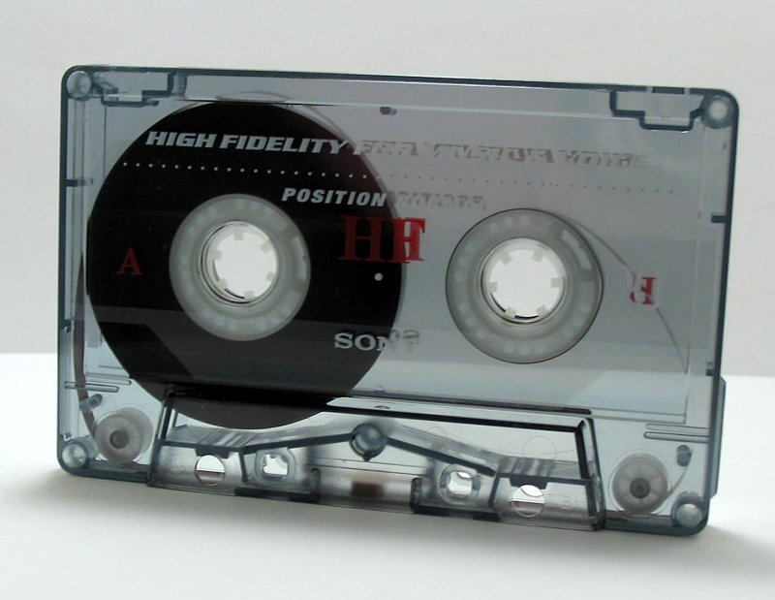
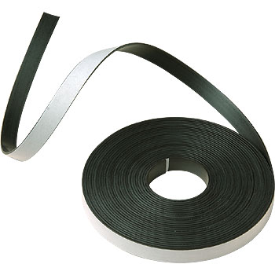
magnetic tape
  Plastic tape with magnetic coating.
  It is Storage medium on a large open reel or cassette.
  They can be written, erased and rewritten.
  Sequential access device, i.e. tape needs to rewind or forward to the location where requested data is present.
  Hence not suitable for storing data files that are constantly updated.

Slide 78
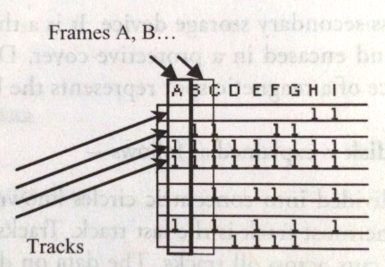
Working of magnetic tape
Divided horizontally into tracks (7 or 9) and vertically into frames
A frame store one byte of data and a track in a frame store one bit.
Data is stored in successive frames as a string with one data(byte) per frame.

Slide 79
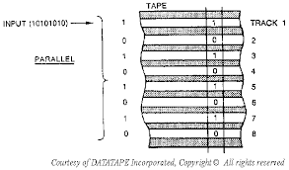

Slide 80
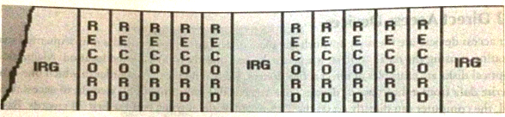
Data is recorded on a tape in the form of blocks, where a block consists of groups of data called records
Each block is read continually.
There is Inter Record Grip between two blocks that provide time for the tape to be stopped and started between records.

Slide 81
Features of magnetic tape are:
  Inexpensive storage device.
  Can store a large amount of data.
  Easy to carry or transport.
  Not suitable for random access data.
  Slow access device.
  Needs dust prevention or dust can harm the tape.
  Suitable for backup storage or archiving.

Slide 82
Magnetic disk
Direct access storage device
Thin plastic or metallic circular plate coated with magnetic oxide and encased in a protective cover
Data store on magnetic disk as magnetized spots
The presence of magnetic spot represent the bit 1 and its absence represents the bit 0

Slide 83
Working of magnetic disk
The surface of disk is divided into concentric circles known as tracks
Tracks is divided into sectors
A sector is a pie that cuts across all tracks
The data on disk is stored in sector
Sector is the smallest unit that can be read or written on a disk
A disk has eight or more sectors per track
Magnetic disk is inserted into magnetic drive, consists of a read/write head that is attached to a disk arm, which moves the head
The disk arm can move inward and outward on the disk
The motor of the disk drive moves the disk at high speed

Slide 84
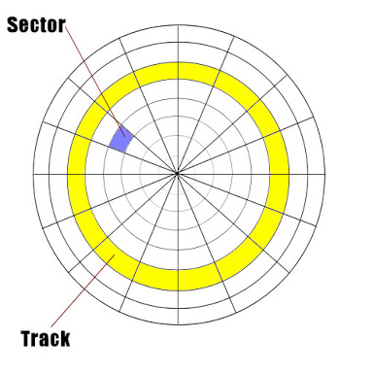

Slide 85
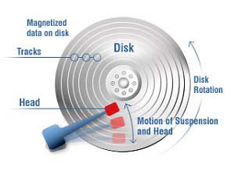

Slide 86
Accessing data on the disk
The read/write head is positioned to the desired track where the data is to be read from or written to.
The time taken to move the read/write head to the desired track is called seek time
Once the read/write head is at the right track, then the head waits for the right sector to come under it
The time taken for the desired sector of the track to come under read/write head is latency time
Once the read/write head is placed at the right track and sector, the data has to be written to disk or read from disk

Slide 87
The rate at which data is written to disk or read from disk is called data transfer rate
The sum of seek time, latency time and the time of data transfer is the access time of the disk
The storage capacity of disk drive is measured in GB
Large disk storage is created by stacking together multiple disks.
A set of same tracks on all disks form a cylinder
Each disk has its own read/write head which work on coordination
A disk can also have tracks and sectors on both sides. Such disk is called double sided disk

Slide 88
Features of magnetic disk
Cheap storage device
Can store a large amount of data
Reliable storage
Easy to carry
Fast access
Suitable for back up storage

Slide 89
Finding Data on a Magnetic Disk
Boot block - located in the first few sectors of a file system. The boot block contains the initial bootstrap program used to load the operating system.
Super block - contains information about the file system: the total size of the partition, the block size, pointers to a list of free blocks, the inode number of the root directory etc.
inode block - contains the information about each file in the data block .
  The file information is stored in records known as inodes
  There is one inode for each file on the disk
Data blocks - blocks containing the actual contents of files

Slide 90
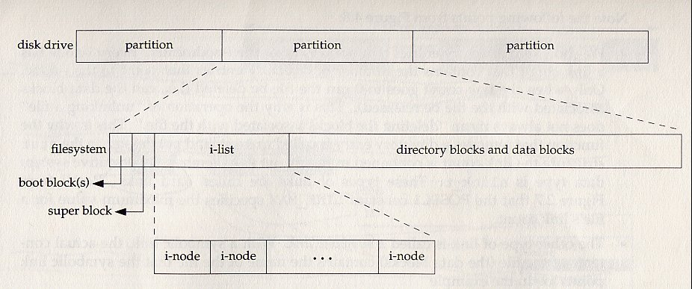
Disk File Format

Slide 91
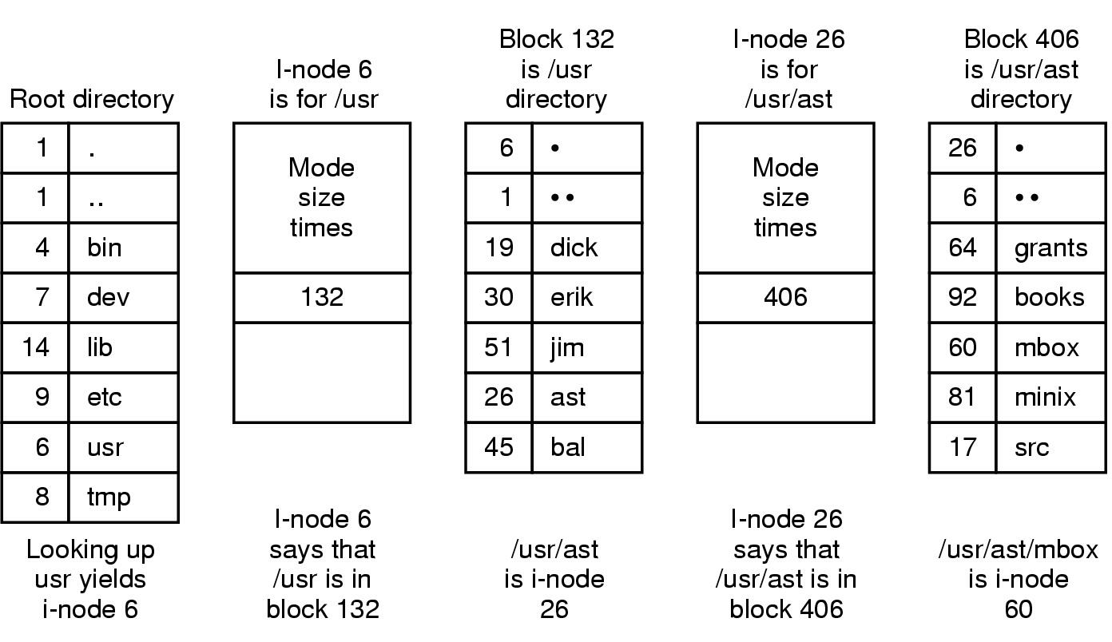
The steps in looking up /usr/ast/mbox

Slide 92
hard disk
Consists of one or more platters divided into concentric tracks and sectors
It is mounted on a spindle
It can be read by a read/write head that pivots across the rotating disks
Fixed disk, not removable
Multiple platters with data stored on both sides
More storage than floppy
Portable eternal HDD is also available

Slide 93
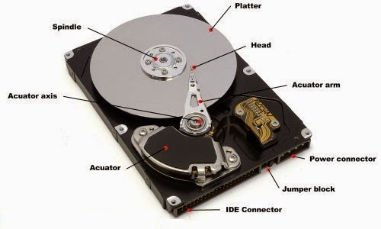
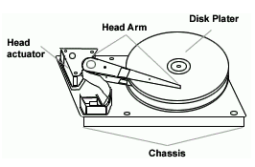
The head actuator controls the head arm, which reads the data off of the disk platter. The chassis encases and holds all the hard disk drive components.

Slide 94
Hard disk is a fixed disk. It is not removable from the drive unlike floppy.
High storage capacity.
Operating System is stored in hard disk.
Portable external hard disk drive is available which is attached to USB drive of computer.

Slide 95
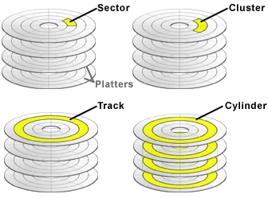

Slide 96
Floppy disk
Flat, round , single disk made of plastic and enclosed in square plastic jacket
Floppy disk is inserted to the FDD
Has a write protected slide tab that prevents a user from writing it
Can be single sided or double sided
Portable
Inexpensive less storage capacity

Slide 97
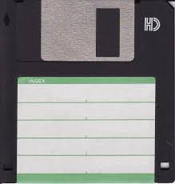

Slide 98
Zip disk
Much higher capacity than floppy disk
Capacity ranges from 100 MB to 750MB
Same size as that of floppy

Slide 99
Optical disk
Flat circular disk which is coated with reflective plastic material that can be altered by laser light
Optical disk does not use magnetism
The bits 1 an 0 are stored as spots that are relatively bright and light respectively
Consists of single spiral track that starts from the edge to the centre of disk
Tracks are further divided into sectors which are of same length
Slower than hard disk
Access time ranges from 100 to 200 ns

Slide 100
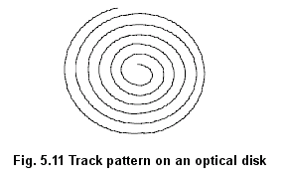

Slide 101
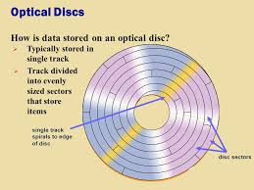

Slide 102
CD-ROM
Compact Disk Read Only Memory.
Optical disk that can be read and not written on.
It is written by the manufacturer using laser light.
Data is stored as pits(depressions) and lands(flat area).
When laser light is focused on disk, the pits scatter the light(interpreted as 0) and the lands reflect the light to a sensor(interpreted as 1).
Cost is low when compared to floppy and hard disk.
Access time is less. Can read data at 150 Kbps.
Commonly used medium to distribute software and large data.

Slide 103
DVD-ROM
Digital Video Disk-Read Only Memory.
Optical storage device used to store digital video or computer data.
DVD’s look like CDs in shape and size.
It is a high density medium with increased track and bit density.
Uses both sides of the disk and special data compression techmologies.
Each side of DVD-ROM can store 4.7GB so in total can store 9.4GB.

Slide 104
Recordable Optical Disks
Compact Disk-Recordable (CD-R) is a Write Once Read Many Disk(WORM).
  Once data is written cannot be erased..
  Uses a laser that burns pits into the disk surface.
  To write a CD-R disk, a device named CD-Writer or CD-burner is used.
  Can store 700 MB data
Compact Disk-ReWritable(CD-RW)
  Allows data to be written, erased and rewritten.
  Capacity is same as that of CD-R.
Digital Video Disk-Recordable (DVD-R)
  Allows recording of data on a DVD.
  DVD writer device is used to write data to DVD.
  Data once written cannot be erased or changed

Slide 105
Magneto Optical disk
Use laser beam to read data and magnetic field to write data.
Data can be written, erased and rewritten.
Expensive.
Outdated. Was used in mid 1990’s. Now replaced with CD-RW and DVD-R.

Slide 106
I/O DEVICES

Slide 107
Computer interacts with external environment via the input/output devices attached to it.
i/p device is used for providing data and instructions to the computer.
All i/p devices translate the input data to a machine readable form. This is done by the i/p interface of i/p device. The transformed data is then send for processing.
After processing the i/p data, o/p interface transforms machine form back to human readable form. The computer then provides o/p to the user via o/p device.
i/o devices that are attached to the computer machine are called peripheral devices.

Slide 108
Input Devices
Are classified as human data entry devices and source data entry devices
Human data entry devices – data is entered manually to the computer.
  Keyboard
  Pointing devices – mouse, trackball, joystick
  Pick devices – light pen, touch screen
Source data entry devices – do not require data to be typed-in, keyed-in or pointed to a particular location.
  Audio i/p- speech recognition
  Video i/p- digital camera
  Scanner – hand held scanner, flat-bed scanner
  Optical scanner – OCR, OMR, MICR, barcode reader

Slide 109
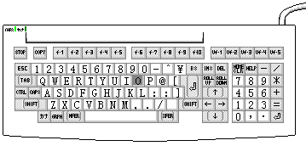
Keyboard
It is most commonly used input device. It is used to input data into written form. Keyboard is merely a collection of momentary switches.

Slide 110
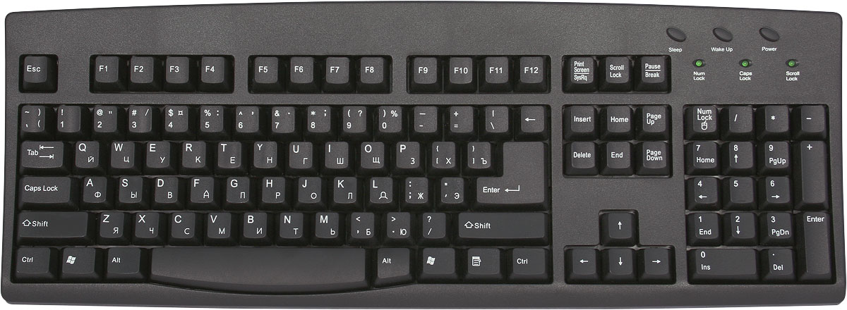
A normal keyboard has 101-104 keys which are distributed in five categories.
  Typing keys (1, 2, 3…, A, B,C…)
  Numeric keypad (numeric keys on right side.
  Function keys (F1 to F12 on top side)
  Control keys ( cursor keys, ctrl, alt…)
  Special purpose keys (Insert, Home, End, Esc etc.)
When a key is pressed , keyboard interacts with keyboard controller and keyboard buffer. Keyboard controller stores the code of pressed key in keyboard buffer and informs the computer s/w that an action has happened on the keyboard. Computer s/w checks and reads the keyboard buffer and passes the code of pressed character to the system software.

Slide 111

Mouse
It is a pointing device where data is entered by moving the device to a particular location.
It is a hand held device that controls the pointer on the screen.
It has two buttons viz. left button & right button & one scrolling wheel.
With the help of mouse you can draw images, select options & move text & images.
Mouse is classified as physical and optical mouse.
  Physical or traditional mouse has a rubber ball on the bottom side.
  Optical Mouse uses Light emitting diode(LED) and a sensor to detect the movement of mouse.

Slide 112
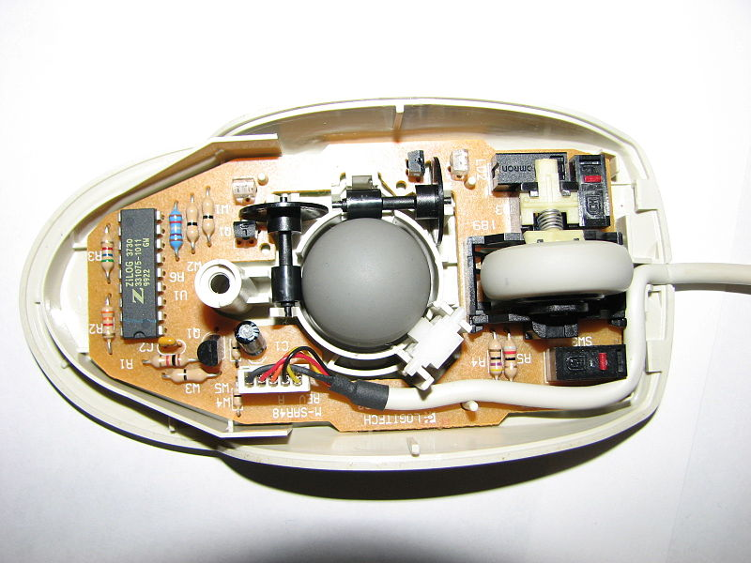
Physical Mouse
Traditional mouse used a ball built into the bottom with two small rollers placed two sides of the ball at 90 degree angle from each other. They spin when the ball rolls. A sensor detects how much each roller spins and sends the information to computer via the mouse chord.

Slide 113

OPTICAL MOUSE
Optical mouse is an advance pointing device that uses a light diode (LED).Optical mouse need plain surface to produce high performance efficiency. Each time the mouse is moved, the beam of light is reflected from its underside. The pulses of light determine the direction and rate of movement.

Slide 114
Mouse is used in 5 different ways.
  Pointing
  Left click or click
  Right click – displays menu.
  Double click
  Drag and drop

Slide 115

Trackball
Variant of mouse but has same functionality as that of mouse.
Looks like an upside down physical mouse.
Device remains stationary.
Requires ball to be rotated using a finger. Curser moves in the direction of ball moved.

Slide 116

joystick
Joystick is a pointing device mostly used for playing games.
It consist of a lever used to move the pointer on the screen and buttons used to select options.
Direction of push of stick and the amount of deflection determines the change of position and speed.

Slide 117

Light Pen
Light sensitive pen like i/p device which is used to select objects.
Used for making drawings, graphics and for menu selection.
Pen contains a photocell in a small tube. When the pen is moved on the screen, light from the screen at the location of pen causes photocell to respond. Electric response is transmitted to computer that can identify the position.

Slide 118

Touch Screen
Touch screen is the easiest way to data input into computer.
Touch screen allows the user to select the item by touching the screen at appropriate spot.
Consists of a clear glass panel that is placed over the view area. In addition to glass panel with sensors it has device driver and controller.

Slide 119


Microphone
Microphone is an input device used to voice signal into the computer.
Microphones are commonly used for live chat.
Microphones are also used to record voice into the computer.

Slide 120
Scanner
Scanner is an optical input device that accepts paper document as input.
Input data to be scanned can be a picture, a text etc.
This is a peripheral device that converts a printed image into digital information.
There are two types of scanners:
  Hand-held scanners
  Flat-bed Scanners

Slide 121

Flat-bed scanner
A flat bed scanner uses a flat surface just like photocopier.
Provides high quality scan in a single pass.
Can place a picture on the surface of the scanner. Scanner scans the image and convert into digital form.
The picture can be seen on the monitor screen after scanning.

Slide 122


hand-held scanner
Bar code reader is an example.
Used to read the values printed on the product in form of vertical lines.
Bar codes are recorded on the products by the manufacturers and usually carry the product number.

Slide 123

Optical Character Recognition(OCR)
Technique used to scan a page, translate it and then use OCR software to recognize the image as ASCII text that is editable.
Uses optical character reader for recognition.
Optical character reader stores the scanned image as bitmap image which is a grid of dots.
OCR s/w translates array of dots into text that computer can understand. This is done by comparing patterns with that stored inside a computer.

Slide 124

Magnetic Ink Character Recognition(MCR)
Used in banks to process large volumes of cheques.
Used for recognizing magnetic encoding numbers at the bottom of cheque.
Numbers are printed using an ink that contains iron particles. Numbers are magnetized.
When cheque is passed through MICR, magnetic field causes the read head to recognize characters.

Slide 125

Optical Mark Recognition(OMR)
Used to detect marks on a paper.
Marks are recognized by their darkness.
OMR uses optical mark reader to read the marks.
OMR reader scans the form, detects the mark that is positioned correctly and passes information to the computer for processing.
OMR detects the presence of marks by measuring reflected light

Slide 126
OUTPUT DEVICES
Hard Copy Devices
  Printer
  Plotter
  Computer Output on Microfilm (microfiche)
Soft Copy Devices
  Monitor
  Visual Display Terminal
  Video Output
  Audio Response

Slide 127
I/O PORT
Are the external interfaces that are used to connect i/o devices to computer.
i/o devices are connected via serial and parallel ports, USB ports, Firewire port etc.
Parallel port – 8 wires through which 8 bits of data are transmitted simultaneously. High speed data transmission. Eg. Used to connect printers.
Serial port – transmits data serially as single bits. Slow speed data transmission. Used to connect external modems, plotters etc.
USB port – used to connect different devices.
Firewire(IEEE 1394) – used to connect audio and video multimedia devices like video camera. Expensive technology and is used for large data movement. Hard disk drives and new DVD drives connect through firewire.

Slide 128
Working of i/o system
Combine i/o hardware and i/o software.
i/o hardware include ports, buses and device controllers for different devices.
i/o software include device driver that is embedded with OS or comes with each device.
Operating system –> device drivers –> device controllers -> devices

Slide 129
Inside a computer cabinet

Slide 130
motherboard
Large Printed Circuit Board , which is used to connect all the essential components of a computer
Contains processor, memory chips, ports etc.
Characterized by form factor, chipset and type of processor socket used.
Form factor refers to motherboards geometry, dimensions, arrangement and electrical requirements.
ATX (Advanced technology Extended) is the most common design of motherboard
Processor
Chipset
is to coordinate data transfer between various parts of computer
BIOS :
stored in ROM and cannot be rewritten
Contains instructions for starting up the computer

Slide 131
It performs a Power On Self Test (POST) that checks that the hardware is working properly
BIOS invokes bootstrap loader to load the operating system to memory
CMOS Chip:
saves system information, such as system date and time
battery provides charge to the CMOS Chip.

Slide 132
Ports and interfaces
Connect external devices to the port which get connected to the computer’s motherboard
Serial port – connect serial devices
Parallel port – connect printers
USB ports –
VGA connector – connect monitor
RJ45 connector (called LAN or ethernet port)– used to connect to network
Audio port – for connecting sound speakers
PS/2 – connect keyboard and mouse

Slide 133
Expansion slots
Expansion cards are inserted into the expansion slots. Cards give new features or increased performance. There are several types:
  ISA (Industry Standard Architecture) – To connect modem and other cards.
  PCI (Peripheral Computer Interconnect)– To connect audio, video and graphics. They are much faster than ISA cards.
  AGP (Accelerated Graphics Port)– A fast port for a graphics card.
  PCI – E (PCI-Express) - Faster bus architecture than AGP and PCI buses.

Slide 134
Ribbon cables
Carry data to different components
Connect floppy disk, disk drives, cd drives to motherboard
SATA (Serial Advanced Technology Attachment) has replaced ribbon cables.

Slide 135
Memory chips
RAM consists of chips in a circuit board.
Two types of chips - SIMM and DIMM.
64 bit data transfer with DIMM compared to 16 or 32 bit data transfer with SIMM.
Storage Devices
Hard disk, floppy, CD, DVD

Slide 136

Interconnecting Units of a Computer
Data, instructions and signals are carried between different components via a bus.
A bus is a communication pathway connecting two or more devices.
Different components CPU, I/O, and memory unit are connected with each other by a bus.

Slide 137

Features or functionalities of bus
  A bus is a set of wires used for interconnection where each wire carries one bit of data.
  Bus width is determined by number of wires. Eg: 32 bit data bus is 32 separate single bit channels
  2 types : Internal bus and external bus.
  Internal bus connects components inside motherboard like CPU and system memory. Also called system bus.
  External bus connect different external devices, peripherals, expansion slots, I/O ports and drive connections to rest of computer.

Slide 138
System Bus
Comprises of data, address and control bus.
Data bus
  Transfers data between CPU and memory.
  Bus width of a data bus affects speed of computer.
  Size of data bus defines size of processor. It can be 8,16,32,64 bit processor.
  An 8 bit processor has 8 wire data bus to carry 1 byte of data.
Address bus
  Connects CPU and RAM.
  Width of address bus determines the maximum number of memory locations computer can address.
Control bus
  Specifies whether data is to be read or written to memory.

Slide 139
Expansion Bus
Connects external devices to the rest of computer.
Comprises of data, address and control buses.
Data Bus
  Is used to transfer data between i/o and CPU.
  Exchange of data between CPU and i/o devices is according to industry standard data buses.
  The most commonly used standard is Extended Industry Standard Architecture(EISA) which is a 32 bit architecture.
  Some of common bus technologies are IDE, SATA
Address Bus
  Carries the addresses of different i/o devices to be accessed like the hard disk, CD ROM etc.
Control Bus
  Is used to carry read/write commands, status of i/o devices etc.

Slide 140
COMPUTER SOFTWARE

Slide 141
Software is a set of programs that instructs the computer about the tasks to be performed.
Different kinds of s/w can be loaded on the same h/w to do different tasks.
Two categories of software:
  System software
  Application software

Slide 142
System software
Functions/purposes of system software
  To provide basic functionality to computer.
  Control computer hardware.
  To act as an interface b/w user, application s/w and h/w.
On the basis of their functionality, system s/w is divided into 2 categories
  System s/w for management and functionality of computer – deals with proper functioning of different components of computer like processor, i/o etc.
  For the development of application s/w – provides services required for the development and execution of application s/w

Slide 143


Slide 144
Operating system
Acts as an interface b/w user and hardware.
It controls and coordinates the use of h/w among different application software and the users.
Objectives
  To make computer system convenient and easy to use for the user.
  To use computer hardware in an efficient way.
Commonly used operating systems are MS-DOS, Windows 7, Windows XP, Linux etc

Slide 145
Types of OS
Depending on the capability of processing
  Single user and single task OS
    is for use of single user for a standalone single computer for performing a single task. Eg: MS-DOS
  Single user and multitasking OS
    Allows execution of more than one task or process concurrently.
    Processor time is divided among different tasks.
    Division of time is also called time sharing.
    Processor switches rapidly between processes.
    Eg: windows 95 and later versions
  Multiuser OS
    Used in computer networks that allow same data and applications to be accessed by multiple users at the same time.
    Eg: Linux, Windows 7

Slide 146
  Multiprocessing OS
    Have two or more processors for a single running process.
    Processing takes place in parallel and is also called parallel processing.
    Each processor works on different parts of the same task or on two or more different tasks.
    Used for high speed execution.
    Eg: Linux, windows 7
  Real Time OS
    Used to respond to an event within a predetermined time.
    Processing is done within a time constraint.
    Used to control processes. OS monitors the events that affect execution of process and respond accordingly.
    Used to respond to queries in areas like medical imaging system, industrial control systems etc.
    Eg: LynxOS
  Embedded OS
    Embedded in a device in the ROM.
    Specific to a device and are less resource intensive.
    Used in appliances like microwaves, washing machines, traffic control systems etc.

Slide 147
Functions of OS
  Process Management
    Control access to shared resources like file, memory, i/o and cpu.
    Control execution of applications.
    Create, execute and delete a process(system or user process)
    Cancel or resume a process.
    Schedule a process.
    Synchronization, communication and deadlock handling for processes.
  Memory Management
    Allocate memory
    Free memory
    Re-allocate memory to a program when a used block is freed.
    Keep track of memory usage.
  File Management
    Create and delete files and directories.
    Provide access to files.
    Allocate space for files.
    Keep back-up files.
    Secure files.

Slide 148
  Device Management
    Open, close and write device drivers.
    Communicate, control and monitor device driver.
  Protection and Security
    OS protects resources of system.
    User authentication, file attributes like read, write, encryption and back-up of data are used by OS provide basic protection.
  User Interface or Command Interpretor.
    User interface is a set of commands or a geographical user interface via which user interacts with the application and the hardware.

Slide 149
Device Driver
A device driver is a piece of software that allows your computer’s operating system to communicate with a hardware device, the driver is written for.
It acts as a translator b/w hardware and software that uses the devices.
For proper working of devices, device driver must be installed.
Device drivers works within the kernel layer of the operating system. Kernel is the part of the operating system that directly interacts with the physical structure of the system.

Slide 150
Instead of accessing a device directly, an operating system loads the device drivers and calls the specific functions in the driver software in order to execute specific tasks on the device. Each driver contains the device specific codes required to carry out the actions on the device.
When we choose an operation (like Control + P to print a document) on the printer then this command goes to the device driver through the kernel of the operating system. Resultantly a calling program invokes a routine in the device driver and the driver issues corresponding commands to the microcontrollers within the printer. Further these microcontrollers control the components of the printer like motors etc. to start printing the document.

Slide 151
Device drivers of some devices come preinstalled with computer. Such devices are called plug and play devices.
Device drivers can be character or block device drivers.
Character device drivers are for character based devices like keyboard, which transfer data character by character.
Block device drivers are for devices that transfer data as a block, like in hard disk.

Slide 152
System Utilities
Used for supporting and enhancing programs and the data in a computer.
Egs:
  antivirus utility to scan computer for virus
  data compression utility to compress files
  cryptographic utility to encrypt and decrypt files
  disk compression utility to compress contents of disk
  disk partitioning to partition disk into multiple logical drives
  disk cleaners to find files not used for long time. Tells users what to delete when disk is full.
  backup utility to make a backup copy of hard disk to restore content in case of failure.
  system profiling utility provides detailed information about software installed in computer.
  network managers to check computer n/w log events

Slide 153

Programming Languages
Language used to write a program that tells the system of the tasks it has to perform.
Each language has a unique set of keywords and a special syntax for organizing program instructions..
Should be understood by both programmer and machine.
Three categories:
  Machine Language
  Assembly Language
  High Level Language

Slide 154

Machine Language
Collections of binary digits or bits that the computer can read and interpret.
System of instructions and data executed directly by computer’s CPU. No translation is needed.
Defined by hardware of the computer. Thus, it is machine dependent.
Machine level instructions have opcode field which specify basic instruction type, actual operation and many other fields.
Writing programs in binary is very difficult. Hence not written using it.

Slide 155
Assembly Language
Uses symbolic representation of machine codes.
Usually written by manufacturers and is based on mnemonics.
Easier to write than machine language pgms. Uses mnemonics like ADD, LOAD etc.
Assembler is used to translate assembly language to machine code.
Assembly language programs are machine-dependent.

Slide 156
High-Level Language
Programs are easier to write, read or understand in high level language.
Interpreter or compiler is the translator software used to convert source code in high level language to object code in machine language.
One line of code in high level lang may be equivalent to more than one line of machine code.
Easily portable from one computer to another.

Slide 157

Generations of Programming Languages

Slide 158
Translator Software
Used to convert a program written in high-level and assembly level language to a form machine can understand.
Translated program is called object code.
There are 3 different kinds of translator software:
  Assembler
  Compiler
  Interpreter
Source code
Compiler
Assembler
Interpreter
Object Code

Slide 159

Assembler
Converts a program written in assembly language to machine language.
There is a one-to-one correspondence between simple assembly statements and machine language instructions.

Slide 160
Compiler
Converts a program written in high level language to machine language.
Program written in high level language is called source code.
The compiled program is called object code.
Object code is executable code , which can run as a stand-alone code. i.e. doesn’t require compiler to be present during execution.
Object code can be executed multiple number of times by user.
Compilation process generally has two parts-
  Breaking source program into small pieces and creating intermediate representation.
  Reports syntax errors if any. present during execution.
Eg: C++, COBOL, Pascal, FORTRAN etc.

Slide 161
Interpreter
Converts a program written in high level language to machine language.
Performs line-by-line execution of the source code during program execution.
Reads source code line by line, converts it into machine understandable form, executes the line and then proceed to next line.
Slower than compiler.
Eg: BASIC and Python

Slide 162
Linker
Linker is a module that links several object modules and libraries to a single executable program.
Source code may be split into several independent modules and may not be stored as a single object file.
Source code may also have several reference to libraries.
Linker software links all theses modules and the required libraries before execution.
Compiled and the linked program are called the executable code.

Slide 163
Loader
Loader software is used to load and re-locate the executable program in the main memory during execution.
It assigns storage space to the program in the main memory for execution.

Slide 164

Hierarchy for program execution

Slide 165
Application Software
Software that a user uses for accomplishing a specific task is the application software.
A set of programs that are written for a specific purpose and provide the required functionality is called software package.
Some egs of application software packages are:
  Word Processing software
  Image processing software
  Accounting software
  Spreadsheet software
  Presentation software
  CAD/CAM software
  Web Browser Software

Slide 166
Software Acquisition
Different ways in which software is made available to users are:
  Retail s/w – Sold by retail stores. Comes with printed manuals and installation instructions.
  OEM software – stands for Original Equipment Manufacturer. S/w which is sold and bundled with h/w.
  Demo software – used to demonstrate what a purchased version of s/w is capable to do and provides a restricted set of features.
  Shareware – program that user is allowed to try for free, for a specified period, as defined by license. Downloadable from internet.

