Slide 1
SYLLABUS
Functions, calling functions, type conversion and coercion, composition of functions, mathematical functions, user-defined functions,parameters and arguments.
Study materials
1.mod4.pdf
2.Text(Downey) chapters 3 &6
MODULE 4

Slide 2
Functions

Slide 3
Function Definition
In Python a function is some reusable code that takes arguments(s) as input does some computation and then returns a result or results
We define a function using the def reserved word
We call/invoke the function by using the function name, parenthesis and arguments in an expression

Slide 4
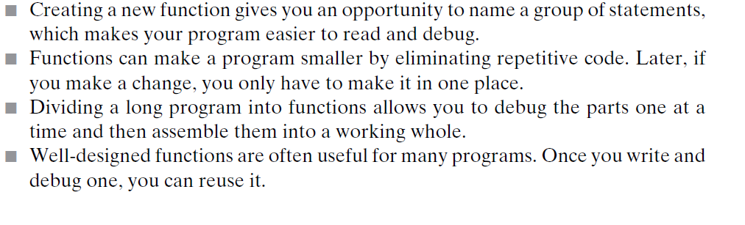
Why Functions?

Slide 5
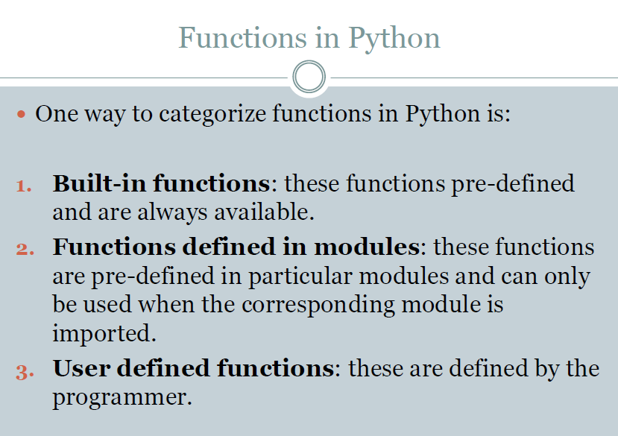

Slide 6
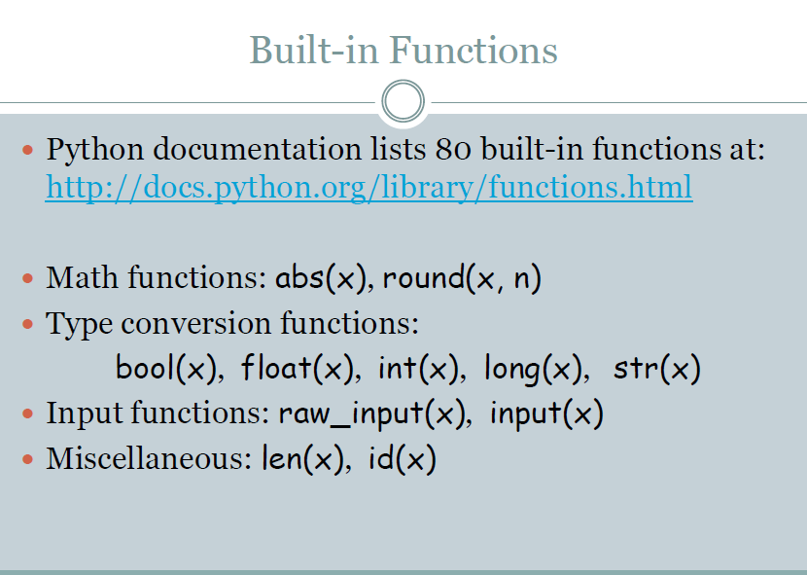

Slide 7
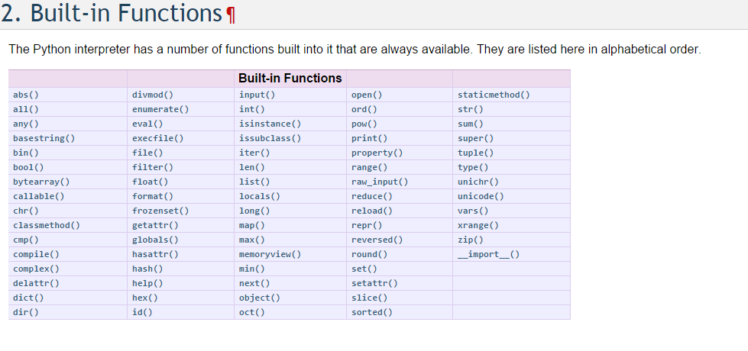

Slide 8
Examples
>>>max(1,2,3)
3
>>>min(1,2,3)
1
>>> big = max('Hello world')
>>> print big
W
>>> tiny = min('Hello world')
>>> print tiny
e

Slide 9
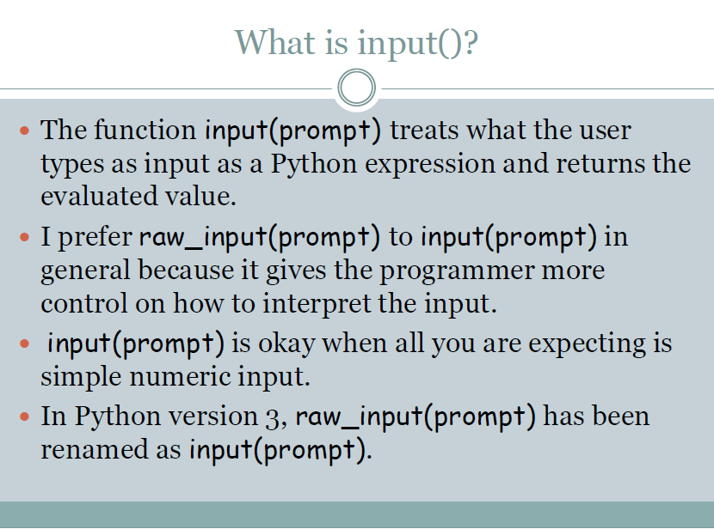

Slide 10
Type conversion
The word conversion refers to either implicitly or explicitly changing a value from one data type to another, e.g. a 16-bit integer to a 32-bit integer.
The word coercion is used to denote an implicit conversion.
The word cast typically refers to an explicit type conversion (as opposed to an implicit conversion), regardless of whether this is a re-interpretation of a bit-pattern or a real conversion.
So, coercion is implicit, cast is explicit, and conversion is any of them.
Type Coercion is the conversion of one type of object to a new object of a different type with similar content
A common example is the coercion of string "5" into an integer 5 or a double 5.0

Slide 11
Type Conversion
Type conversion is converting one type of data to another type.
Implicit type conversion - These conversions are performed by interpreter.
Explicit type conversion - These conversions are done explicitly by users using the pre-defined functions.
The word conversion refers to either implicitly or explicitly changing a value from one data type to another.
The word coercion is used to denote an implicit conversion.
The word cast typically refers to an explicit type
So, coercion is implicit, cast is explicit, and conversion is any of them

Slide 12
Type Conversion
Python provides a collection of built-in functions that convert values from one type to another. The int function takes any value and converts it to an integer, if possible, or complains otherwise:
>>> int("32")
32
>>> int("Hello")
ValueError: invalid literal for int(): Hello
int can also convert floating-point values to integers, but remember that it truncates the fractional part:
>>> int(3.99999) >>> int(-2.3)
3 -2

Slide 13
Type Conversion
The float function converts integers and strings to floating-point numbers:
>>> float(32) >>> float("3.14159")
32.0 3.14159
Finally, the str function converts to type string:
>>> str(32) >>> str(3.14149)
‘32’ ‘3.14149’
You will get an error if the string does not contain numeric characters
>>>

Slide 14
built-in type conversion functions
Function | Description
int(x) | Converts x to an integer.
long(x) | Converts x to a long integer.
float(x) | Converts x to a floating-point number.
complex(real [,imag]) | Creates a complex number.
str(x) | Converts object x to a string representation.
repr(x) | Converts object x to an expression string.
eval(str) | Evaluates a string and returns an object.
tuple(s) | Converts s to a tuple.
list(s) | Converts s to a list.
set(s) | Converts s to a set.
dict(d) | Creates a dictionary. d must be a sequence of (key,value) tuples.
frozenset(s) | Converts s to a frozen set.
chr(x) | Converts an integer to a character.
unichr(x) | Converts an integer to a Unicode character.
ord(x) | Converts a single character to its integer value.
hex(x) | Converts an integer to a hexadecimal string.
oct(x) | Converts an integer to an octal string.

Slide 15
Type Conversion
Now that we can convert between types, we have another way to deal with integer division.
Suppose we want to calculate the fraction of an hour that has elapsed. The most obvious expression, minute / 60, does integer arithmetic, so the result is always 0.
One solution is to convert minute to floating-point and do floating-point division:
>>> minute = 59
>>> float(minute) / 60.0
0.983333333333

Slide 16
Type Coercion
Alternatively, we can take advantage of the rules for automatic type conversion, which is called type coercion. For the mathematical operators, if either operand is a float, the other is automatically converted to a float:
>>> minute = 59
>>> minute / 60.0
0.983333333333
By making the denominator a float, we force Python to do floating-point division.

Slide 17
User Defined Functions
We create a new function using the def keyword followed by optional parameters in parenthesis.
This line is called function header and function header ends with : (colon)
We indent the body of the function
This defines the function but does not execute the body of the function
Syntax→function definition
def function name([parameters]):
function body
return[expression]

Slide 18
Function call
The statements inside function is executed only when the function is called.
Syntax for calling function
  Function name([arguments])
  [ ]→Optional

Slide 19
Example
Program
def sub(lang):
if lang == ‘python':
return ‘ktu’
else:
return ‘mgu’
print “University“
uty=sub(‘python’)
print uty
Output
University
Python
Function
Definition
Function call

Slide 20
Parameters
A parameter is a variable which we use in the function definition that is a “handle” that allows the code in the function to access the arguments for a particular function invocation.

Slide 21
Arguments
An argument is a value we pass into the function as its input when we call the function
We use arguments so we can direct the function to do different kinds of work when we call it at different times
We put the arguments in parenthesis after the name of the function

Slide 22
Return Values
Often a function will take its arguments, do some computation and return a value to be used as the value of the function call in the calling expression. The return keyword is used for this.
The return statement ends the function execution and “sends back” the result of the function

Slide 23
Arguments, Parameters,Return Value,Result
Parameter
def sub(lang):
if lang == ‘python':
return ‘ktu’
else:
return ‘mgu’
print “University“
uty=sub(‘python’)
print uty
Return Value
Argument
Result

Slide 24
Definitions and Uses
Once we have defined a function, we can call (or invoke) it as many times as we like
This is the store and reuse pattern

Slide 25
Stored (and reused) Steps
def
thing():
print 'Hello‘
print ‘Fun’
Program:
def thing():
print 'Hello’
print 'Fun’
thing()
print 'Zip’
thing()
Output:
Hello
Fun
Zip
Hello
Fun
thing()
print “Zip”
thing()
We call these reusable pieces of code “functions”.

Slide 26
Call for use
The statements inside functions do not get executed until the function is called.
x = 5
print 'Hello'
def lyrics():
print “Rain rain go away,”
print ‘Come again another day.'
print ‘S1it'
x = x + 2
print x
Output
Hello
S1it
7

Slide 27
Call for use
x = 5
print 'Hello'
def lyrics():
print “Rain rain go away,”
print ‘Come again another day.’
print ‘s1it'
x = x + 2
lyrics()
print x
Output
Hello
s1it
7
Rain rain go away,
Come again another day

Slide 28
Reuse
x = 5
print 'Hello'
def lyrics():
print “Rain rain go away,”
print ‘Come again another day.’
print ‘s1it’
lyrics()
x = x + 2
print x
lyrics()
Output
Hello
Rain rain go away,
Come again another day
s1it
7
Rain rain go away,
Come again another day

Slide 29
Different types of function
No argument No return type
With arguments No return type
No argument with return type
With argument and return type

Slide 30
No argument No return type
def sqr():
a=3
s=a*a
print s
sqr()
OUTPUT
9

Slide 31
With arguments No return type
def sqr(a):
s=a*a
print s
#a=3
#sqr(a)
sqr(3)
OUTPUT
9

Slide 32
No arguments With return type
def sqr():
a=3
s=a*a
return s
s=sqr()
print s
OUTPUT
9

Slide 33
With arguments With return type
def sqr(a):
s=a*a
return s
r=sqr(3)
print r
OUTPUT
9

Slide 34
Multiple Parameters / Arguments
We can define more than one parameter in the function definition
We simply add more arguments when we call the function
We match the number and order of arguments and parameters
def addtwo(a, b):
added = a + b
return added
x = addtwo(3, 5)
print x

Slide 35
Variables and Parameters are Local
When you create a variable inside a function,it is local which means that it exists only inside the function
When sqr() terminates the variable s also destroyed,if we try to print it we get an exception
Program
def sqr(a):
s=a*a
sqr(3)
print s
Output
NameError: name 's' is not defined

Slide 36
Variables and Parameters are Local
Parameters are also local.
For example,outside sqr() there is no such thing as ‘a’
Program
def sqr(a):
s=a*a
sqr(3)
print a
Output
NameError: name 'a' is not defined

Slide 37
Scope & Life of variable
Program
def my_func():
x = 10
print("Value inside function:",x)
x = 20
my_func()
print("Value outside function:",x)
Output
Value inside function: 10 Value outside function: 20

Slide 38
Fruitful Functions
Functions that return values are "fruitful" functions
A “fruitful” function is one that produces a result (or return value)
Program
def sqr(a):
s=a*a
return s
r=sqr(3)
print r
OUTPUT
9

Slide 39
Void Functions
When a function does not return a value, we call it a "void" function
Void functions might display something on the screen, but they don’t have a return value
Program
def sqr(a):
s=a*a
print s
sqr(3)
OUTPUT
9

Slide 40
Void Functions
If you try to assign the result to a variable, you get a special value called NONE
Program
def sqr(a):
s=a*a
r=sqr(3)
print r
output
None

Slide 41
Nested function
Once function is defined ,it can use inside another function.
def rhymes():
  print “Nursery Rhymes”
  lyrics1()
  lyrics2()
  rhymes()
  Output
  Nursery Rhymes
  Rain rain go away
  Twinkle Twinkle little star
PROGRAM
def lyrics1():
print “Rain rain go away ”
def lyrics2():
print “Twinkle Twinkle little star”

Slide 42
Tutorial
Multiply two numbers
Set I
Factorial
Simple Calculator
Set II
Swap two numbers
Area of Circle Rectangle and Square

Slide 43
Recursion
Recursion is the process of defining something in terms of itself. A physical world example would be to place two parallel mirrors facing each other. Any object in between them would be reflected recursively.
Python Recursive Function
We know that in Python, a function can call other functions. It is even possible for the function to call itself. These type of construct are termed as recursive functions.
Following is an example of recursive function to find the factorial of an integer. Factorial of a number is the product of all the integers from 1 to that number. For example, the factorial of 6 (denoted as 6!) is 1*2*3*4*5*6 = 720.

Slide 44
Example of recursive function
Program
# An example of a recursive function to #find the factorial of a number
def recur_fact(x):
if x == 1:
return 1
else:
return (x * recur_fact(x-1))
num = input("Enter a number: ")
if num >= 1:
print("The factorial of", num, "is", recur_fact(num))
Output
Enter a number: 4
The factorial of 4 is 24

Slide 45
Explanation
In the above example, recur_fact() is a recursive functions as it calls itself.
When we call this function with a positive integer, it will recursively call itself by decreasing the number.
Each function call multiples the number with the factorial of number-1 until the number is equal to one.
This recursive call can be explained in the following steps.

Slide 46
Explanation
recur_fact(4) # 1st call with 4
4 * recur_fact(3) # 2nd call with 3
4 * 3 * recur_fact(2) # 3rd call with 2
4 * 3 * 2 * recur_fact(1) # 4th call with 1
4 * 3 * 2 * 1 # retrun from 4th call as number=1
4 * 3 * 2 # return from 3rd call
4 * 6 # return from 2nd call
24 # return from 1st call
Our recursion ends when the number reduces to 1. This is called the base condition. Every recursive function must have a base condition that stops the recursion or else the function calls itself infinitely. We must avoid infinite recursion.

Slide 47
Advantages of recursion
Recursive functions make the code look clean and elegant.
A complex task can be broken down into simpler sub-problems using recursion.
Sequence generation is easier with recursion than using some nested iteration.

Slide 48
Disadvantages of recursion
Sometimes the logic behind recursion is hard to follow through.
Recursive calls are expensive (inefficient) as they take up a lot of memory and time.
Recursive functions are hard to debug.

Slide 49
Try..
Program to find sum of first n natural numbers using recursion
Program to print Fibonacci series using recursion
Program to find nPr and nCr

Slide 50
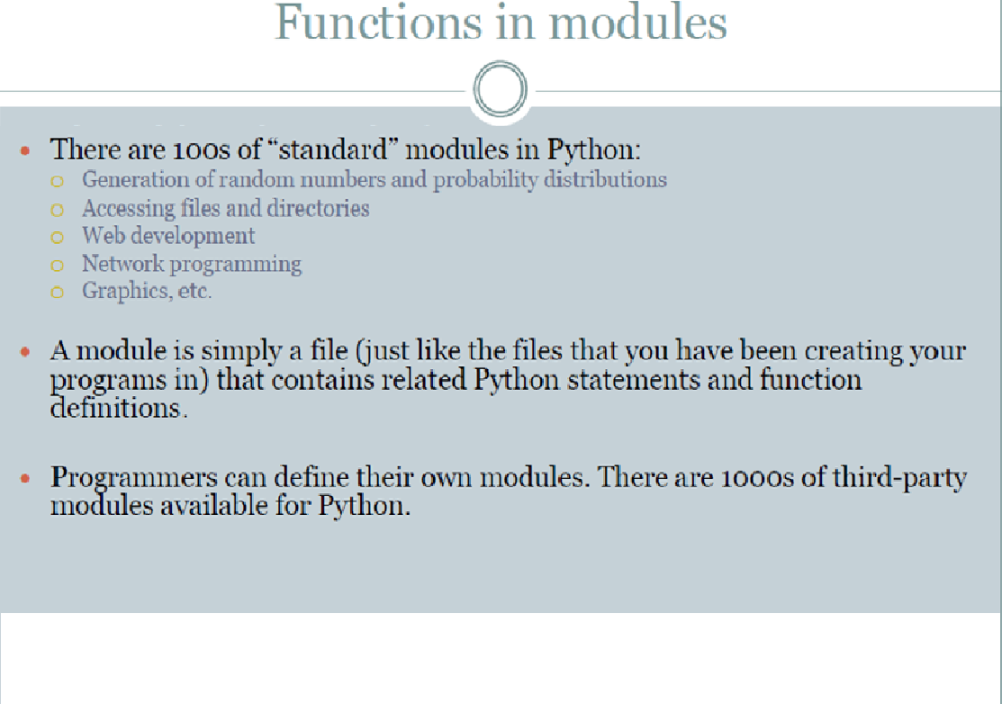

Slide 51
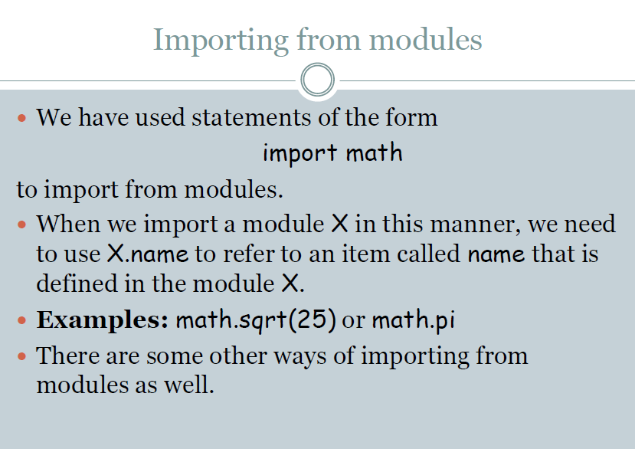

Slide 52
Import example
For clearing output screen
import os
os.system(‘clear’)

Slide 53
import statement example
Program
# to import standard module math
import math
print("The value of pi is", math.pi)
Output
The value of pi is 3.141592653589793

Slide 54
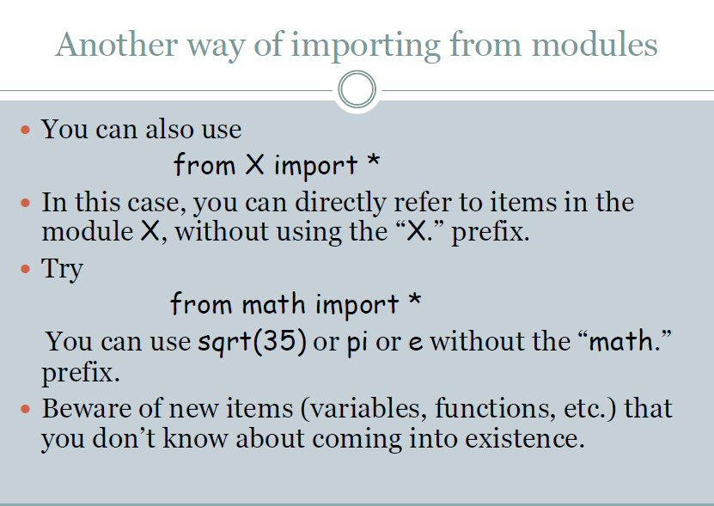

Slide 55
Example
Program
# import only pi from math module
from math import pi
print("The value of pi is", pi)
Output
The value of pi is 3.141592653589793

Slide 56
Functions in math module
displays various functions in math module
>>>dir(math)
['__doc__', '__file__', '__name__', 'acos', 'asin', 'atan', 'atan2', 'ceil', 'cos', 'cosh', 'degrees', 'e', 'exp', 'fabs', 'floor', 'fmod', 'frexp', 'hypot', 'ldexp', 'log', 'log10', 'modf', 'pi', 'pow', 'radians', 'sin', 'sinh', 'sqrt', 'tan', 'tanh']

Slide 57
Math Functions
In mathematics, you have probably seen functions like sin and log, and you have learned to evaluate expressions like sin(pi/2) and log(1/x).
First, you evaluate the expression in parentheses (the argument). For example, pi/2 is approximately 1.571, and 1/x is 0.1 (if x happens to be 10.0)
Then, you evaluate the function itself, either by looking it up in a table or by performing various computations. The sin of 1.571 is 1, and the log of 0.1 is -1 (assuming that log indicates the logarithm base 10).
This process can be applied repeatedly to evaluate more complicated expressions like log(1/sin(pi/2)).

Slide 58
Math Functions (Cont...)
First, you evaluate the argument of the innermost function, then evaluate the function, and so on.
Python has a math module that provides most of the familiar mathematical functions.
A module is a file that contains a collection of related functions grouped together.

Slide 59
Math Functions (Cont...)
Before we can use the functions from a module, we have to import them:
>>> import math
To call one of the functions, we have to specify the name of the module and the name of the function, separated by a dot, also known as a period. This format is called dot notation.
>>> decibel = math.log10 (17.0)
>>> angle = 1.5
>>> height = math.sin(angle)
The first statement sets decibel to the logarithm of 17, base 10. There is also a function called log that takes logarithm base e.
The third statement finds the sin of the value of the variable angle. sin and the other trigonometric functions (cos, tan, etc.) take arguments in radians.

Slide 60
Math Functions (Cont...)
To convert from degrees to radians, divide by 360 and multiply by 2*pi. For example, to find the sine of 45 degrees, first calculate the angle in radians and then take the sin:
>>> degrees = 45
>>> angle = degrees * 2 * math.pi / 360.0
>>> math.sin(angle)

Slide 61
Composition of functions
Just as with mathematical functions, Python functions can be composed, meaning that you use one expression as part of another. For example, you can use any expression as an argument to a function:
>>> x = math.cos(angle + math.pi/2)
This statement takes the value of pi, divides it by 2, and adds the result to the value of angle. The sum is then passed as an argument to the cos function.
You can also take the result of one function and pass it as an argument to another:
>>> x = math.exp(math.log(10.0))
This statement finds the log base e of 10 and then raises e to that power. The result gets assigned to x.

