Slide 1
What Is a Computer?
An electronic device, operating under the control of instructions stored in its own memory, that can:
  Accept data (input)
  Process the data according to specified rules (process)
  Produce results (output)
  Store the results (storage) for future use

Slide 2
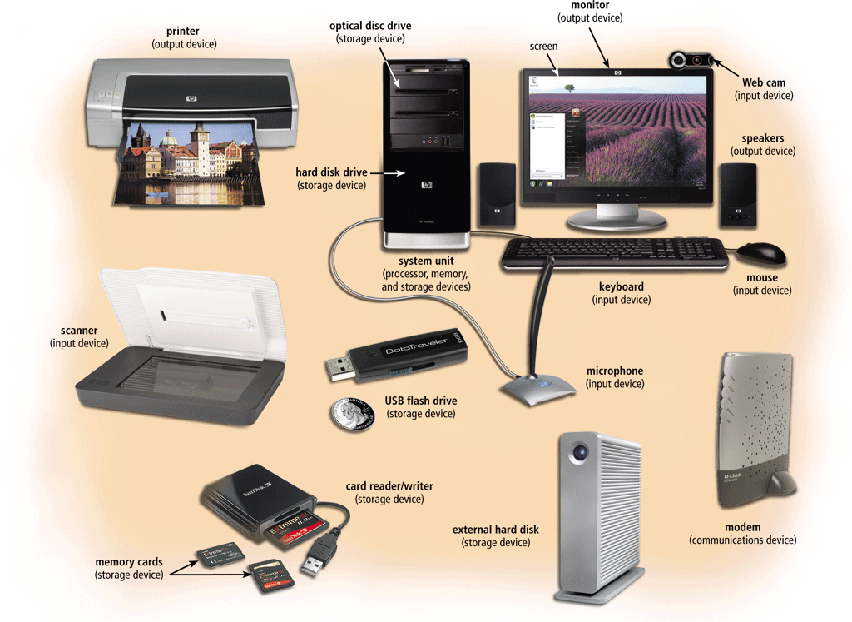

Slide 3
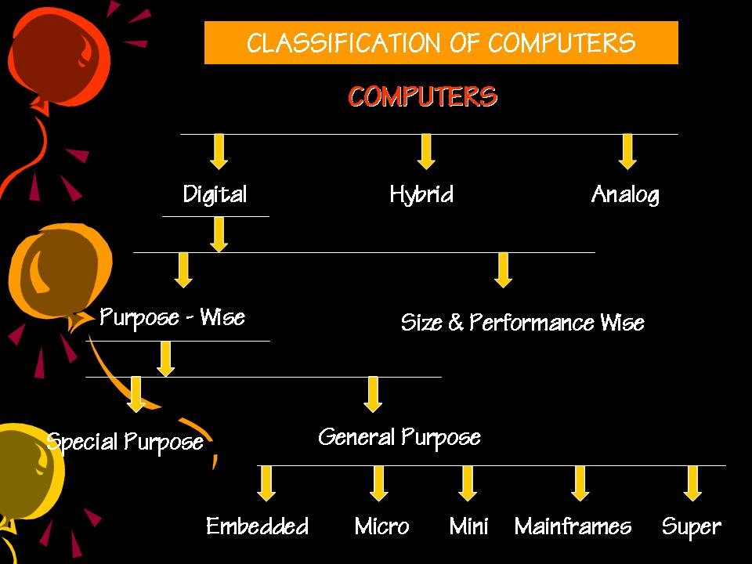

Slide 4
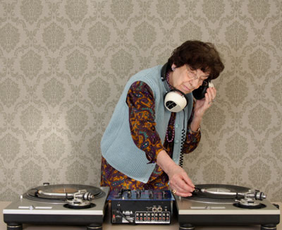
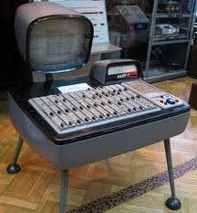
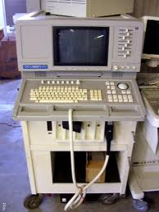
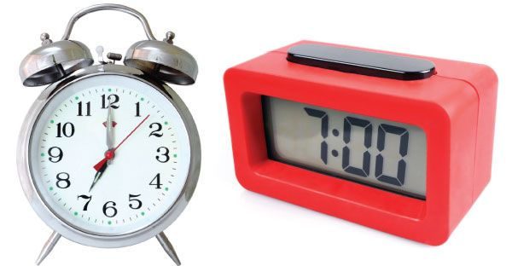
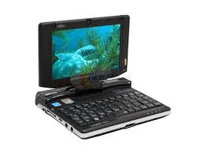
Types of Computers
On the basis of principle of construction
Computers are divided into two ypes:
Analog Computers
Digital Computers

Slide 5
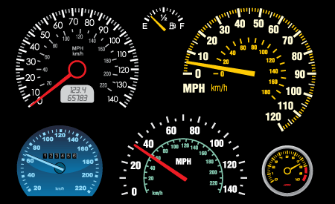
Analog Computers
A computer in which data are represented by measurable physical variables, such as electrical voltage.
An analog computers is a form of computer that uses the continuously changeable aspects of physical phenomena such electrical, mechanical, or hydraulic quantities to model the problem being solved.
As mechanical computers used in World War Second II for controlling gun fire.
Analog computers are also used in science and industry.
Analog computers deal with measure data.
Examples:
Thermometer because it measures the length of a mercury column, which varies continuously.
Analog Clock
Car Speedometer

Slide 6

Digital Computers
A digital computer is an electronic computing machine that uses the binary digits(bits) 0 and 1 to represent all forms of information internally in digital form.
Every computer has a set of instructions that define the basic functions it can perform.
Sequences of these instructions constitute machine-language (Low level language in the form of 0’s and 1’s )programs that can be stored in the computers.
Examples:
1. Calculator (a small computer)
2.Digital clock, Digital watches
3. Weighing machines
4. Consumer electronic equipment (such as microwave oven )
5. Automobiles
6. Mini, Micro, Mainframe and super computers.

Slide 7
Digital Computers
Types
  MICRO COMPUTERS
  MINI COMPUTERS
  MAINFRAME COMPUTERS
  SUPER COMPUTERS

Slide 8
Personal (Micro) Computers
A personal computer (PC) is any general-purpose Computer whose size, capabilities, and original sales price make it useful for individuals, and which is intended to be operated directly by an end user.
A personal computer may be a desktop computer, a laptop, a notebook, a tablet PC, or a handheld PC, Smart phones
Software applications for personal computers include word processing, spreadsheets, databases, Web browsers and e-mail clients, games and special-purpose software applications.
A PC may be used at home or in an office.

Slide 9
Personal (Micro) Computers : Features
Cheap and easy to use:
Storage Capacity
  They have less storage capacity
Software Capacity
  These computers support very limited number of software
Architecture
  Most of microcomputers are self-contained unit, which are light enough and can be moved easily.
Data Storage
  Hard disk and floppy disk drivers are used to enter and store data and programs
Number of Operators
  They are designed to be used by one person at a time.

Slide 10
Mini Computers
Minicomputers are relatively low cost and small .
Minicomputer is a class of multi-user Computer that lies in the middle range of the computing spectrum, in between the largest Multi-user systems (mainframe computer) and the smallest single-user systems (Microcomputers or personal computers.
Can support 4-200 users simultaneously.
Uses:
  Used for real time applications in industries research centers etc
  Example
  PDP 7, PDP 11,IBM(8000 series)

Slide 11
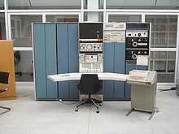
Mini Computer Name: PDP 7

Slide 12
Mainframe Computers
Mainframe computers are larger than Mini Computers.
Multi user, Multi Programming, High Speed, High Storage
Centralized Database
Usually, a main frame would occupy an entire room and could cost over million dollars.
Users access Mainframe via dumb terminals
Uses:
  Mainframe computers are used to run commercial applications and other large-scale computing purposes.
  It is also used in banking and insurance businesses where enormous amounts of data are processed.
  For example millions of records , each day.
  Example:
  CDC 6600 and IBM ES000 series

Slide 13
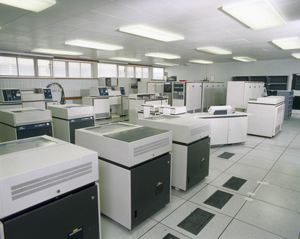
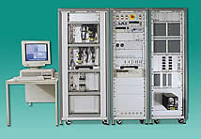
Mainframe Compuer

Slide 14
Super Computers
Supercomputer are very fast computers that can perform hundreds of millions of instructions per second. These are the fastest calculating devices.
Built by interconnecting thousands of processors that can work parallel
Speed is measured in FLOPS(Floating Point Operations Per Second)
Can perform trillions of calculations per second

Slide 15
Super Computers
Uses:
  Super computer are used by government agencies .
  Used for scientific and engineering applications that must handle very large databases or do a great amount of computation.
  Astronomers and space scientists use super computers to study the Sun and space weather.
  Supercomputers are used in nuclear technology.
  Supercomputers are used to research in the field of medicine. For example Cancer.
  Supercomputers are used for the heavy stuff like weather maps, construction of atom bombs, finding oil, earthquake prediction, and sciences where a lot of calculations must be done.
  Example:
  IBMRoadrunner, IBM Blue gene ,Titan, Intel ASCI red
  PARAM is a series of supercomputers assembled in India by C -DAC

Slide 16
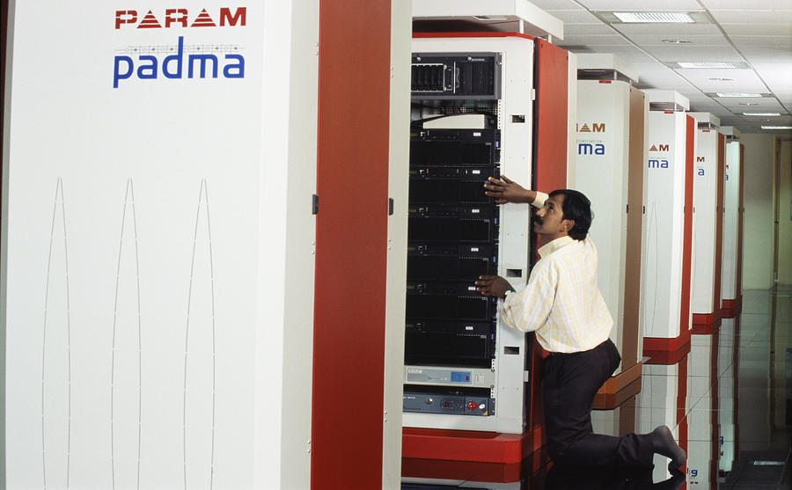
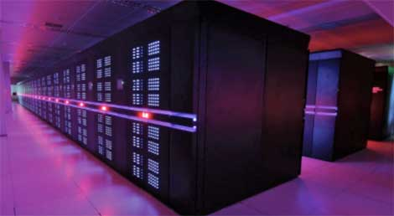
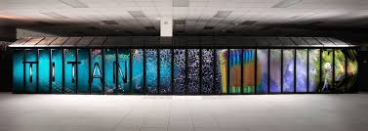
Sequoia - BlueGene/Q
Titan - Cray XK7

Slide 17
The Von Neumann Architecture
Model for designing and building computers, based on the following three characteristics:
  The computer consists of four main sub-systems:
    Memory
    ALU (Arithmetic/Logic Unit)
    Control Unit
    Input/Output System (I/O)
  Program is stored in memory during execution.
  Program instructions are executed sequentially.

Slide 18
The Von Neumann Architecture
Bus
Processor (CPU)
Memory
Input-Output
Control Unit
ALU
Store data and program
Communicate with
"outside world", e.g.
Screen
Keyboard
Storage devices
...
Registers
Execute program
Do arithmetic/logic operations
requested by program

Slide 19
INPUT UNIT:
Converts the external world data to a binary format, which can be understood by CPU
Eg: Keyboard, Mouse, Joystick etc
OUTPUT UNIT:
Converts the binary format data to a format that a common man can understand
Eg: Monitor, Printer, LCD, LED etc

Slide 20
CPU
The “brain” of the machine
Responsible for carrying out computational task
Contains ALU, CU, Registers
ALU Performs Arithmetic and logical operations
CU Provides control signals in accordance with some timings which in turn controls the execution process
Register Stores data and result and speeds up the operation

Slide 21
Arithmetic & Logic Unit
  As the name implies performs two functions:
  Arithmetic
    Responsible for performing the arithmetic operations of addition, subtraction, multiplication and division
  Logic
    Makes simple “decisions” by comparing alternatives and choosing between them
      Less than, greater than, equal to
      AND, OR and NOT

Slide 22
Control Unit
The Control Unit is the computer’s internal coordinator
  Sends out electronic signals directing the computer to perform specific tasks such as:
    Move data between memory and the CPU
    Activating the ALU
    Receiving data
    Sending information to an output device
  The control unit manages the flow of data throughout the machine based on the instructions it receives from programs.

Slide 23
BUSES
  are circuitry paths for transmitting data and signals among the parts of the computer system.
  MEMORY
  Unit for storing data and instruction
  REGISTER
  Registers are fast stand-alone storage locations that hold data temporarily. Multiple registers are needed to facilitate the operation of the CPU.

