Slide 1
Floating Point Arithmetic Operations
Module 2

Slide 2
2 parts
  Mantissa->signed fixed point number
  exponent->the position of the decimal(binary) point
  Eg:6132.739
      +06132739->fraction
      4-> exponent
      Similar to +0.6132739*10^+4
General form M*r^e
  M->mantissa
  r->radix
  E->exponent

Slide 3
For binary fp;
  Similar to fp decimal point, but uses radix 2
  Eg:+1001.11
  01001110(mantssa)
  000100(exponent)

Slide 4
Normalization
A floating point no. is said to be normalized if the most significant digit of the mantissa is nonzero.
Eg:350->normalized
  00035-> not normalized.
  Can be normalized by shifting it 3 positions to the left and discarding the leading zeros.(10^3)
Zero cannot be normalized bcoz it doesnot have a nonzero digit.
  Denoted by all zeros at mantissa and exponenet.

Slide 5
Operations on fp numbers requires complex hardware and takes more time.
Addition or subtraction requires:
  Alignment of radix point(exponents must be equal).
  Done by shifting mantissa and adjust exponent accordingly.
  Eg: 0.5372400*10^2+
  0.1580000*10^-1

Slide 6
Either shift the 1st no 3 positions to the left or shift the 2nd by 3 position to the right.
2nd method is more preferable.
  So, .5272400*10^2+
  .0001580*10^2
  .5373980 *10^2
  Normalized addition will cause an overflow and can be corrected by shifting the sum once to the right and incrementing the exponent.

Slide 7
Underflow
  Floating point number has a 0 in the MSB of the mantissa.
  Shift the mantissa to the left and decrement the exponent(normalization)
Multiplication and division doesnot require alignment.
  Result(multiply mantissa and add the exponent for multiplication)
  Divide the mantissa and subtract the exponent for division

Slide 8
The operation performed with exponent are:
  Compare &increment(align mantissa)
  Add &subtract(multiplication and division)
  Decrement(nomalization)
Exponent representation
  Signed magnitude
  Signed 2’s complement
  Signed 1’s complement
  Biased exponent

Slide 9
In biased exponent
  Sign bit is not taken as separate entity.
  Is a +ve number that is added to each exponent as the floating point number is formed.
  Internally all exponents are +ve.
  the bias, is subtracted from the field to get the true exponent value.
Bias=(2^{k-1}-1), where k is the number of bits in the binary exponent.

Slide 10
Advantages
  They contain only positive numbers(easy to compare)
  The smallest possible biased exponent contains all zeros

Slide 11
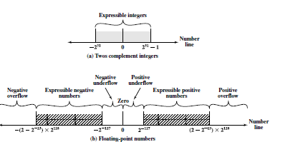

Slide 12


Slide 13
IEEE Standard for Binary Floating-Point Representation
IEEE 754 in 1985.
developed to facilitate the portability of
programs from one processor to another and to encourage the development of sophisticated, numerically oriented programs.

Slide 14
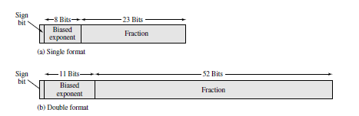
IEEE 754 Formats

Slide 15
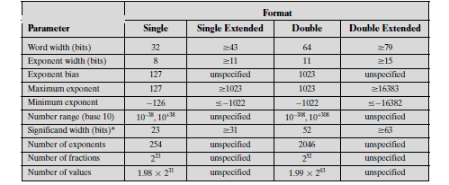
Parameter List

Slide 16
Register Configuration
The same registers & adders are in the case of fixed point arithmetic are used for processing mantissa.
Differs the way in which exponents are handled

Slide 17
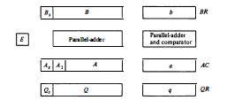

Slide 18
BR,AC,QR(divided into 2 parts).
Mantissa is stored in B,A and Q registers
Exponent in b,a,q registers.
  Mantissa in signed magnitude in A and sign in As and MSB in A1.
  Biased exponent in a.
  A1->1 if the no. Has to be normalized
  Similarly for other registers

Slide 19
2Parallel adders
  1 ,Adds two mantissas and sum stores in A,Carry to E.
  2nd adds the exponents(don’t have distinct sign bit,but taken as +ve).
Exponent overflow is neglected.
Exponents are connected to comparator that provides 3 binary outputs to indicate their relative magnitude.

Slide 20
The number in the mantissa is taken as a fraction, so binary point resides to the left of the magnitude part.
Numbers are normalized both during initial and after the operation.

Slide 21
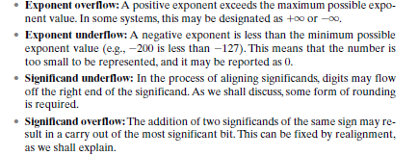
A floating point operation may produce:

Slide 22
Addition and Subtraction
1. Check for zeros.
2. Align the mantissas.
3. Add or subtract the mantissas.
4. Normalize the result.

Slide 23
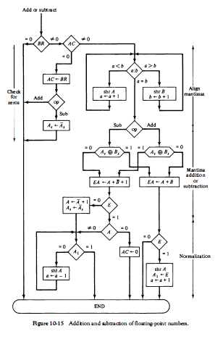

Slide 24
Multiplication
multiply the mantissas and add the exponents.
No comparison of exponents or alignment of mantissas is necessary.

Slide 25
Four components:
1. Check for zeros.
2. Add the exponents.
3. Multiply the mantissas.
4. Normalize the product.

Slide 26
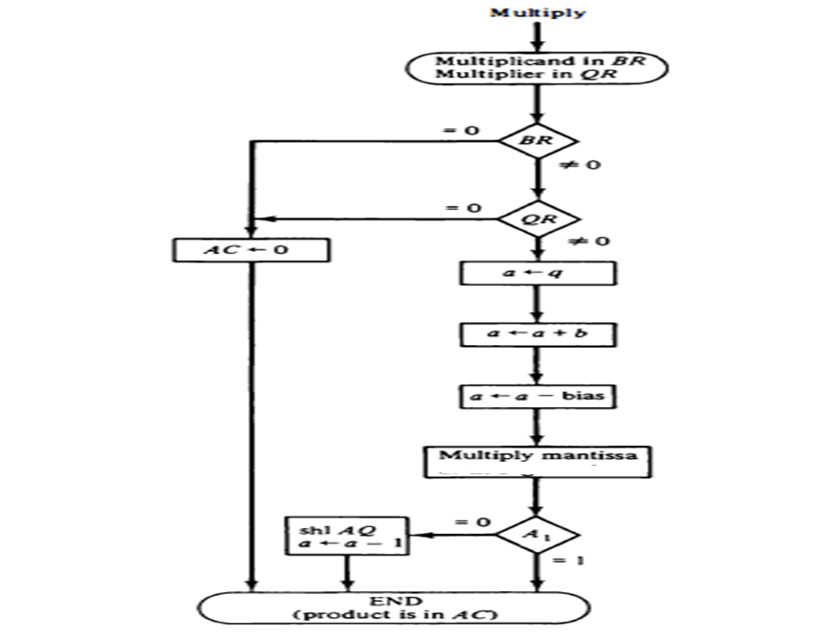

Slide 27
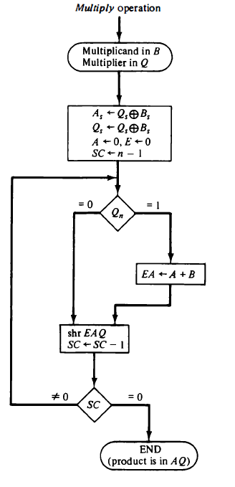

Slide 28
Division
Floating-point division requires that the exponents be subtracted and the mantissas divided.
The mantissa division is done as in fixed-point except that the dividend has a single-precision mantissa that is placed in the AC.

Slide 29
Check for zeros.
Initialize registers and evaluate the sign
Align the dividend(divide overflow check in fixp).
Subtract the exponents.
Divide the mantissas.

Slide 30
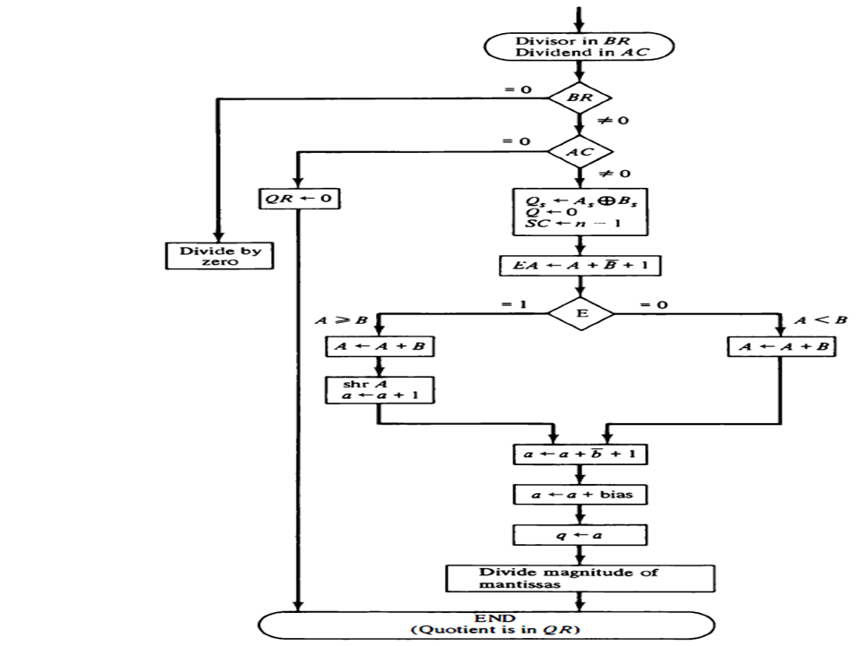
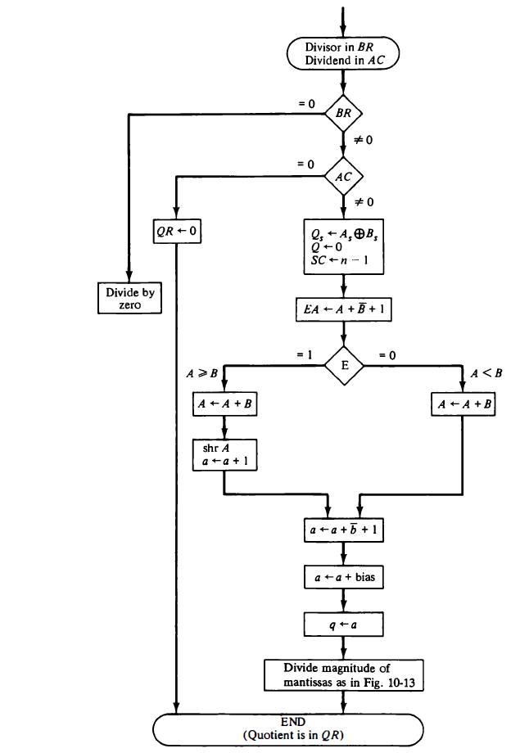

Slide 31
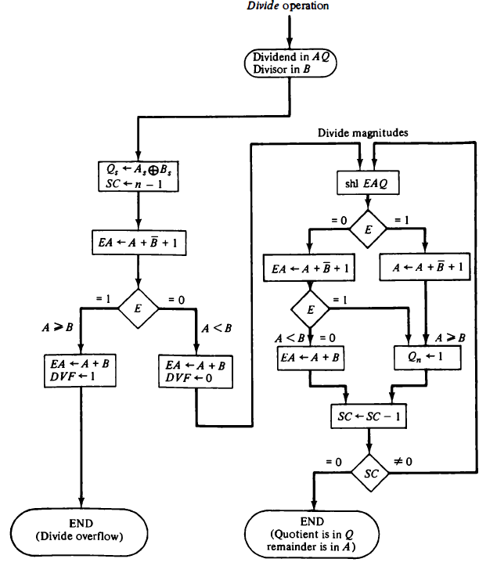

Slide 32
Decimal Arithmetic Unit
is a digital function that performs decimal
microoperations.
can add or subtract decimal numbers, usually by forming the 9's or 10's complement of the subtrahend.
The unit accepts coded decimal numbers and generates results in the same adopted binary code.

Slide 33
A single-stage decimal arithmetic unit consists of:
  nine binary input variables
  five binary output variables
  ( since a minimum of four bits is required to represent each coded decimal digit)
Each stage must have four inputs for the augend digit, four inputs for the addend digit, and an input-carry.

Slide 34
The outputs include four terminals for the sum digit and one for the output-carry.

Slide 35
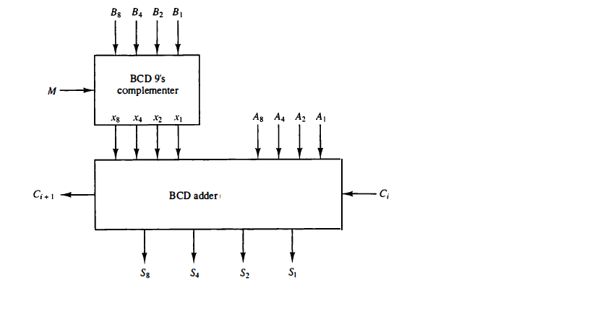
Once cell of Decimal additiom

Slide 36
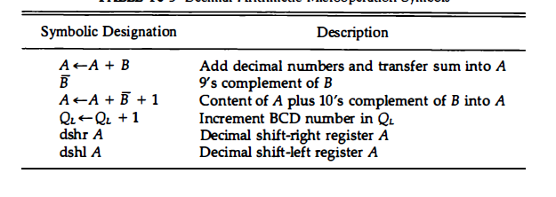
Decimal Arithmetic Operations

Slide 37
Addition and Subtraction
Addition
  Parallel decimal adder
  Digit-serial. Bit-parallel decimal addition
  All serial decimal addition

Slide 38
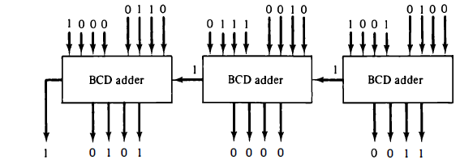
Parallel Decimal Adder
624+829=1503

Slide 39
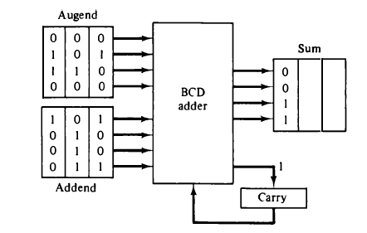
Digit-serial. Bit-parallel decimal addition

Slide 40
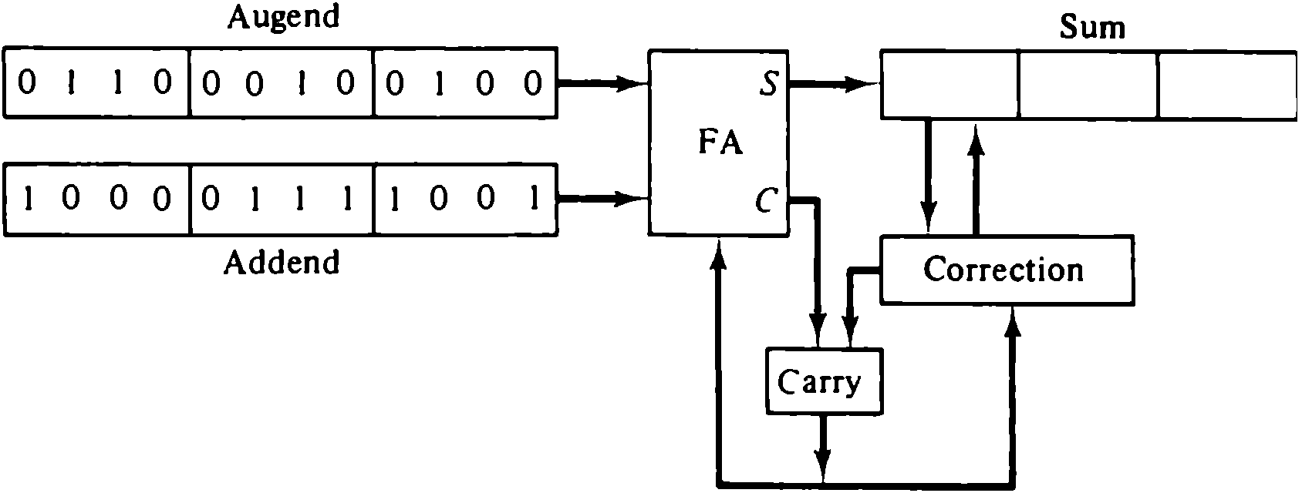
All serial decimal addition

Slide 41
Multiplication

Slide 42
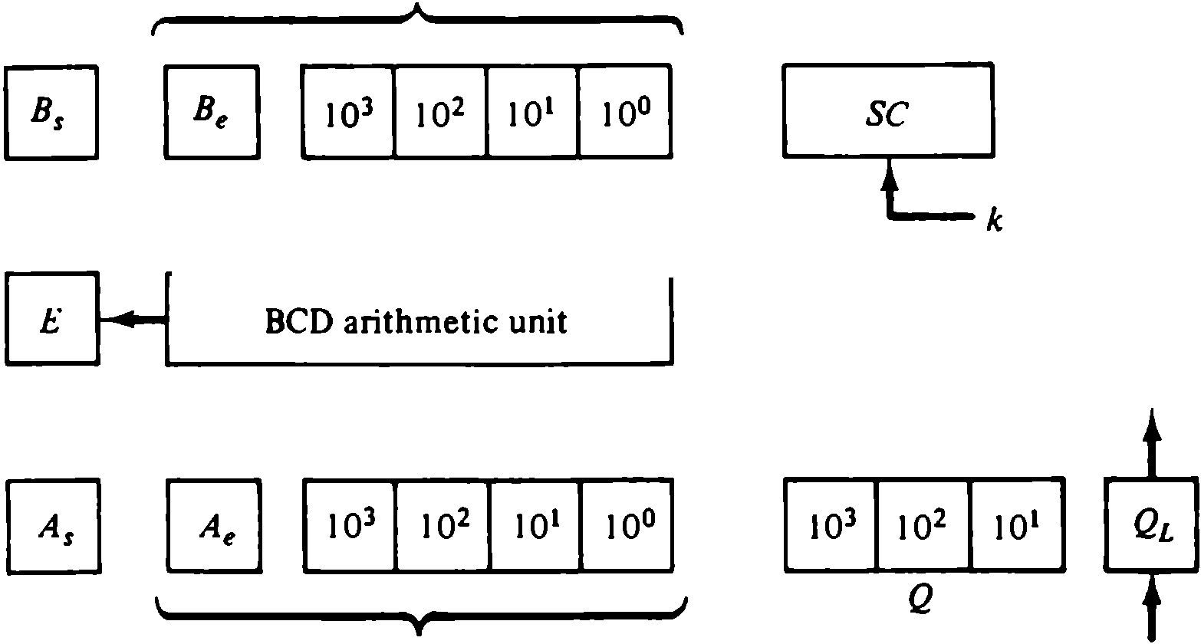
Registers for decimal arithmetic multiplication and division

Slide 43
Ae- to accommodate overflow(adding the multiplicand to the partial product)
Be-to form the 9’s complement of the divisor when subtracted from the partial remainder.

Slide 44
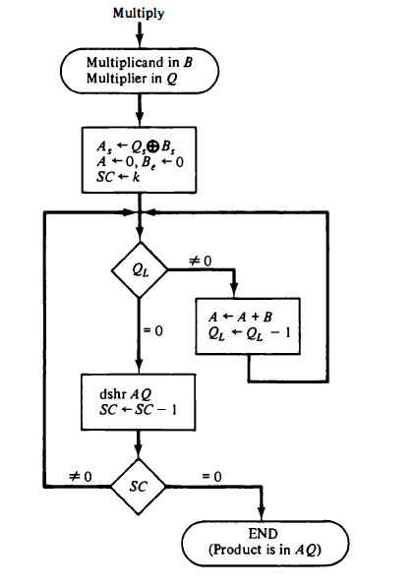

Slide 45
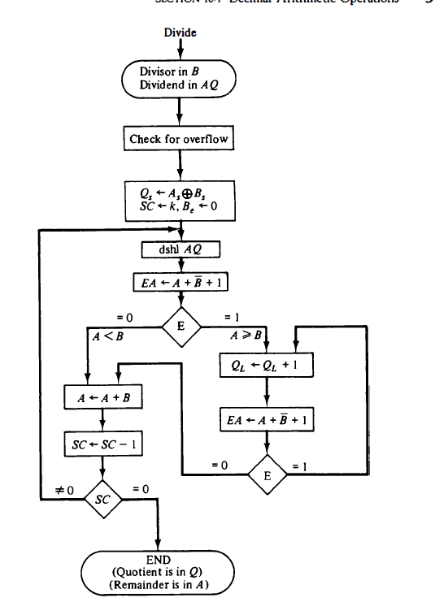
Division

Slide 46
Arithmetic and Logic Unit
Is a multioperation, combinational logic digital function.
Perform
  a set of basic arithmetic operations
  Set of logical operations
No. Of selection lines(to select a particular operation).
K selection variables->2^{k} distinct operations.

Slide 47
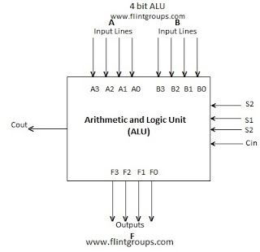
4 bit ALU

Slide 48
Design of ALU will be carried out in 3stages:
  Design of arithmetic section
  Design of logic section
  The arithmetic section will be modified so that it can perform both arithmetic and logic operations.

Slide 49
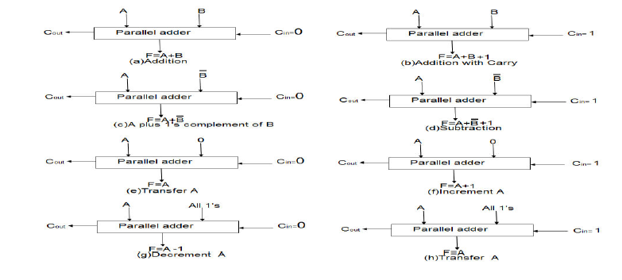
Design of Arithmetic unit

Slide 50
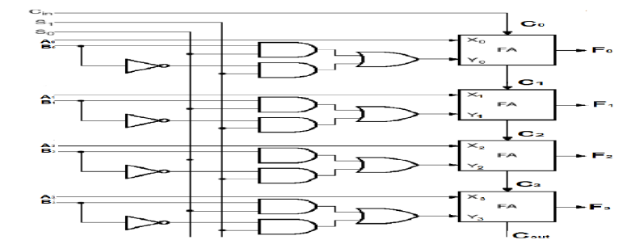

Slide 51
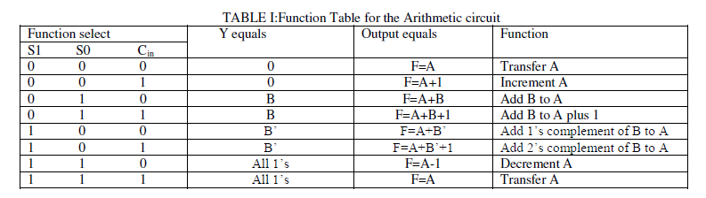

Slide 52
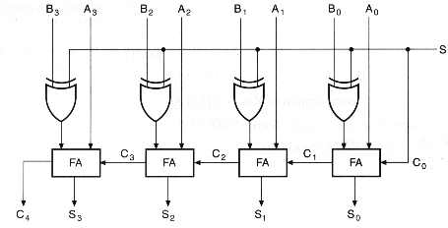
4bit adder/subtractor circuit

Slide 53
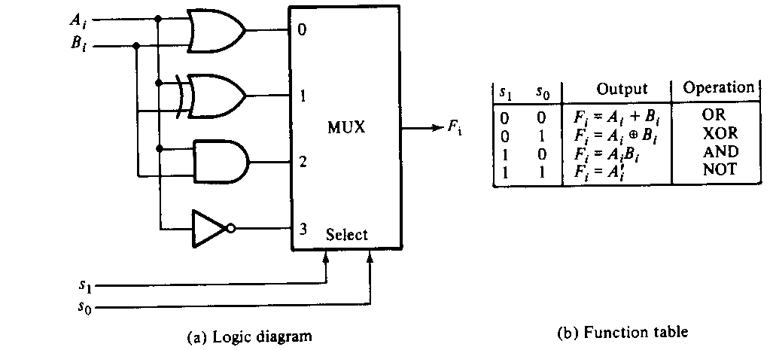
Design of LogiC Circuit

Slide 54
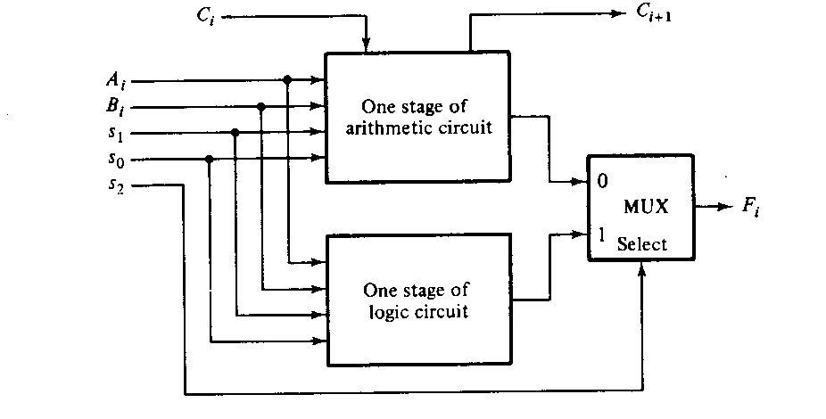
Combining Logic & Arithmetic Circuits

Slide 55
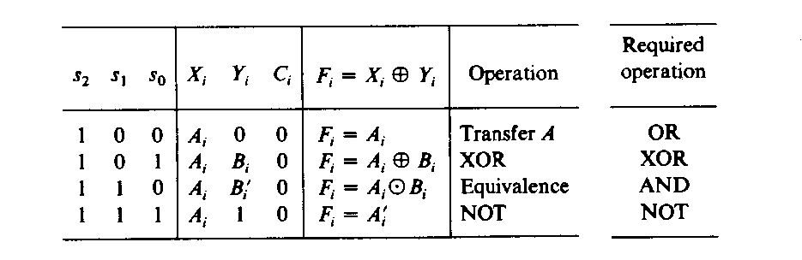
Function Table

Slide 56



Slide 57
Design of Arithmetic & Logic Circuit

Slide 58
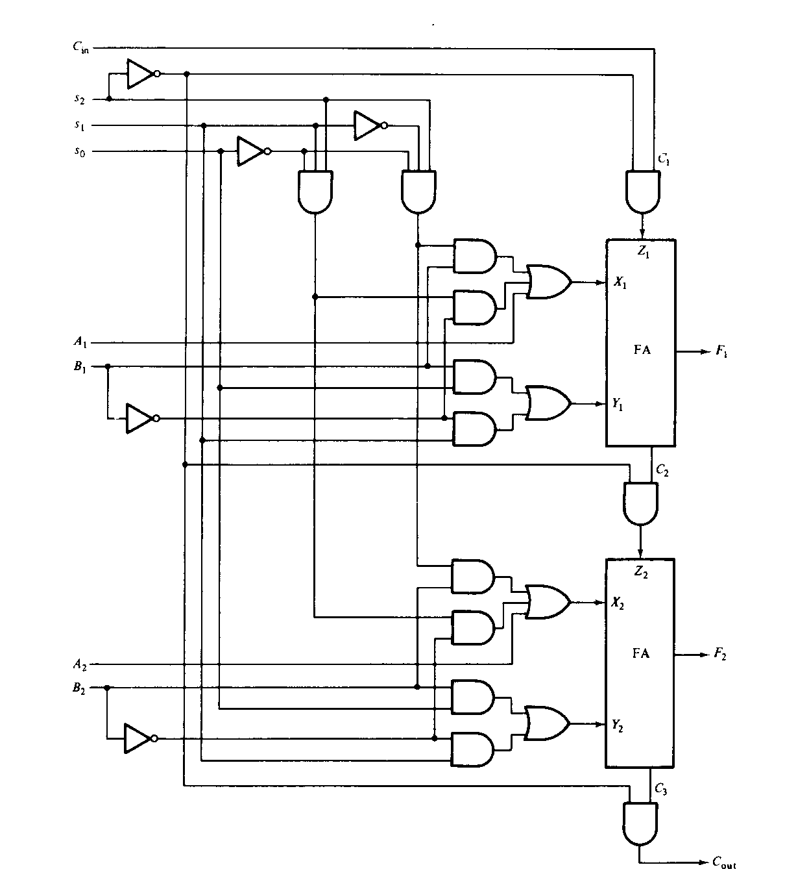
Design of Arithmetic & Logic Circuit

Slide 59

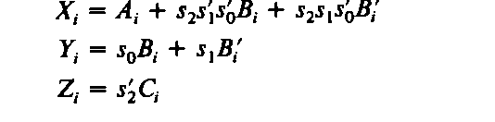
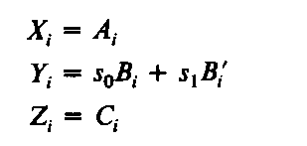
When S2=0

Slide 60
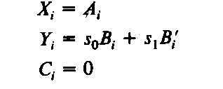
When s2=1

Slide 61
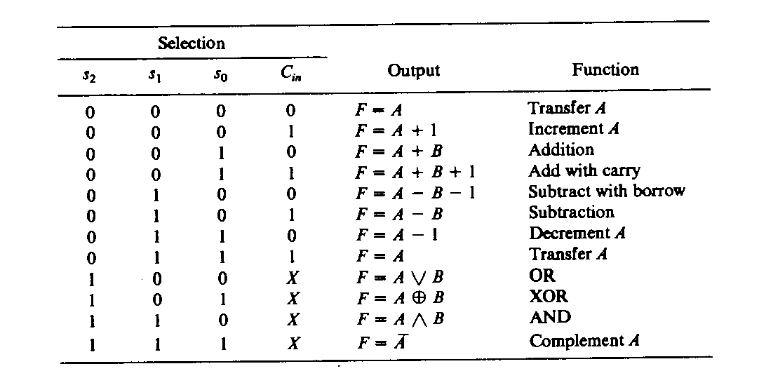
Function Table

