Slide 1
Client Server Architecture and Applications
MODULE 1

Slide 2
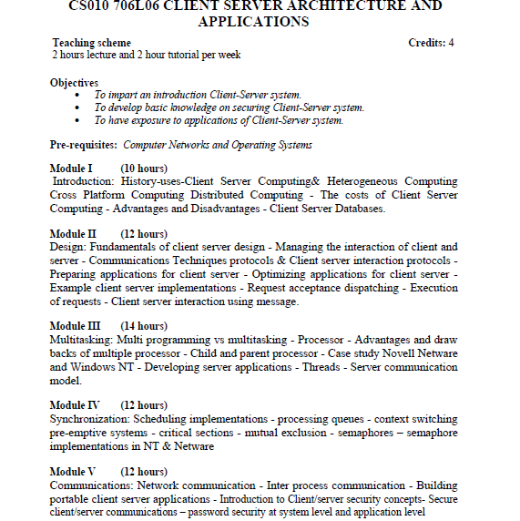

Slide 3
History / Evolution of Client Sever Technology
Mainframe systems were introduced in 1950’s.
Stand alone PC’s with GUIs were developed later.
Client server technology combines the best parts of stand-alone and mainframe technology into a cohesive environment.

Slide 4
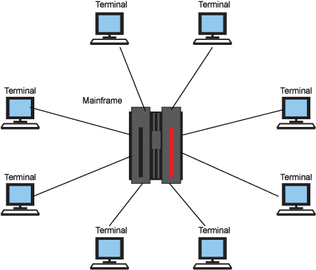
Mainframe Systems

Slide 5
Mainframe Systems
A data processing system employed mainly in large organizations for various applications, including bulk data processing.
Mainframes acquired their name because of their size.
Mainframe terminals are generally dumb.
Mainframe terminals merely act as input/output to the Mainframes.
They also required specialized heating, ventilation and cooling as well as a dedicated power supply.

Slide 6
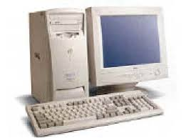
Stand- alone PC

Slide 7
PC
A desktop or laptop computer that is used on its own without requiring a connection to a local area network (LAN) or wide area network (WAN).
When the computer is running local applications without Internet access, the machine is technically a stand-alone PC.
Has many resources and does not rely on server.
Also called Fat client .

Slide 8
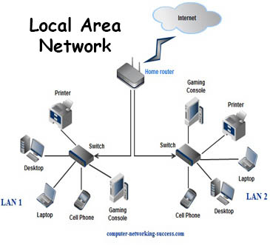
Client Server Model

Slide 9
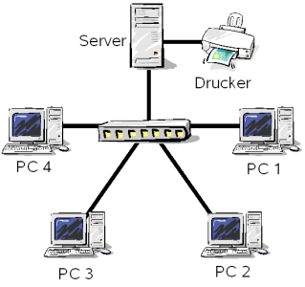
Client Server Model

Slide 10
Mainframe to Client- server
Client Server applications run on both a client and server and they meld the best parts of stand-alone and mainframe technology into a cohesive environment.
With client server computing , client is intelligent, having a CPU and capable of processing information.

Slide 11
Client Server Architecture
A network architecture in which each computer or process on the network is either a client or a server.

Slide 12
Components
Clients
Servers
Communication Networks
Server
Client

Slide 13
Clients
Applications that run on computers
Rely on servers for
  Files
  Devices
  Processing power
Example: E-mail client
  An application that enables you to send and receive e-mail
Clients are Applications

Slide 14
Servers
Computers or processes that manage network resources
  Disk drives (file servers)
  Printers (print servers)
  Network traffic (network servers)
Example: Database Server
  A computer system that processes database queries
Servers Manage Resources

Slide 15
Communication Networks
Networks Connect Clients and Servers

Slide 16
Client–Server Computing
Servers
  Store and protect data
  Process requests from clients
Clients
  Make requests
  Format data on the desktop
Client-Server Computing Optimizes Computing Resources

Slide 17
Application Components
3
Data Management
2 Client Types
2
Application Logic
Fat
Client
1
Presentation
Thin
Client
3 Logical Tiers
Database Applications:
  Most common use of client-server architectures

Slide 18
Application Functions
Software application functions are separated into three distinct parts
Server:
Data Management
Client: Presentation & Application Logic

Slide 19
Types of Servers
Application Servers
Audio/Video Servers
Chat Servers
FTP Server
Mail Servers
News Servers
Telnet Servers
Web Servers

Slide 20
Client Server architecture
Client-server architecture (client/server) is a network architecture in which each computer or process on the network is either a client or a server.
Servers are powerful computers or processes dedicated to managing disk drives (file servers), printers (print servers), or network traffic (network servers ).
Clients are PCs or workstation which users run applications.
Clients rely on servers for resources, such as files, devices, and even processing power.

Slide 21
Another type of network architecture is known as a peer-to-peer architecture because each node has equivalent responsibilities.
Both client/server and peer-to-peer architectures are widely used, and each has unique advantages and disadvantages.
Client-server architectures are sometimes called two-tier architectures.

Slide 22
“I want to
collaborate
with my
colleague”
“I want to access
some information”
Client
Server
Peer-to-peer
Client/server

Slide 23
Distinctions
Client-server
  Asymmetric relationship
  Client predominately makes requests, server makes replies
Peer-to-peer
  Symmetric relationship

Slide 24
Email application
Server
Client
Client
Email client sends message to server
Later, recipient’s email client retrieves message from server
Message is stored on POP server

Slide 25
How client- server technology evolved?
First operating systems were broken up into components and their interaction was managed as client and server processes running on the same machine.
Later network file systems were introduced.
In such environments, requests for data were routed over the network and serviced by a network file server.

Slide 26
The most common client server application today is the relational database.
Requests are formulated at the client and shipped to server for execution.
Server processes the queries and returns the results over a network.

Slide 27
Communication
Client –server model of computing is a distributed application structure.
Client and server exchange messages in a request -response pattern.
Exchange of messages is an example of IPC.
Each computer must have a common language.
Scheduling is used to prioritize the requests.

Slide 28
Client- server computing
Client server is the distribution of an application program into two logically separate components , each performing very separate duties.
Client issues a request for a server to perform some work on its behalf.
Server’s job is to process the requests of the client and return the results
LAN is usually used as the mechanism of communication.

Slide 29
Uses Of Client Sever Computing
Computing where it is most efficient to do so
By migrating the portions of client and server application program between client and server , the developer can determine the most optimal results.
Balancing load between client and server
Client server offers opportunity to scale very efficiently.
Application logic that interfaces with the central data would be located on a machine with data , thus data would not be transmitted over LAN.

Slide 30
Client Server Technology and Heterogeneous Computing
Heterogeneous computing refers to systems that use more than one kind of processor.
These are systems that gain performance not just by adding the same type of processors, but by adding dissimilar processors, usually incorporating specialized processing capabilities to handle particular tasks.
The issue is how to make all the systems communicate and interoperate with each other.
Heterogeneous Computing is the term used to describe this diverse computing environment.

Slide 31
Heterogeneity of
Architecture
Data format
Computational speed
Machine load
Network load

Slide 32
Issues regarding heterogeneous computing
Three main components of any system is its hardware , operating system, and software programs.
Hardware platform must be able to support multiple operating systems, networks and protocols.
Operating system must deal with logical connections between peer components and OS.
Application program must work over diverse hardware , operating systems and networks.

Slide 33
Hardware independent OS
UNIX is the most recognizable operating system for platform independence.(From high end micro-computers to low end PC’s )
Microsoft Windows NT promises to run on Intel platforms , MIPS and DEC Alpha as well.
Novell Netware has achieved hardware independence with Processor Independent Netware(PIN).
PIN allows Netware to be executed on Intel, HP, SUN, Power PC,DEC etc.

Slide 34
Netware’s support of native connections
Novell supports IPX/SPX, TCP/IP, Apple Talk, OSI and SNA.
Also It supports Netware Core Protocol (NCP),Network File System (NFS) , Apple Filing Protocol (AFP),File Transfer Access Method (FTAM).

Slide 35
Advantages Heterogeneous computing
Costs are very low.
Maximize the Performance by assigning each individual task to the appropriate architecture.
Program development can be enhanced by using a familiar environment .

Slide 36
Opportunities and challenges-Heterogeneous computing
Application developers could write applications that supported native communications to multiple platform from a single server.

Slide 37
Challenges
Operating system must provide a platform for applications to use these service.
Networks and segments of computer users should be more integrated.
Solutions must be simple, easy to integrate and easy to maintain.

Slide 38
Cross Platform Computing
Defined as the implementation of technologies across heterogeneous environments.

Slide 39
Issues in the creation of Cross-Platform applications
The application must run on Multiple Platforms.
It must have the same look and feel as on other platforms.
It must integrate with native operating environment.
It must behave the same on all platforms.
It must be maintained simply and consistently.

Slide 40
Running on Multiple platforms
Applications must support multiple environments to give users the freedom of choice for deployment.
Many corporations are making their investment decisions based on application support of platforms.

Slide 41
Maintaining the same look and feel on all platforms
The functions and general feel of the application should be consistent between platforms including features such layout, menu items, dialog information etc.
ie, The information presented to the user should remain consistent as possible across platforms.

Slide 42
Supporting native operating systems
The developer does not force any additional constraints or software on user.
The use of prerequisite software may be a prohibitive factor in the deployment of a system.

Slide 43
Behaving the same on all platforms
Software must behave similarly on all systems
If a feature or function is implemented on one platform , it should be on the another as well.

Slide 44
Simple and consistent maintenance
Developers should ease the integration of their software into new environments by providing similar maintenance of application programs.

Slide 45
Approaches to cross platform computing
Using the proper application architecture
Majority of application code native to any given platform can be removed with proper architecture.
Because the platform specific code is limited to independent modules for each system ,the application is mostly portable.
Portable code usually requires only a recompile.

Slide 46
Distributed Computing
Distributed computing involves the distribution of work among more than one machine.
Many machines may be processing work behalf of client machines.
ie, Distributed Computing is Client server computing with one client and many servers.

Slide 47
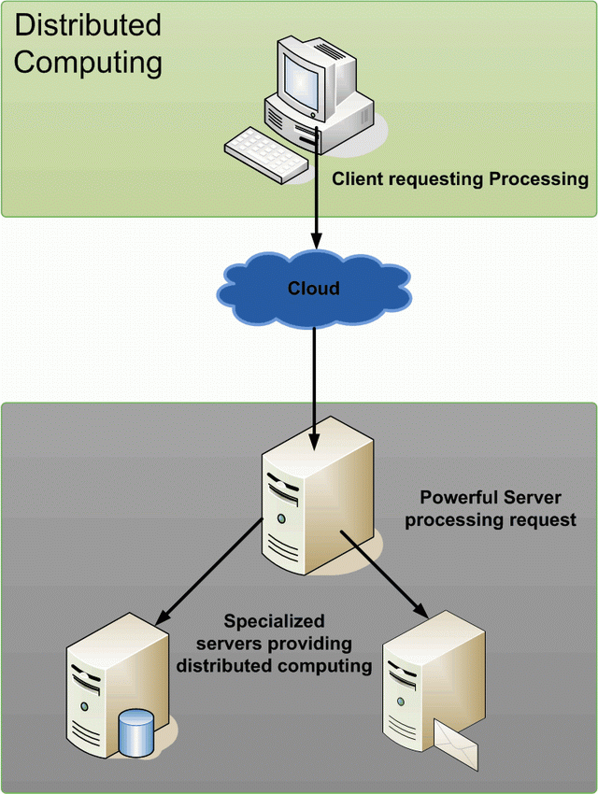
Distributed Computing

Slide 48
Why Distributed Systems?
Application Integration and Distributed Processing are the same thing
  Constructing information-sharing distributed systems from diverse sources:
    heterogeneous
    networked
    physically disparate
    multi-vendor

Slide 49
Benefits of distributed computing
Distributed computing benefits users and corporations alike.
Increased overall throughput and ability to multitask are tremendous benefits to user.
Corporations benefits from the integration of discrete network components and their functioning as a whole to increase efficiency and reduce costs.

Slide 50
Distributed computing promises to revolutionize the computing industry.
It promises to allow heterogeneous systems and networks to efficiently operate as a whole.
It will maximize the use of existing equipment and fully optimize heterogeneous environment.

Slide 51
Severs in distributed computing
Server represents a program responding to requests and providing computation to a requesting client.
Requests are send to distributed machines (nodes), computation is performed, and the results are usually returned to the client requester.
Many distributed nodes may be working on behalf of one requesting client , and it is the clients responsibility to manage information requests and the receipt of results.

Slide 52
Balancing the load of distributed computing
By knowing the current load of available distributed nodes , more logical dispatching can occur.
In addition , work may be dispatched to specific nodes , such as those geographically nearest the requesting client.
For example , when a client issues a request for a piece of work to be performed, the distributed server could then route the request to the most idle or nearest distributed node.

Slide 53
Component development for distributed applications
Applications and their functions must be modularized so as to operate as discrete components.
These discrete components must be bounded only by encapsulated data and functions that may be moved between systems
To be distributable this components must have knowledge only of themselves and the data passed to them.
The concept of class is a distributable entity and is an increasingly popular programming method.

Slide 54
Downsizing: Migrating Mainframe applications to smaller computing platforms
Downsizing may be simply defined as the migration of traditional mainframe applications to smaller , less expensive computing platforms such as UNIX, Netware, OS/2, and Windows NT.
These systems must interact as a whole in order to process the work .

Slide 55
Benefits of downsizing
PC based distributed processing requires only a fraction of the cost of traditional mainframe systems.
Flexibility and scalability
Distributed systems have access to other data sources ,including legacy applications.

Slide 56
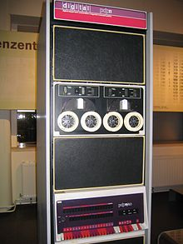
Mini Computer
Minicomputers were also known as midrange computers.
The term "minicomputer" came to mean a machine that lies in the middle range of the computing spectrum, in between the smallest mainframe computers and the microcomputers.

Slide 57
The costs of Client -Server Computing
1. Hardware and Infrastructure costs
2. Software development costs
3. Labor costs: Training , Administration and Support

Slide 58
COST COMPONENT | CLIENT SERVER (%) | MINI COMPUTER (%)
Application Development | 28 | 40
Infrastructure | 25 | 27
Systems support/ maintenance | 40 | 30
Training | 7 | 3

Slide 59
Hardware and Infrastructure costs
Infrastructure costs of client server computing were less than those of a minicomputer based solution.
However the difference was very slim in terms of cost , due to the fact that PC’s , networks , gateways, bridges, and routers needs to be purchased for initial installation.

Slide 60
Software Development Costs
Cost difference is due to many factors , including development tools available and ease of developing applications using those tools.
Client server development with 4GL component greatly reduces the amount of work necessary to create client server applications.

Slide 61
Labor Costs-Training , Administration, Support
Labor costs themselves account for almost 50 percent of the total cost of a client server implementation.
The maintenance and support of client server networks is a major cost factor facing corporation today.

Slide 62
Ways of Preserving Existing Investment
Reducing client hardware requirements
Reductions in client processing
Client server promises both to preserve existing investments in computer systems and ease of pain of transition to newer systems.

Slide 63
The Benefits of Client- Server Computing
Benefits to users
Benefits to corporations

Slide 64
Benefits to users
Client server technology performs data intensive tasks on multiple computers.
This means that client can respond better to local , end user requests.
As execution is ongoing on other machines, client is relieved of intensive computing tasks and can perform other duties.
Eg: Reporting function running at server

Slide 65
Benefits to corporations
Expensive servers and peripherals can be shared among many clients which maximizes the use of costly systems and fully utilizes their available resources.
Since the server is performing work on behalf of many clients , existing client computing power is extended .
Scalability of distributed networks is a performance advantage.
Client server is used for centralized data management.

Slide 66
Benefits of client server computing
Servers as the focal point for data management
Increased access to corporate data
More effective use of server resources
Better application performance and network usage.
Scalability

Slide 67
1. Servers as the focal point for data management
Server can act as a focal point for data accessibility.
A server application is the place where multiple potentially diverse client platforms are integrated.
Interoperability is preserved by this way.
Data access is maintained by module independent programming.
( Refer Text book :page no 43 )

Slide 68
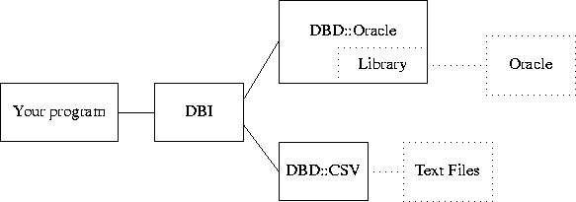
DBI-Data Base Interface

Slide 69
2.Increased access to corporate data
Database middleware masks the access to multiple data sources through a single interface.
Products such as IDAPI or ODBC provides a single interface to multiple SQL data sources.
Many server based system provide integration with legacy data found on mainframe systems.

Slide 70
3.More effective use of server resources
Shared server resources are assets when hosting server based applications.
Disks, printers , faxes, and services are examples of peripherals shared by network clients.

Slide 71
4.Better application performance and network usage
Performance advantages of Client Server Technology are:
Reduced total execution time
Reduced client CPU usage
Increased client CPU usage
Reduced client memory usage
Reduced network traffic
(Refer text pg no: 49)

Slide 72
Reduced total execution time
With client server , work is off loaded to a machine with greater processing abilities.
Execution of an application on a faster platform reduces total execution time.

Slide 73
Reduced client CPU usage
By off- loading work to a server computer , workstation machine may see a reduction in amount of CPU usage.
Client machine has less code to execute , as functions have been moved to the server computer.
Client machine may take the advantage of additional CPU cycles that become available.

Slide 74
Increased client CPU usage
In client server environment it is important to integrate the effective processing power of the entire LAN.
This includes integrating high performance servers as well as clients throughout the network.
Distributed computing maximizes the efficiency of the network by using available CPU cycles at client machines.
Client server efficiency is maximized in such an environment because CPU cycles at the client as well as the server are used to create more effective system.

Slide 75
Reduced client memory usage
Memory usage may be decreased when implementing client server , because many relevant features are to be deployed on another system.
Application code as well as third party modules were migrated to other platforms. (Refer text pg no : 51)

Slide 76
Client application memory usage
 | CLIENT -ONLY | CLIENT SERVER
Database Interface | 77 K | 29 K
Reporter function | 50 K | 50 K
General Application | 50 K | 50 K
Total | 177 K | 129 K

Slide 77
Client application memory usage with client server Reporting
 | CLIENT -ONLY | CLIENT SERVER REPORTING
Database Interface | 77 K | 0 K (Located on server)
Communications | 0 K | 10 K (additional requirement)
Reporter function | 50 K | 0 K
General Application | 50 K | 50 K
Total | 177 K | 60 K

Slide 78
Reduced network traffic
Data manipulation is taking place on server computer and usually not transferred to client workstation during processing.
The client computer only receives data when the unit of work (request) is completed.
As a result fewer network transmissions are required to compute tasks.
(Refer text pg no : 54)

Slide 79
5. Scalability
Client server computing has the ability to scale very efficiently for small and large networks
Scalability is the ability to utilize more powerful systems for the execution of application programs.
It is important for both OS and computer application to be scalable.

Slide 80
scalability
Symmetric based and asymmetric based solutions (MP-Multiprocessor)
SMP based solutions are theoretically more flexible in that each processor shares all system memory.
AMP based solutions assign an application and separate physical memory to each processor.
Fault tolerant subsystems
Eg: RAID and ecc based memory

Slide 81
It is necessary for an application software to scale efficiently over many machines , each processing portions of the program.
Also the operating system should be scalable and must have unique characteristics
They must be hosted on many different microprocessors
They must support underlying hardware
They must provide system management
They must provide full-featured APIs for developers.

Slide 82
Performance advantages of Client Server Technology
Reduced total execution time
Reduced client CPU usage
Increased client CPU usage
Reduced client memory usage
Reduced network traffic

Slide 83
Assignment No : 01
Client Server Database systems (3 tier and 2 tier architectures)
Explain in brief , practical examples of client server model.
List various client server developing tools (3 GL, 4 GL , 5GL tools)
To be submitted on or before 18/08/2015

Slide 84
Annexure
Windows NT- new technology
MIPS-MP without interlocked pipeline stages
DEC –Digital equipment corporation
Alpha –Instruction set developed by DEC
Novell- US based multi national company
Netware- first network OS (ShareNet) Renamed as Netware by Intel.

Slide 85
HP- Hewlett-Packard Company
IPX/SPX stands for Internetwork Packet Exchange/Sequenced Packet Exchange.
IPX and SPX are networking protocols used primarily on networks using the Novell NetWare operating systems.
TCP/IP-Transmission Control Protocol/Internet Protocol (TCP/IP) is the suite of communications protocols used to connect hosts on the Internet.

Slide 86
AppleTalk is a set of local area network communication protocols originally created for Apple computers.
Systems Network Architecture (SNA) is IBM's proprietary networking architecture, created in 1974.
It is a complete protocol stack for interconnecting computers and their resources.

Slide 87
NetWare Core Protocol, a network protocol used in Novell NetWare
Network File System (NFS) is a distributed file system protocol originally developed by Sun Microsystems in 1984, allowing a user on a client computer to access files over a network much like local storage is accessed.
The Apple Filing Protocol (AFP), formerly AppleTalk Filing Protocol, is a proprietary network protocol that offers file services for Mac OS X and original Mac OS.

Slide 88
FTAM, ISO standard 8571, is the OSI Application layer protocol for File Transfer Access and Management.

