Slide 1
Communication
MODULE 5

Slide 2
Communication is the core component of client server applications.
There are many ways to communicate, many means of transferring data, many protocols to co-ordinate the transmission of data and many topologies for the protocols to run.
Client server developers deals with two means of communication:
Network communication
Inter process communication

Slide 3
Network communication is used to communicate between physically separate computers on a network.
Inter process communication is used to communicate between processes on the same computer.

Slide 4
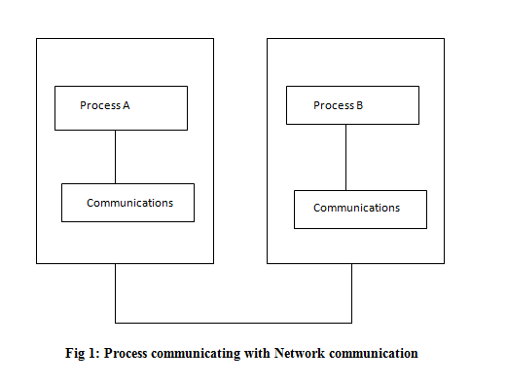

Slide 5
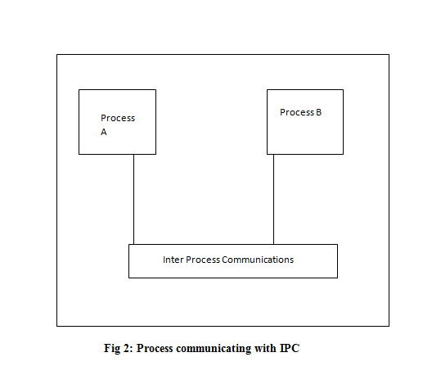

Slide 6
Network communication
IBM Mainframe
LAN
WAN
The language of communication
If two partners establish a physical communications link but have no way of knowing what data or format the other partner is sending , the communication is useless. Protocols are designed to solve this problem by establishing a language as a set of rules that both parties understand.

Slide 7
Functional Characteristics of Network Communication
Network communication is meant to facilitate data transmission between any number of stations or nodes.
Certain functional characteristics like protocols, addressing and programming interface are common to network communications.

Slide 8
Due to the complex and expanding nature of communications protocols , there has been a great need for standardization.
International Standards Organization (ISO) has developed a standard layered model for communications called Open System Interconnection (OSI).

Slide 9
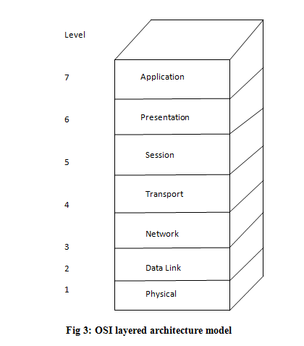
OSI layered architecture model

Slide 10
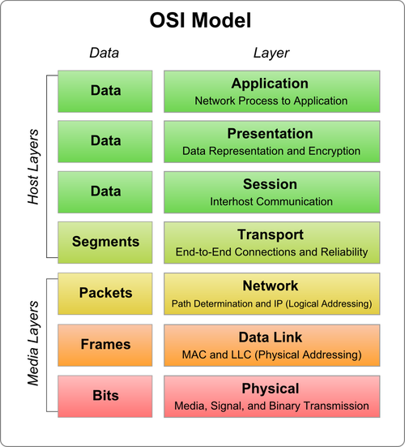

Slide 11
Application Layer
These are created by the developer for communicating between partner application.
Responsibilities include application to application interaction protocols.
Client server application interaction protocols are represented at this layer .
File Transfer Protocol (FTP)
Simple Mail Transfer Protocol (SMTP)

Slide 12
Presentation Layer
Deals with the conversion of data, structures and syntactical differences between nodes communicating on the network.
Each application partner receives data in a format that it understands.
Allows underlying conversion and representation of data into native format of target system.
Eg: HTML,CSS

Slide 13
Session Layer
Provides semantics of conversion between partner nodes.
This decides the organization of communication whether it is half duplex (only one node sends or receives at a time) or full duplex (either can send or receives at any time).
This layer also deals with the ability to synchronize communication at certain points.
Eg: RPC

Slide 14
Transport Layer
This layer is responsible for providing reliable data communications between nodes on a network.
This layer provides the basis of communication to all upper layers.
All the underlying network infrastructure necessary for the transmission of data is being masked by this layer from upper levels.
Eg: TCP, UDP

Slide 15
Network Layer
This layer is responsible for managing the operations of the network specifically for the routing of packets sent between Transport level products.
This layer provides control information for the management of data packets for which it routes.
Eg: IP, Apple Talk

Slide 16
Data Link Layer
Responsible for controlling the exchange of data between the Physical layer and upper level network layer.
This layer places packet data into frames for appropriate physical network.
It is also responsible for detecting and correcting errors.
Eg: PPP, MAC

Slide 17
Physical Layer
Responsible for physical transmission of the information over a network.
This layer represents anything pertaining to physical network like encoding, transmission and topology.
Eg: CSMA/CD,DSL, ISDN

Slide 18
Network Protocols
Network protocols are implemented to allow for the knowledgeable transfer of data between nodes on the network.
A protocol is a set of rules that must be understood and followed when communicating between stations.
Protocols exist at all levels of OSI. Each level protocol is independent of low level protocol layer.

Slide 19
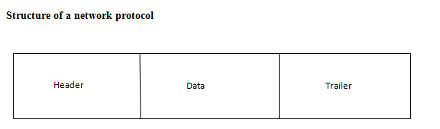
Structure of a network protocol

Slide 20
The header and trailer portions contain the rules governing how information is addressed, transferred , checked for accuracy, sequenced and acknowledged.

Slide 21
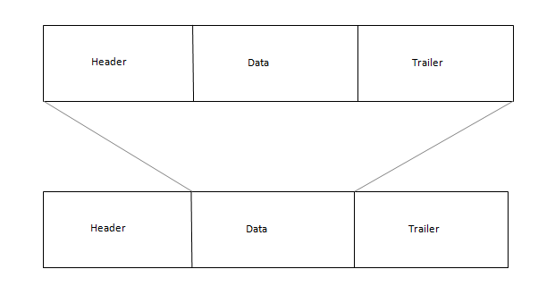
Encapsulation of layered protocols

Slide 22
Each protocol provides header , data and optionally trailer data .
In case of layered protocols , an upper layer protocol must be totally contained within lower layer protocol.
This is done by placing the upper layer protocols in the data portion of the lower layer protocol.

Slide 23
Connection Oriented and Connectionless Communication
Two forms of services are generally associated with network communication: connection oriented and connection less communication.
Connectionless protocols: It provides best effort service. Messages (datagrams) are sent fully contained between partners in the communication. This protocol is generally used for high performance since error checking and flow control are not implemented.
Connectionless datagrams are not reliable and are not necessarily in the order which they are sent. Eg: UDP and IPX
Connection-oriented protocols: they provide reliable, guaranteed delivery. End to end communication are established and reliable link is guaranteed. They are generally used for long lived communications. Eg: SPX, and TCP .

Slide 24
Addresses: Physical and Logical
Addresses are used to locate and direct communications. Each physical network station has an address.
Logical names are also associated with the protocol address. These names may be associated with the protocol addresses.
These names are higher level symbolic names assigned to network address. Each node on any network must contain physical address. This address is generally associated with the physical network adapter in the computer.

Slide 25
Physical addresses
A physical address is the hardware-level address used by the Ethernet interface to communicate on the network. Every device must have a unique physical address.
This is often referred to as its MAC (Media Access Control) address. An Ethernet physical address is six bytes long and consists of six hexadecimal numbers, usually separated by colon characters (:)

Slide 26
Logical addresses
A logical address is a network-layer address that is interpreted by a protocol handler.
Logical addresses are used by networking software to allow packets to be independent of the physical connection of the network, that is, to work with different network topologies and types of media.

Slide 27
Programmatic Interfaces: Blocking and Non Blocking
In computer programming, an application programming interface (API) is a set of routines, protocols, and tools for building software applications.
An API expresses a software component in terms of its operations, inputs, outputs, and underlying types.
Generally communication programming interfaces provide two modes of operation:
Synchronous or blocking mode
Asynchronous or non blocking mode
Programmatic interfaces which require the entire request to complete before returning control back to application developer are said to be synchronous or blocking. APIs that return immediately- possible before the entire request is satisfied- are said to be asynchronous or non blocking.

Slide 28
Inter Process Communication
IPC is used as a communication vehicle for two processes running on the same physical machine.
These process generally communicate with each other by sharing handles, signals or data.

Slide 29
IPC mechanisms
Pipes: pipes are file based mechanism for communicating data back and forth between tasks. Pipes may one way- where there is one writer and one reader, or bi-directional- where there may be reads and writes by either process.
Messages: message provide basic send and receive primitives to transfer data between processes.
Semaphores: used to coordinate access between processes.
Shared memory : it is the process of defining a section of memory visible to more than one process for storage and retrieval of data

Slide 30
Pipes are used for communication between two processes physically located on the same machine. The most popular protocol for communicating locally is by means of named pipes.
Named pipes are used to communicate between unrelated processes and anonymous or unnamed pipes are used to communicate between related processes.

Slide 31
UnixWare Support for Pipes
pipe(fileDescriptors[2])- creates an anonymous pipes and returns two file descriptors. Each file descriptor has read and write access.
fattach(fileDescriptor, path)- attaches an open fileDescriptor with named node in the local file system. Executed by server to give named access to a pipe.
Attaches a file descriptor to a file.
fdetach(path)- used to detach a name from a file system node.

Slide 32
WINDOWS NT SUPPORT FOR PIPES
Windows NT provides two operating modes of IPC – named and unnamed. Unnamed pipes are unidirectional in nature.
Creating unnamed pipes returns two handles for reading and writing and are passed to child process via inheritance. Named pipes may be unidirectional or bidirectional in nature.
Windows NT pipe functions
CreatePipe(&readHandle, &writeHandle, security, numBytes)- used to create an unnamed pipe of buffer size
numBytes –buffer size for unidirectional IPC. If 0 is specified, a default size will be used.
readHandle and writeHandle is returned for read and write access.
Security is optional , specify security rights for inheriting of this handles.

Slide 33
CreateNamedPipe(name,openMode,operationMode,maxInstances,outBufferSize,inBufferSize,timeout,security) : used to create a named pipe specified by name on the local server machine.
This function may create additional instances upto maxInstances.
Openmode -specifies on open mode like PIPE_ACCESS_DUPLEX for bidirectional, PIPE_ACCESS_INBOUND for client to server transmission etc.
Operational mode -specifies whether the pipe is a bytemode or message mode.
Outbuffersize and inbuffersize specifies the size of buffers to reserve for instances.
Timeout can be used for wait operations.
Security –for access privileges

Slide 34
ConnectNamedPipe (pipeHandle,operationMode) - used by server process to wait for an incoming open request.
pipeHandle-handle to connect or returned
operationMode-structure for controlling access
DisconnectNamedPipe(pipeHandle)- disconnects the server end of named pipe instance

Slide 35
PeekNamedPipe(pipeHandle, &buffer,&bufferSize, &numRead, &numAvail, &numLeft)- used to copy data from a named or unnamed pipe specified by pipeHandle without removing from pipe.
Data is copied into &buffer for bufferSize bytes.
bufferSize-size of buffer in bytes
numRead-number of bytes actually read from pipe
numAvail-number of bytes available to read from pipe
numLeft-number of bytes left in message
TransactNamedPipe(name,writeBuffer,writeBufSize,readBuffer,readBufSize,numBytesRead,overlap)-used to perform a discrete read and write operation.
Overlap structure is used to allow nondestructive asynchronous mode operation.

Slide 36
WaitNamedPipe(name,timeout)-used to wait for a server process to place pending ConnectNamedPipe() specified by name. A timeout value specified as time out for specified interval on creation.
CallNamedPipe(name,writeBuffer,writeBufsize,readBuffer,readBufSize,numBytesRead,timeout)-performs the operations on many other named pipe function.
GetNamedPipeHandleState(pipeHandle,&state,&numInstances,&maxBytes,&maxTime,name,maxNameSize)- used to query information about the state of named pipe specified by pipeHandle.
State- returns state of information, P_NOWAIT, PIPE_READ-MODE_MESSAGE etc
numInstance- instance count returned
maxNameSize- the name of the pipe not to exceed maxNameSize
maxByte- parameter specified the number of bytes collected locally before transmitting to server
maxTime- specifies maximum time in millisec that may transpire before sending locally buffered data to server

Slide 37
GetNamedPipeInfo(pipeHandle,&type,&outputBufferSize,&inputBufferSize,&maxInstance)-function returns information about named pipe specified by pipeHandle
Type- associated type returned, PIPE_SERVER_END determine which end of the pipe handle references, PIPE_TYPE_MESSAGE- determine the mode of the pipe(msg or byte).
inputBufferSize, OutputBufferSize-Size of internal buffers
maxInstances-Maximum number of instances

Slide 38
SetNamedPipeHandleState(pipeHandle, &mode, &maxBytes, &maxTime)-this function allows the application developer to change the state information associated with pipeHandle
Mode: options such as message or byte mode
MaxBytes and maxTime - to control when the local buffer is flushed to the server.

Slide 39
Queues or messages for IPC
Queues are advanced method of IPC
UnixWare Interfaces for IPC
Unix provides a three main methods of interfaces for allowing IPC to take place between related and unrelated processes
Semaphores
Shared memory
Messages

Slide 40
UnixWare message APIs
  msgget(key,flags)-used to create a new message queue.
  Key can be IPC_PRIVATE or a unique number
  Flag specifies the operation permissions
  msgsnd(qID,data,size,flags)-used to place data into message queue specified by qID
  qID-specifies the queue ID
  Data-pointer to data
  Size-size of the data
  Flag- control operational mode

Slide 41
  msgrcv(qID,data,size,flags)-retrieve messages from queue
  Message is returned in the data area not to exceed maximum size field
  Type parameter is used to control which element is accessed.
  msgctl(qID,command,msgIDBuf)-performs various control operations on msgqueue.
Commands can be
IPC_STAT-to query the UnixWare about state of msgqueue
IPC_SET-set values in the queue
IPC_RMID-remove msg queue

Slide 42
Windows NT interface for IPC
WindowsNT provides interfaces for IPC through mailslots.
Mailslot is a oneway IPC using msg as a communication mechanism. Server creates a mailslot to be accessed by client station.
Client station request access to mailslots writes msg to server and continues. Server reads the data from mailslot
mailslots broadcast messages using datagrams.

Slide 43
Mailslot APIs
CreateMailslot(name,maxMsgSize,timeout,security)- create a mailslot called name on server.
Name-mailslotname
maxMsgSize-size of msg written to mailslot
Timeout may 0 to return immediately or MAILSLOT_WAIT_FOREVER for indefinite block wait
Security- access privileges

Slide 44
GetMailSlotInfo(mailslotHandle,&maxMsgSize,&nextMsgSize,&numMessages,&timeout)-used to query the information about mailslot .
SetMailSlotInfo(mailslotHandle,timeout)- allows the application developer to specify the read timeout value to be associated with mailslotHandle.

Slide 45
Architecting Portable Application Code
Portability may be defined as the amount of work necessary to recode an existing application to run on different platform.
When properly architected , any piece of application code can be made more portable .
Portability and interoperability are not limited to object oriented design or development.
Procedural –based programming , combined with comprehensive design and little foresight , can be an ideal environment for writing multi platform application programs.

Slide 46
Object oriented Vs Procedural based design
Both C and C++ allow the developer to reduce the amount of system -dependent code, but the mechanisms used to create the applications are very different.
Neither object oriented nor procedural –based design offers an advantage over the other in application portability.

Slide 47
While object oriented design is more natural for programming portable applications , procedural based implementations can be very successful as well.
Procedural developers are required to architect their own mechanisms for modular applications , whereas object oriented schemes enforce this modularity by design.

Slide 48
Procedural design using C
The C language , For instance makes it easier for the application developer to produce portable application code.

Slide 49
Using standard functions implemented on all platform
This task is made easier by utilizing standard functions that exist on diverse platforms .
Many standards exist for the open adoption by any platform and this adoption benefits developers coding to such interfaces.
Eg: malloc() is an ANSI standard C function call that most every platform supports.
If an application developer uses malloc() instead of native memory allocation functions, less code has to be modified when moving from one platform to next.

Slide 50
Reducing dependencies on data structures and types
Many system dependent functions contain and utilize system dependent data structures.
The application developer must provide a mechanism for dealing with this structures.

Slide 51
Software Layering
Software layering is a concept of providing layers or levels of application source code between higher level services and lower level dependent system services.
Higher level services would include functions such as libraries of video, communications, or database functions .
Lower level dependent system services would include such functions as operating system specific function calls , direct hardware interface (drivers) and low level communications interface.

Slide 52
In software layering , as with protocol layering , levels are defined to provide two specific functions.
To remove underlying dependencies
To combine and define application code to add functionality or services.

Slide 53
Removing underlying dependencies
Applications developed using the software layering model inherently remove underlying dependencies from the majority of application code.
It has been determined that layering can provide full application functionality with minimal performance overhead.

Slide 54
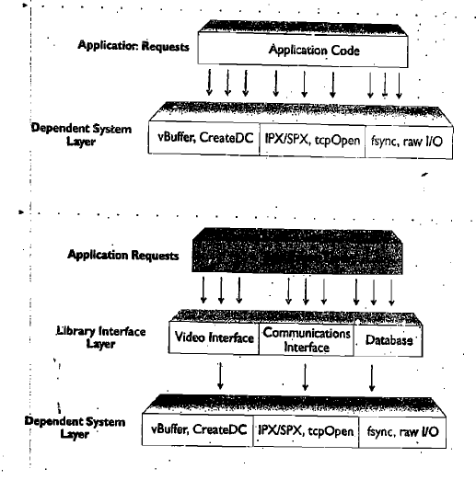
Minimizing coding impact through software layering

Slide 55
Application migration effort is directly correlated to proper architecture.
Figure removes the dependencies on underlying layers of code by providing an interface between majority of application code.
This layer makes decreased porting time between operating systems because it reduces the amount of code changes necessary and it isolates the areas of code to be ported.

Slide 56
Object oriented design using C++
What is an object
Many concepts of C++ and object oriented technology can greatly ease the development of portable applications.
Object is an abstract term referring to the existence of application functions and data within a self contained module.

Slide 57
What is encapsulation
Combing of data and its operations is referred to as encapsulation.
Encapsulation allows the application developer to combine certain application functions , data structures and variables they reference into a self contained module.

Slide 58
Objects and their classes
Conceptually an object is accessed by passing it a message.
The message consists of the name of the function to execute and optional parameters.
The name passed is referred to as a method.

Slide 59
What is a class
Class is a programmer defined type.
Class consists of data and member functions that act on data.
The class based implementation in C++ is used as a shielding mechanism from application dependencies.

Slide 60
Advanced concepts
Handling member variables declared as private
C++ mechanisms for controlling classes
In C++ , a programmer may define a class that inherits all the functionality and data of another class. This mechanism is known as inheritance.
Overriding
The ability of a sub class to provide a function with the same name as one of its parent class.

