Slide 1
MULTI -TASKING
MODULE 3

Slide 2
Multi-programming
Multiprogramming is the capability of an operating system to support multiple applications/programs running concurrently.
It simply means that an operating system can run many applications at same time.
Only one application can actually use a processor at a time ,but the multiprogramming OS is responsible for dividing the processor’s execution time and sharing the processor between many applications.
The operating system may creatively schedule processes to maximize the efficiency of the available CPU’s.

Slide 3
Multiprogramming is also the ability of an operating system to execute more than one program on a single processor machine.
More than one task/program/job/process can reside into the main memory at one point of time.
A computer running excel and firefox browser simultaneously is an example of multiprogramming.

Slide 4
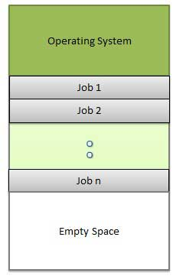
Memory layout multiprogramming

Slide 5
Multitasking
Multitasking is the ability of an operating system to execute more than one task simultaneously on a single processor machine.
Though we say so, but in reality no two tasks on a single processor machine can be executed at the same time.
Actually CPU switches from one task to the next task so quickly that appears as if all the tasks are executing at the same time.
More than one task/program/job/process can reside into the same CPU at one point of time.

Slide 6
Multitasking
This term is used in modern operating systems when multiple tasks share a common processing resource (e.g., CPU and Memory)
The applications are loaded into memory and appear to the user to be running at the same time.
For the developer , the overall system becomes more efficient because the applications are running concurrently and the processor is kept more active.

Slide 7
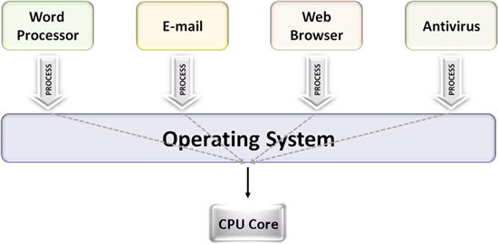
Multi tasking

Slide 8
Multi-programming Vs Multi tasking
A task in a multitasking operating system is not a whole application program but it can also refer to a “thread of execution” when one process is divided into sub-tasks.
Each smaller task does not hijack the CPU until it finishes like in the older multiprogramming but rather a fair share amount of the CPU time called quantum.
Both multiprogramming and multitasking operating systems are (CPU) time sharing systems.
However, while in multiprogramming (older OSs) one program as a whole keeps running until it blocks, in multitasking (modern OSs) time sharing is best manifested because each running process takes only a fair quantum of the CPU time.

Slide 9
I/O and CPU bursts
Applications typically go through cycles of CPU bursts and I/O bursts.
Since the CPU sits idle during I/O operations , efficiency is increased if some work is performed during those I/O operations .
With multitasking system , OS reschedules waiting programs to run during I/O operations.
Overall throughput of the system is thus increased.

Slide 10
Single-Tasking Vs Multi-Tasking systems
In a single tasking system , the two applications would run back to back .
With multi-tasking systems, the application waiting for I/O would be placed on an I/O queue and the other program would begin using the CPU.
This mechanism would continue until both jobs were completed , thus increasing the overall capacity of the system.

Slide 11
Single-user, single-task OS
As the name implies, this operating system is designed to manage the computer so that one user can effectively do one thing at a time.
The Palm OS for Palm handheld computers and MS DOS are good examples of a modern single-user, single-task operating system.

Slide 12
Single-user, multi-tasking
This is the type of operating system most people use on their desktop and laptop computers today.
Microsoft's Windows and Apple's MacOS platforms are both examples of operating systems that will let a single user have several programs in operation at the same time.
For example, it's entirely possible for a Windows user to be writing a note in a word processor while downloading a file from the Internet while printing the text of an e-mail message.

Slide 13
Multi-user OS
A multi-user operating system allows many different users to take advantage of the computer's resources simultaneously.
The operating system must make sure that the requirements of the various users are balanced, and that each of the programs they are using has sufficient and separate resources so that a problem with one user doesn't affect the entire community of users.
Unix, VMS and mainframe operating systems, such as MVS, Windows NT are examples of multi-user operating systems.

Slide 14
Single user , single tasking OS is burdened by only having one unit of execution.
DOS , for instance is a single tasking OS capable of only running one application at a time.
Today , most operating systems used for server based applications are multi-tasking
Eg: Novell Netware, UnixWare, Windows NT, IBM OS/2
In addition to multi-programming, these platforms also provide a means by which each application can have multiple executing tasks , known as processes or threads.

Slide 15
Processes
In computing, a process is an instance of a computer program that is being executed.
A process is made up of a code execution and resource ownership.
A process has two main characteristics , code execution and resource ownership.
Each application is loaded into memory is represented as a process that is the controlling mechanism in a multitasking system.

Slide 16
System becomes more responsive and fully utilized when processes are multitasked.
Application efficiency is thus be enhanced because there will be multiple units of execution representing a program.
When a new process is created , a copy of code and data are created and execution is initiated.

Slide 17
Child and Parent processes
The created process appear logically as child processes and may inherit access to variables , and other resources of the creating process.
The creating process is known as the parent process and usually maintains common data and resources.
The data may be private to the process , inherited by the child process , or shared as a system wide resource.

Slide 18
Advantages and drawbacks of multiple processes
Features and functions may be distributed among multiple co-operating processes , thereby enhancing the execution.
These processes would run concurrently in the system and share the use of the processor.
The system would be very efficient because many processes would be executing concurrently.

Slide 19
Drawbacks
While the processes may increase the performance and efficiency, their use should be tempered by the amount of system resources available.
A process may consume large amount of resources , as an entire code and data segment are created for each one.
Processes are very useful for segments of applications that may be operated concurrently , but because processes own data and resources they may become large and inefficient if overused.

Slide 20
Architecting for Processes
Processes are very important to the server application developer as they may be used to increase responsiveness, execution time, and turn around time for the user requests.
Since server applications typically perform work on behalf of a remote user or application program , these logical units of work are well suited to the process model concept.

Slide 21
Each separate process must communicate via some form of Inter process communication(IPC).
Each operating system has many methods for this IPC communication .
eg: messages, pipes
Developers must take important decisions when architecting for multiple process use because it is important to maximize efficiency without overloading or burdening the overall system.

Slide 22
Developing code using processes
Server application is better suited for concurrent execution (processes).
Application program must logically distribute the server application functionality among different programs.
These programs will be executed as loadable processes and will interact with each other to form server application.

Slide 23
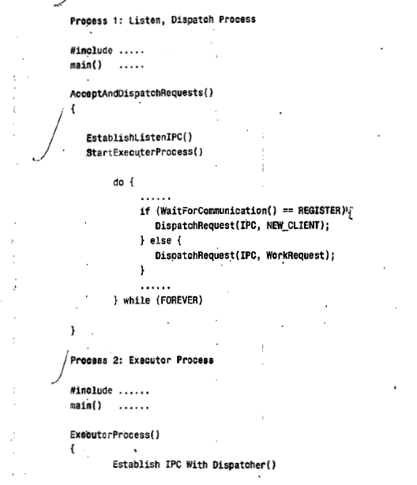
Example pseudo code –server application

Slide 24
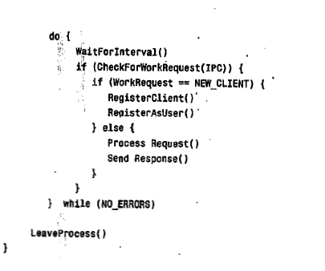

Slide 25
Process 1 is designed to be executed first and will in turn spawn process 2.
Upon successful startup of process2 , process 1 will loop forever, waiting for incoming requests from client for either a register request or work request.
The work is then dispatched to process 2.
Process 2 is designed to execute the work requests sent by process 1.

Slide 26
Its first duties will be to establish IPC communications with process 1 and continue its execution loop.
The only code (other than) that changes between implementations of platform is :
The create process
Wait function
The leave process

Slide 27
Study server application development using processes in the following:
Case study
Microsoft Windows NT
Novell NetWare
Novell UnixWare
Refer Text pg no: 146

Slide 28
Functions used in the NT example
CreateProcess ( execName, cmdLine, procSecurity, threadSecurity, inherit,flags, env, cwd, startInfo, &procInfo)
This command is used to create a process under Windows NT
ExitProcess(ExitCode):
This function call is made to end the currently running process.
Sleep(ms):
This call places the current thread of process in a suspended state for the number of milliseconds passed as the parameter ms.

Slide 29
Functions used in the NetWare example
Spawnlp(flags , execName,arg0….) : used to load a NetWare Loadable module (NLM) specified by execName into memory and begin execution.
delay (ms) : This call simply places the current thread of the NLM in a suspended state for the milliseconds passed as the parameter ms
ExitThread(actionCode, status) : This call gracefully ends thread or NLM execution

Slide 30
Functions used in UnixWare example
Fork() : This function causes a new process to be created.
Execl(execName, arg0…) : It will replace the currently executing process with one specified by execName.
Sleep(sec) : This function suspends the execution of this process for sec number of seconds
Exit(status) : The function causes the calling process to be terminated.

Slide 31
Threads-for concurrent execution
Threads has been introduced as an efficient mechanism for executing concurrent application code.
Thread is defined as a light weight process.
With a thread based system , it might be possible to assign one thread per remote client.
This model is known as Worker model and maximize all clients use of server processor.

Slide 32
Threads can increase the ability to handle requests generated from client machines.
Applications architected for thread use can see significant performance gains as well.
The reason is operating system is much more efficient in creating , executing, and switching threads within the system .

Slide 33
The developer is uniformly presented with a simple API to create and manipulate thread execution.
Thread API allow the developer to specify an arbitrary function at which new thread is to be started.

Slide 34
Architecting for Threads
In a multi-threaded system , each application program may have more than one thread executing.
Multi-threading adds power to the developer by allowing the programmer to dispatch multiple units of execution.
Architecting code to fully utilize threads will maximize the efficiency by using available CPU cycles.
A common mechanism for architecting server applications using threads is Worker model.

Slide 35
Worker Model
It is an ideal design for server applications running with efficient thread scheduling operating system.
In the worker model , a thread is established for each client connection to the server.
All functions executed on behalf of the client are performed using this worker thread.
The worker thread is responsible for accepting incoming requests from client , processing them , and responding back to client.

Slide 36
It is the responsibility of the operating system to provide API support for efficient scheduling and synchronization.
There are three main sections of the Worker model
Server Communication Module( SCM)
Dispatcher
Executor Worker (Thread)

Slide 37
Server Communication Module( SCM)
SCM is responsible for establishing , maintaining, and destroying connections as well as providing interfaces to send and receive data on those connections.
This module is responsible for calling the Worker Dispatcher for thread execution as well as providing interface to Executor for sending and receiving network transmissions.
The SCM should also register and maintain communication data for each client.

Slide 38
Dispatcher
It is the job of the Dispatcher to spawn a thread for each client to server connection.
The dispatcher acts as the go-between of the SCM and the Executor.
Its main function is to provide initiation ( or dispatch) threads to execute on behalf of the client.
The Dispatcher must also establish client data areas , as well as client registration before the spawn.
After the dispatcher is finished , unique thread started for each client will execute concurrently with other threads in the system.

Slide 39
The Executor (Worker Thread)
The responsibility of the Executor is to execute instructions on behalf of a client server connection .
The Executor should be designed to process requests sent from client work stations.
The Worker thread is responsible for executing instructions for client application .
It is also responsible for sending and receiving data back and forth to client station.

Slide 40
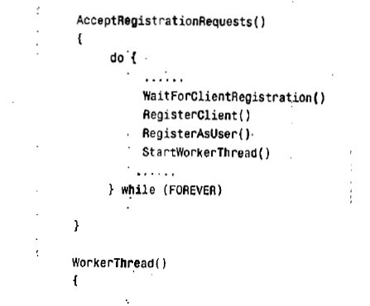
Sample pseudo code for the worker model

Slide 41
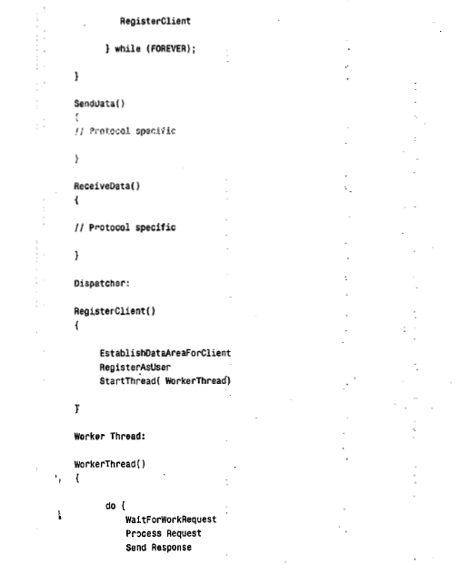

Slide 42
Sample pseudo code for Worker model
Study Developing code with Threads
Microsoft Windows NT
Novell NetWare
Refer Text pg no: 164

Slide 43
Functions used in the NT example
CreateThread(security,size,MyThreadFunction,arg,flags,&tID) : Used to start an instance of a thread and to begin its execution.
ExitThread(ExitCode) : used to end the currently running thread.
Sleep(ms) : This call places the current thread in a suspended state for the number of milliseconds passed as parameter (ms).

Slide 44
Functions used in the NetWare example
BeginThread(MyThreadFunction, stack,size,arg) : Creates a thread and places it on the Netware run queue.
Delay(ms) : This call simply places the current thread of the NLM in a suspended state for the milliseconds passed as the parameter ms.
ExitThread(actionCode, status) : This call gracefully ends thread or NLM execution.

Slide 45
Annexure : System call
In computing, a system call is how a program requests a service from an operating system's kernel. This may include hardware-related services (for example, accessing a hard disk drive), creation and execution of new processes, and communication with integral kernel services such as process scheduling. System calls provide an essential interface between a process and the operating system.

Slide 46
Threads
In computer science, a thread of execution is the smallest sequence of programmed instructions that can be managed independently by a scheduler, which is typically a part of the operating system.
The implementation of threads and processes differs between operating systems, but in most cases a thread is a component of a process.
Multiple threads can exist within the same process, executing concurrently (one starting before others finish) and share resources such as memory, while different processes do not share these resources. In particular, the threads of a process share its instructions (executable code) and its context (the values of its variables at any given moment).

Slide 47
Threads vs. processes
Threads differ from traditional multitasking operating system processes in that:
processes are typically independent, while threads exist as subsets of a process
processes carry considerably more state information than threads, whereas multiple threads within a process share process state as well as memory and other resources
processes have separate address spaces, whereas threads share their address space
processes interact only through system-provided inter-process communication mechanisms
context switching between threads in the same process is typically faster than context switching between processes.

Slide 48
IPC
In computer science, inter-process communication (IPC) is the activity of sharing data across multiple and commonly specialized processes using communication protocols.
Typically, applications using IPC are categorized as clients and servers, where the client requests data and the server responds to client requests.
Many applications are both clients and servers, as commonly seen in distributed computing.
Methods for achieving IPC are divided into categories which vary based on software requirements, such as performance and modularity requirements, and system circumstances, such as network bandwidth and latency.

Slide 49
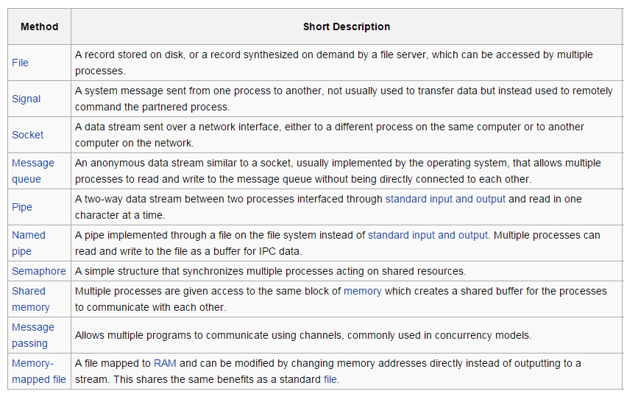
Approaches for IPC

Slide 50
Command line arguments
The full declaration of main looks like this
int main ( int argc, char *argv[] ) The integer, argc is the argument count. It is the number of arguments passed into the program from the command line, including the name of the program.
The array of character pointers is the listing of all the arguments. argv[0] is the name of the program, or an empty string if the name is not available. After that, every element number less than argc is a command line argument. You can use each argv element just like a string, or use argv as a two dimensional array. argv[argc] is a null pointer.

Slide 51
On a single processor, multithreading is generally implemented by time slicing (as in multitasking), and the central processing unit (CPU) switches between different software threads.
This context switching generally happens frequently enough that the user perceives the threads or tasks as running at the same time (in parallel).
On a multiprocessor or multi-core system, multiple threads can be executed in parallel (at the same instant), with every processor or core executing a separate thread simultaneously; on a processor or core with hardware threads, separate software threads can also be executed concurrently by separate hardware threads.

Slide 52
Windows NT
Windows NT is a family of operating systems produced by Microsoft, the first version of which was released in July 1993. It is a processor-independent, multiprocessing, multi-user operating system.
The first version of Windows NT was Windows NT 3.1 and was produced for workstations and server computers. It was intended to complement consumer versions of Windows (including Windows 1.0 through Windows 3.1x) that were based on MS-DOS.
Gradually, the Windows NT family was expanded into Microsoft's general-purpose operating system product line for all personal computers, deprecating the Windows 9x family.

Slide 53
Novell NetWare
NetWare is a computer network operating system developed by Novell, Inc.
It initially used cooperative multitasking to run various services on a personal computer, using the IPX network protocol.

Slide 54
Multi-core processor
A multi-core processor is a single computing component with two or more independent actual processing units (called "cores"), which are the units that read and execute program instructions.
The instructions are ordinary CPU instructions such as add, move data, and branch, but the multiple cores can run multiple instructions at the same time, increasing overall speed for programs amenable to parallel computing.
Manufacturers typically integrate the cores onto a single integrated circuit die (known as a chip multiprocessor or CMP), or onto multiple dies in a single chip package.

Slide 55
MS-DOS
A single-user, single-tasking operating system that uses a command line (i.e., text only) user interface.
It was launched by Microsoft in 1981 and used on the first personal computers, which were introduced by IBM in the same year. In spite of its very small size and relative simplicity, MS-DOS is one of the most successful operating systems that has been developed to date.

